Slide 1
Atypical chest pain, atypical perfusion CMR scan
Dr Heerajnarain Bulluck
10/12/2016
JCR 2016, Busan

Slide 2
Clinical case
48 year-old lady, referred for adenosine perfusion CMR
Central chest tightness mainly occurring at rest and relieved by nitroglycerin spray
PMH: diabetes, dyslipidemia, PCI to LAD 10 years ago following a myocardial infarction
One hospital admission with troponin negative chest pain and underwent coronary angiography: non-obstructive LAD disease – but she was advised to attend for perfusion CMR

Slide 3
CMR perfusion scan
Adenosine was infused at a rate of 140mcg/kg/min for 4 minutes with heart rate increase from 85 to 120bpm, symptoms of dyspnea, hot flush and nausea.

Slide 4
Stress Perfusion

Slide 5
Cines

Slide 6
Rest Perfusion

Slide 7
Questions
What is going on?
What would you do next?

Slide 9
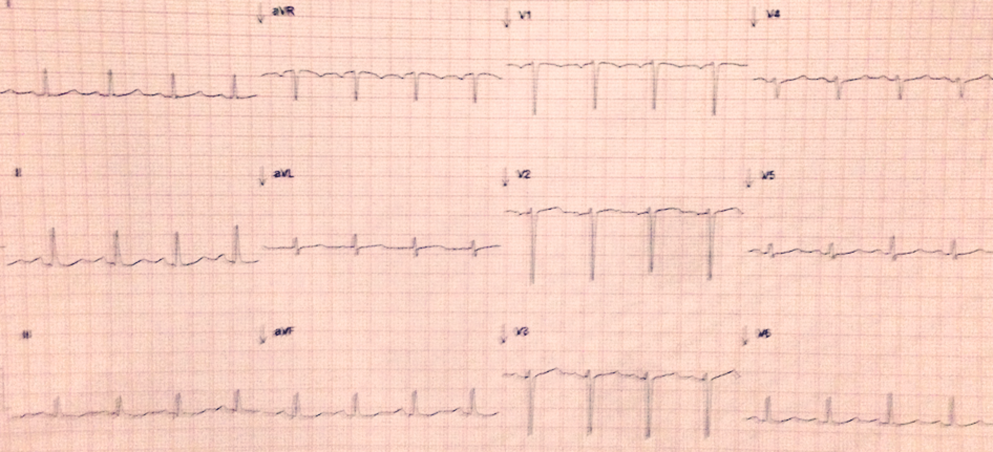
Checked patient: started being symptomatic
Taken out of the scanner
GTN spray
ECG – 10 minutes later

Slide 10
Repeat cine – 1 hour later

Slide 11
Repeat rest perfusion

Slide 12
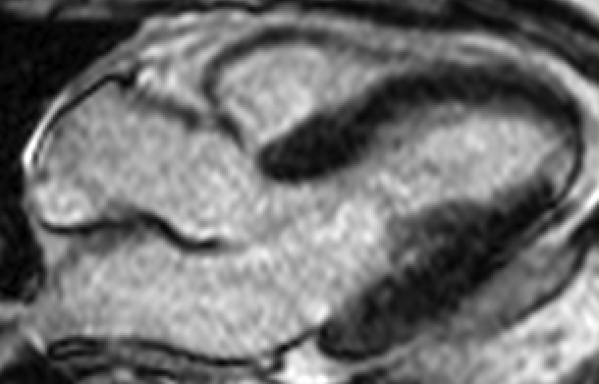
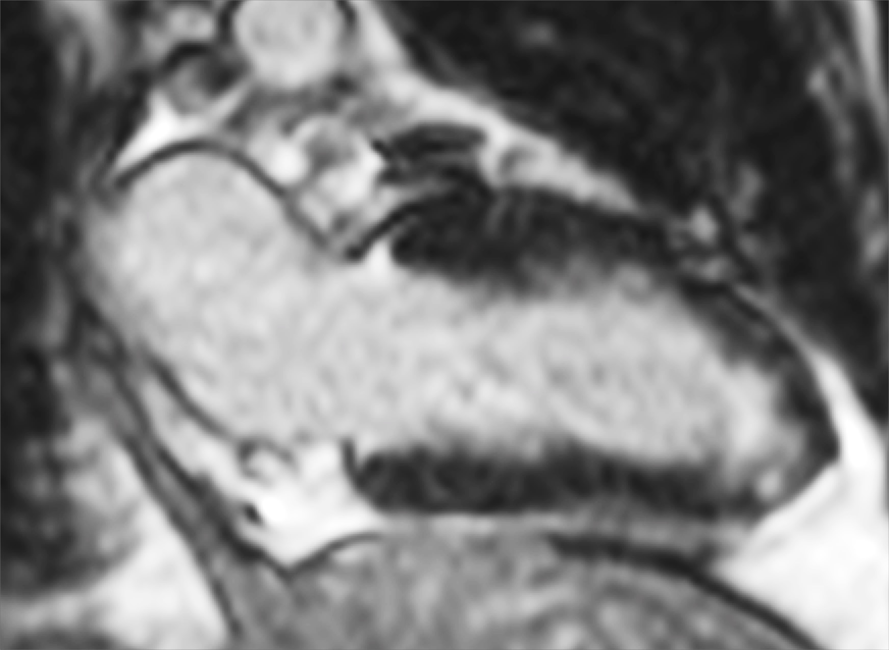
LGE

Slide 13
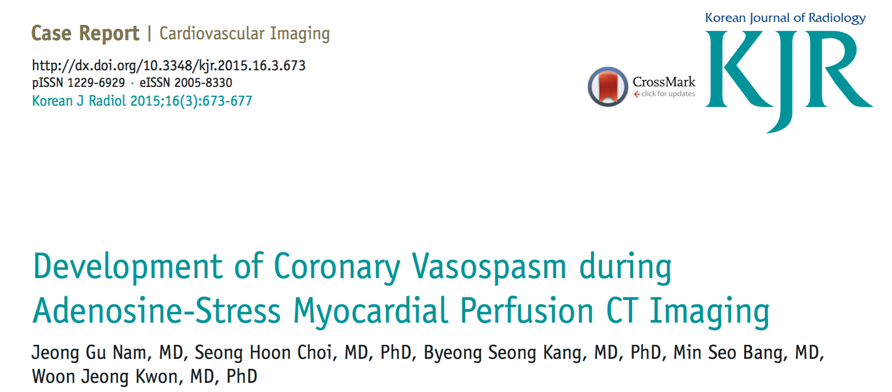
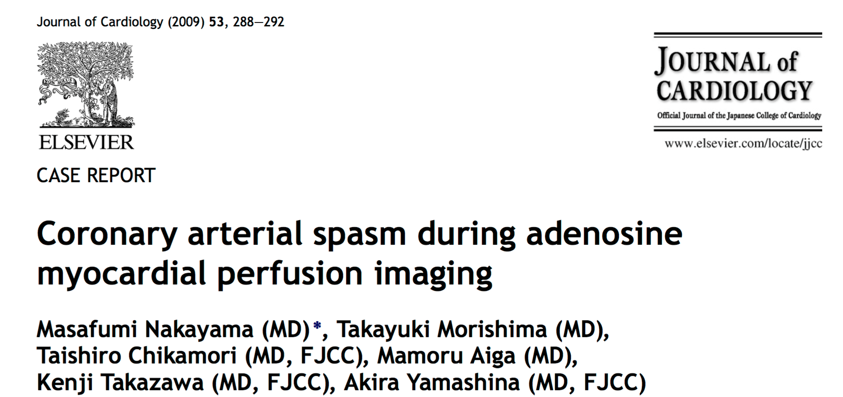
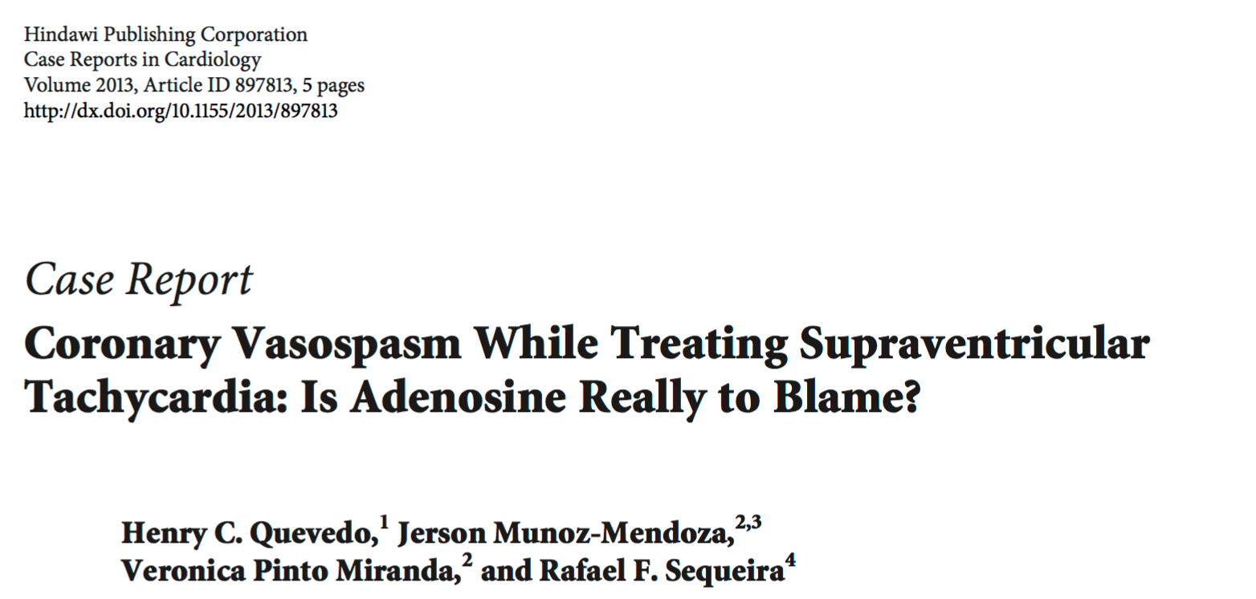
Discussion

Slide 14
Discussion
This is the first reported case of acute coronary artery spasm captured on resting CMR perfusion imaging
Mechanism unclear - ?cessation of adenosine could plausibly induce rebound increase in sympathetic tone in those subjects predisposed coronary artery spasm

Slide 15
Coronary artery spasm/ vasospastic angina
Severe chest pain, usually without physical effort and with a concurrent ECG showing transient ST elevation
Mechanism: vagal withdrawal/ a change in sympathetic activity/ abnormalities in the smooth muscle K_{ATP} channel / endothelial dysfunction
Risk factors: Illicit drug use/ smoking/ genetic predisposition
Treatment: calcium channel blockers/ nitrates
Stern et al, Circulation.2009; 119: 2531-2534

Slide 16
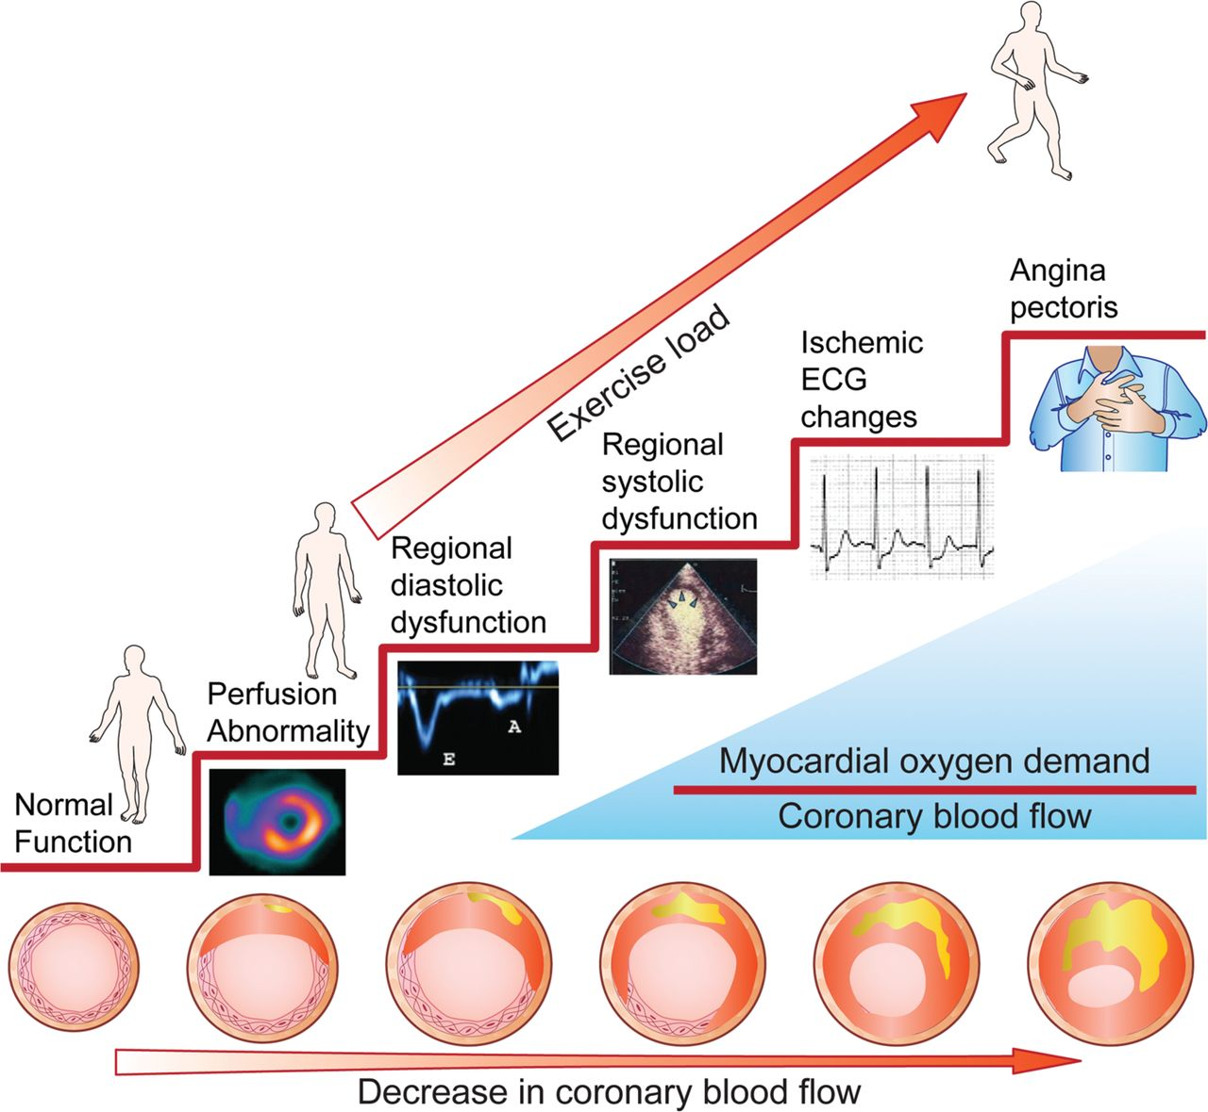
Ischaemic cascade

Slide 17
Thanks!
Acknowledgement
Dr Gabriella Captur
Dr Anish N Bhuva
Dr Andrew D’Silva
Dr Charlotte Manisty
Prof James C Moon
Prof Charles Knight
Prof Steffen Petersen

