Slide 1


Recent Update of Korea Acute Myocardial Infarction Registry
16th Joint Meeting of Coronary Revascularization
Busan, Korea
Dec 9-10th 2016
Myung Ho Jeong, MD, PhD, FACC, FAHA, FESC, FSCAI, FAPSIC
On behalf of KAMIR Investigators
Principal Investigator of Korea Acute Myocardial Infarction Registry,
Director of Korea Cardiovascular Stent Research Institute,
Director of Heart Research Center Nominated by Korea Ministry of Health and Welfare,
Professor of Chonnam National University Hospital,
Gwangju, Korea

Slide 2

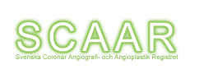
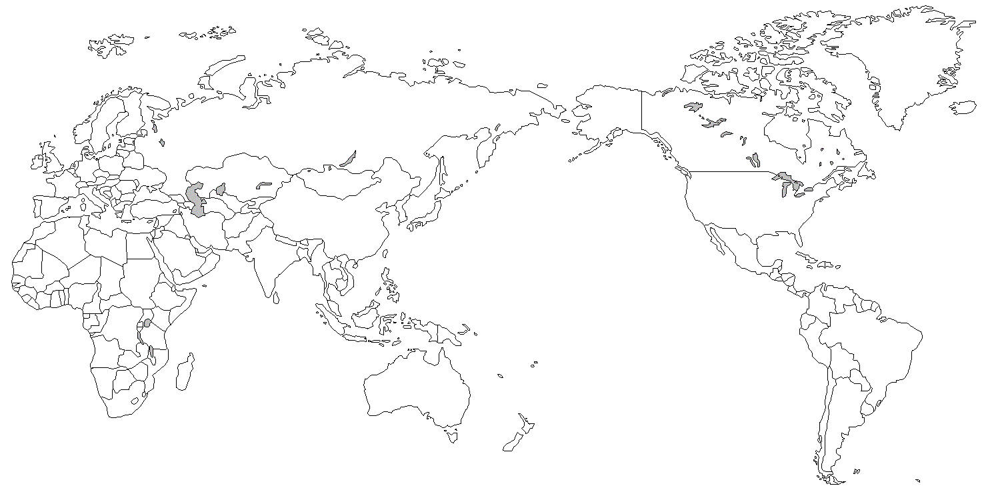


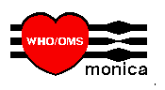
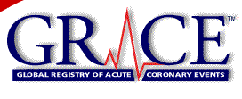
Background
KAMIR
Korea Acute Myocardial Infarction Registry
Asia Guideline
ESC Guideline
ACC/AHA Guideline

Slide 3
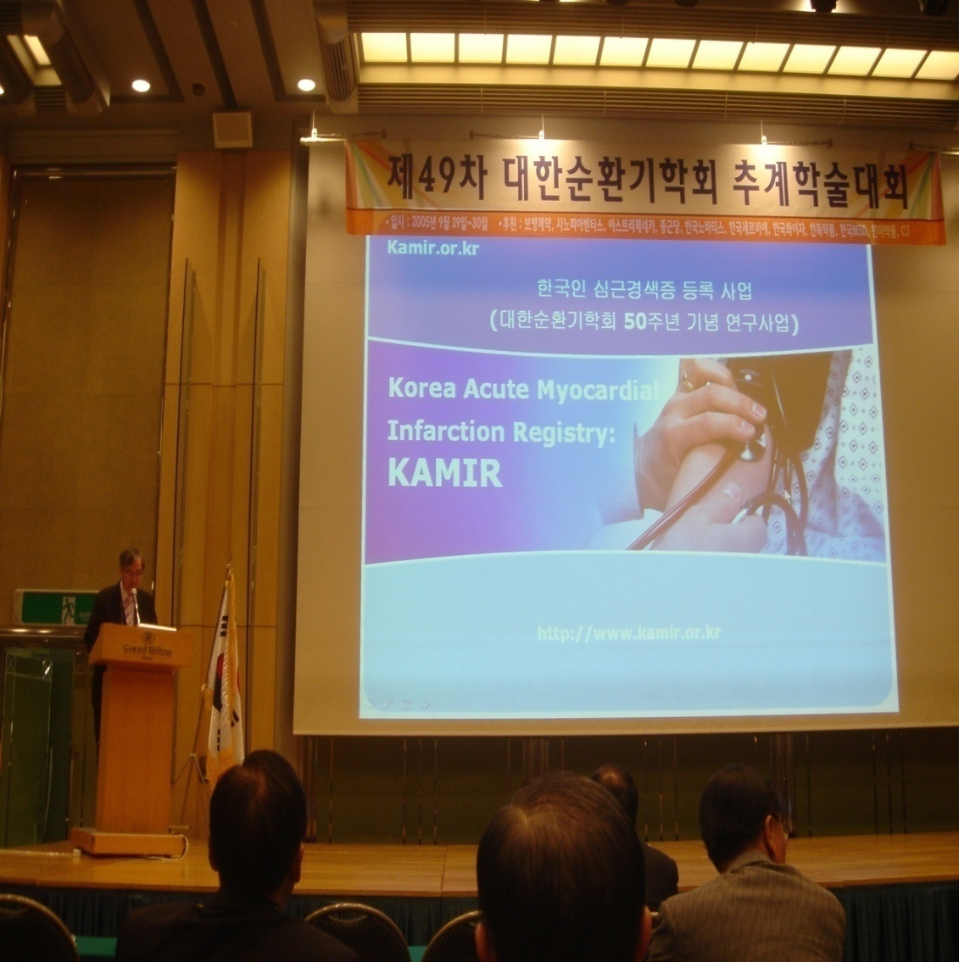
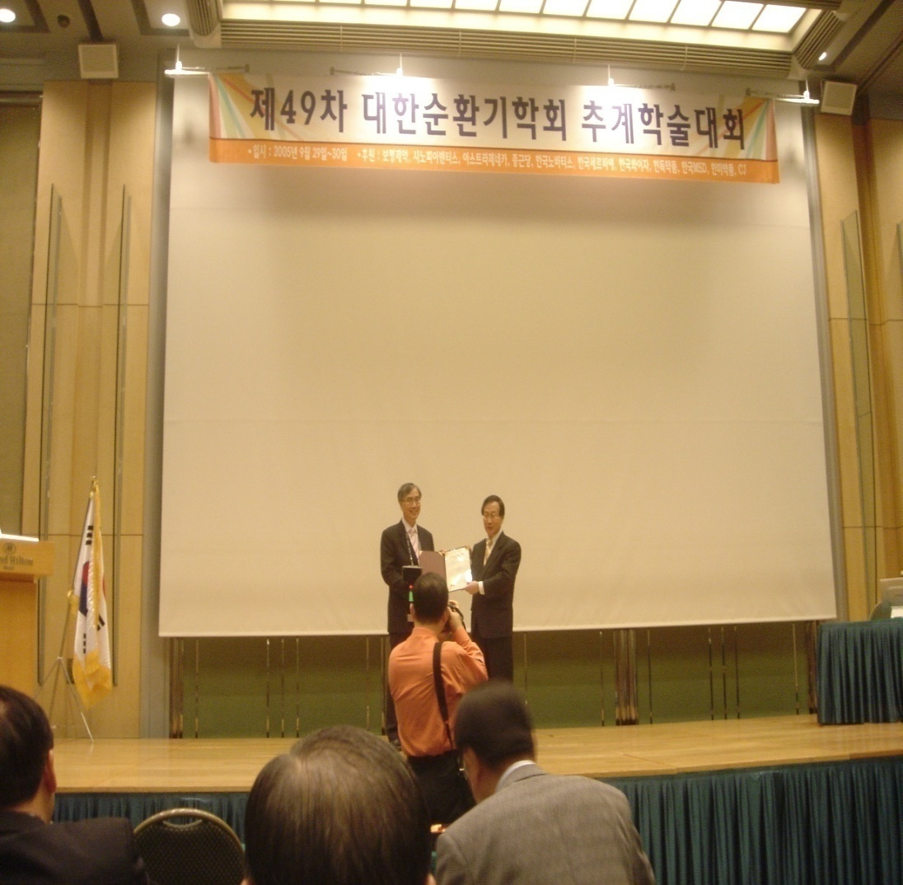
Korea Acute Myocardial Infarction Registry (KAMIR)
for the memorandum of 50th Anniversary of Korean Circulation Society
Sep 29-30th 2005
Notes:
KAMIR has been performed for the memorandum of the 50th anniversary of KCS.

Slide 4
KAMIR: Korea Acute Myocardial Infarction Registry
Principal Investigator: Jeong MH
Sub-investigators: Kim YJ, Kim CJ, Cho MC, Ahn YK
Co-investigators: 55 primary PCI centers - major centers in Korea
Ko YP, Koo BG, Gwon HC, Kim KS, Kim DI, Kim MH, Kim BO, Kim SW, Kim SJ, Kim YJ, Kim JK, Kim CJ, Kim TI, Rha SW, Rhew JY, Park GS, Park SW, Park SH, Bae JH, Seong IW, Seung KB, Ahn YK, Ahn TH, Yang JY, Oh SK, Yoon Jh, Lee HS, Lee MY, Lee SH, Lee SW, Rhim JY, Jeong KT, Jeong MH, Chung WS, Jeong HJ, Cho MC, Cho JH, Cho JM, Joo SJ, Jin DG, Jin SW, Chae SC, Chae IH, Chae JK, Choi DH, Tahk SJ, Han KR, Hur SH, Hwang JY
Steering Committee:
Park SJ, Jang YS, Seung KB, Chung WS, Cho JG, Kim YJ, Kim CJ, Cho MC, Yoon JH, Chae IH, Jeong MH

Slide 5
Purpose of KAMIR Study
1. On-line registration of Korean AMI patients
2. Early detection of high risk patients
3. Risk factor documentation and analysis
4. New therapeutic strategy for AMI
5. Effective prevention strategy for AMI
6. Establish Asian guideline of AMI

Slide 6
KAMIR-I
  (Nov 2005-Dec 2006)
KAMIR Supported by Korean Society of Cardiology and Korea NIH
N=8,489
KAMIR-II
(Jan 2007-Jan 2008)
N=6,381
(14,870)
KAMIR-III
(Feb 2008-Mar 2012)
N=24,600
(39,470)
KAMIR-IV and V
(Apr 2012~) (Jan 2016~)
KAMIR-NIH (Nov 2011~)
=22,146
(61,616)

Slide 7
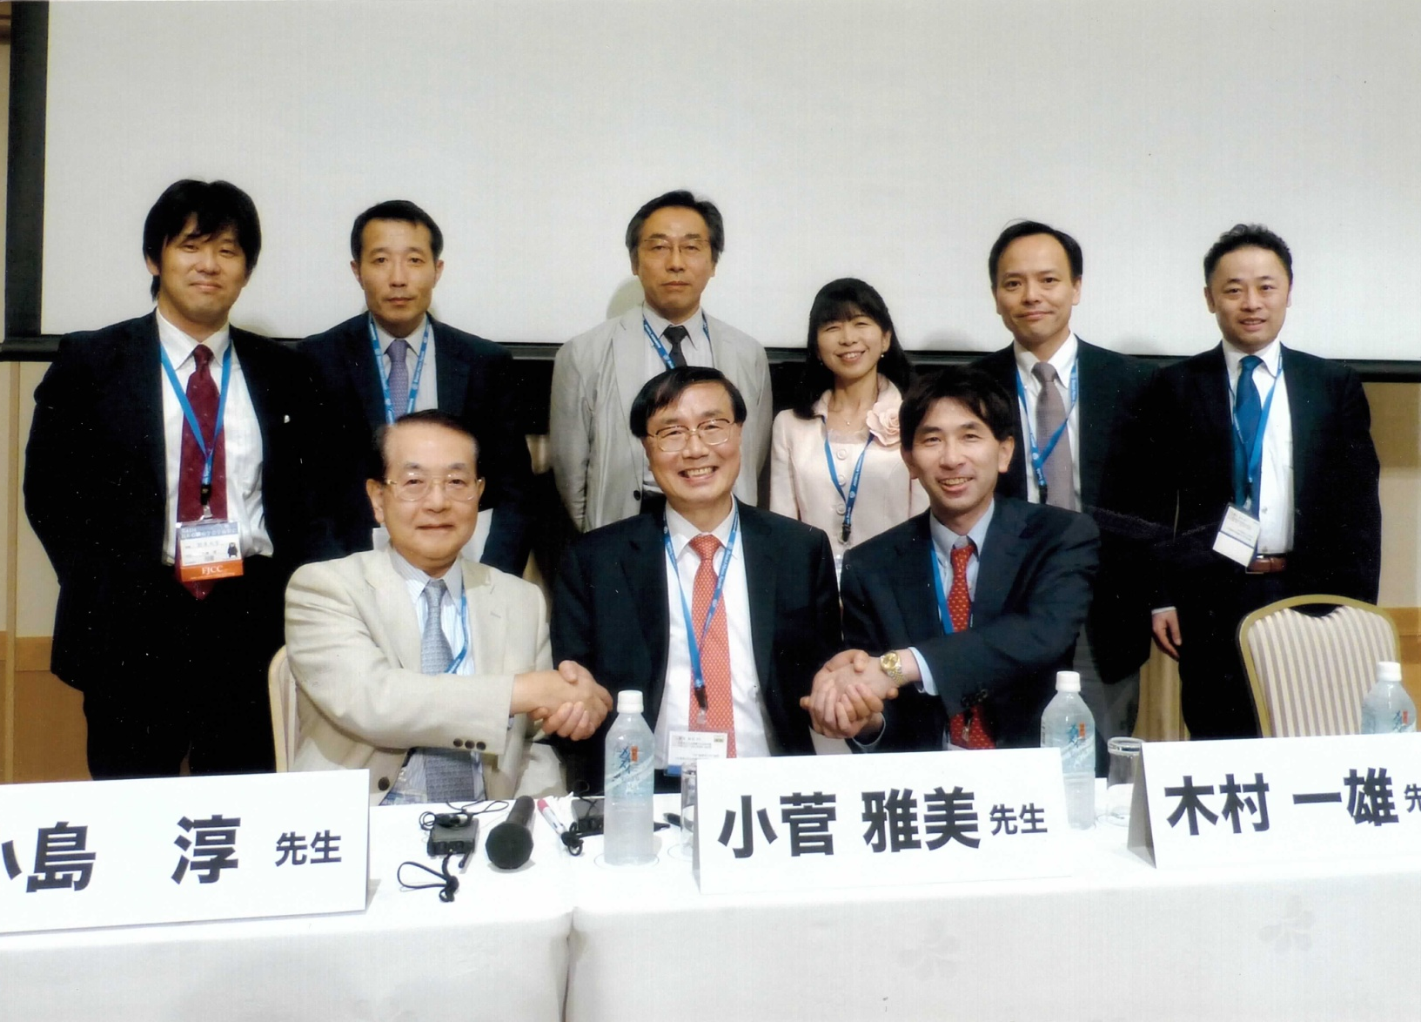
61th Japanese College of Cardiology, Sep 20-22 2013, Kumamoto, Japan

Slide 8
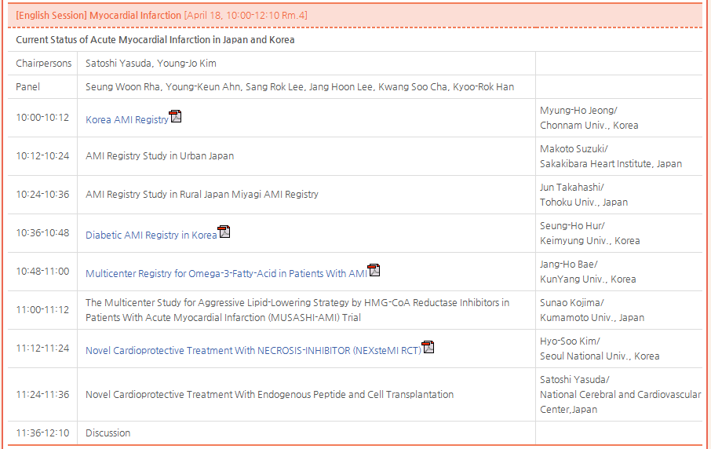
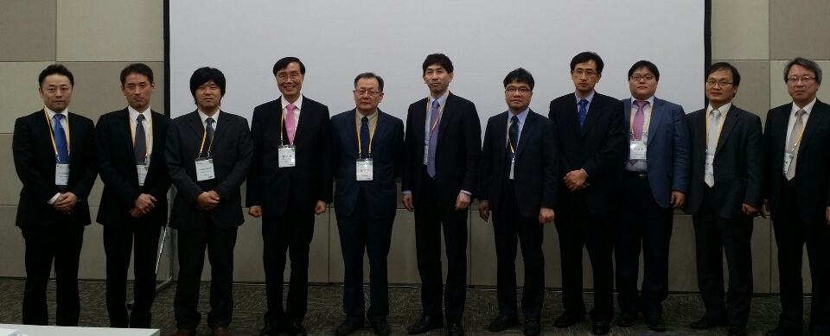
58th Korean Society of Cardiology, Apr 18-19 2014, Gwangju, Korea

Slide 9
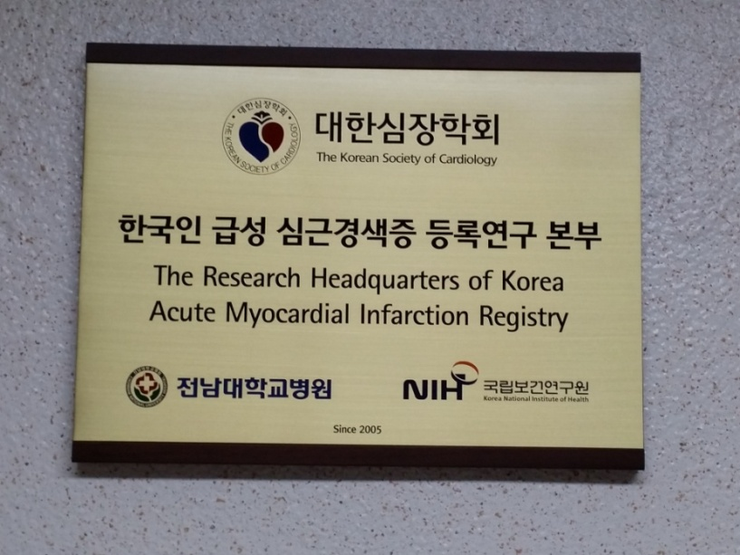
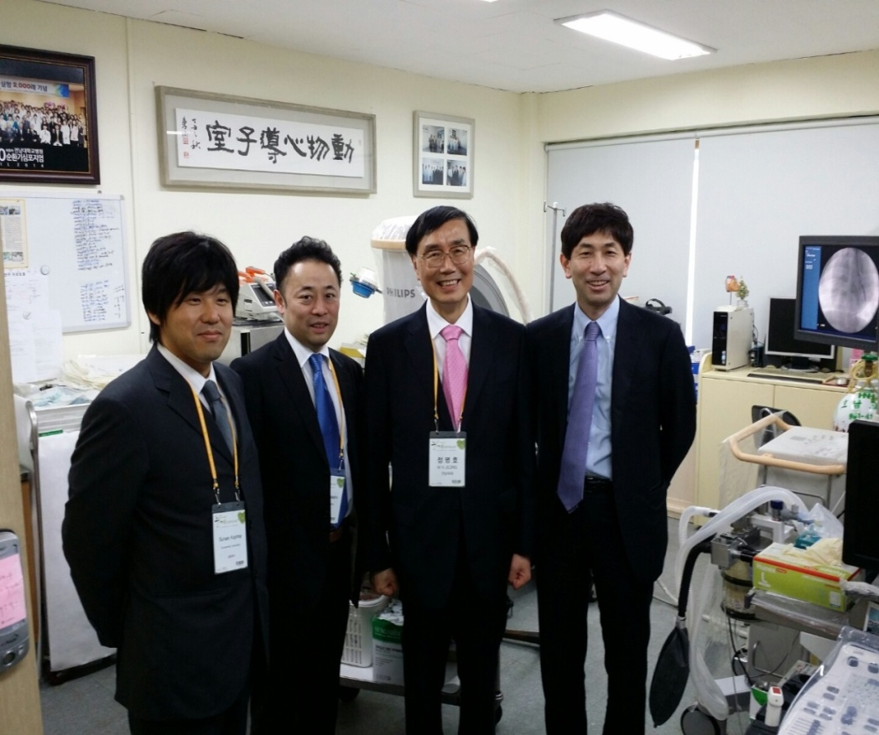
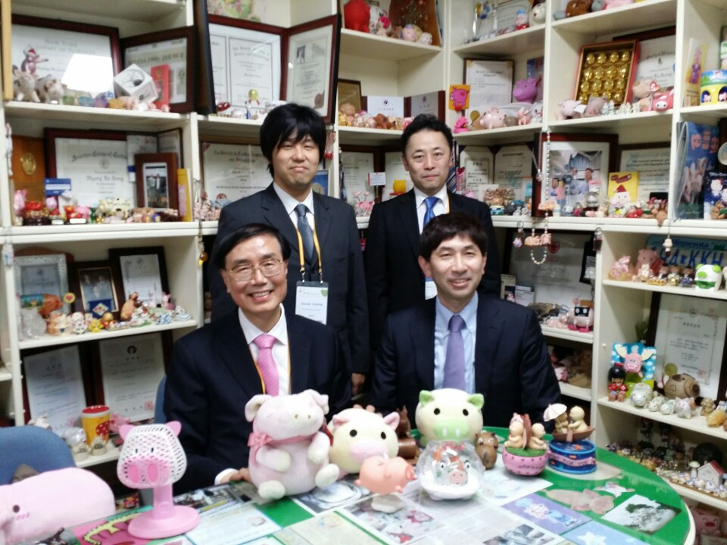
JAMIR Team Visited CNUH
Research Headquarter of KAMIR at CNUH
Supported by KSC and NIH
Pig Miniatures in My Office
Animal Catheterization Lab

Slide 10
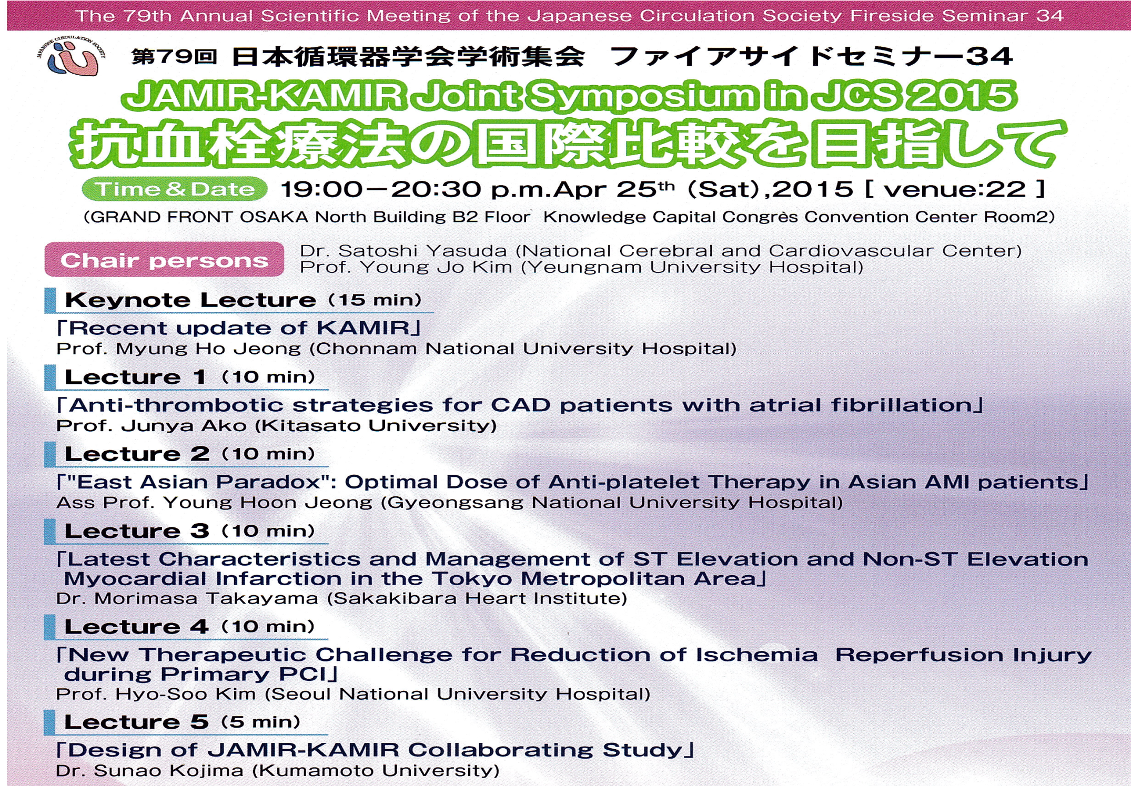
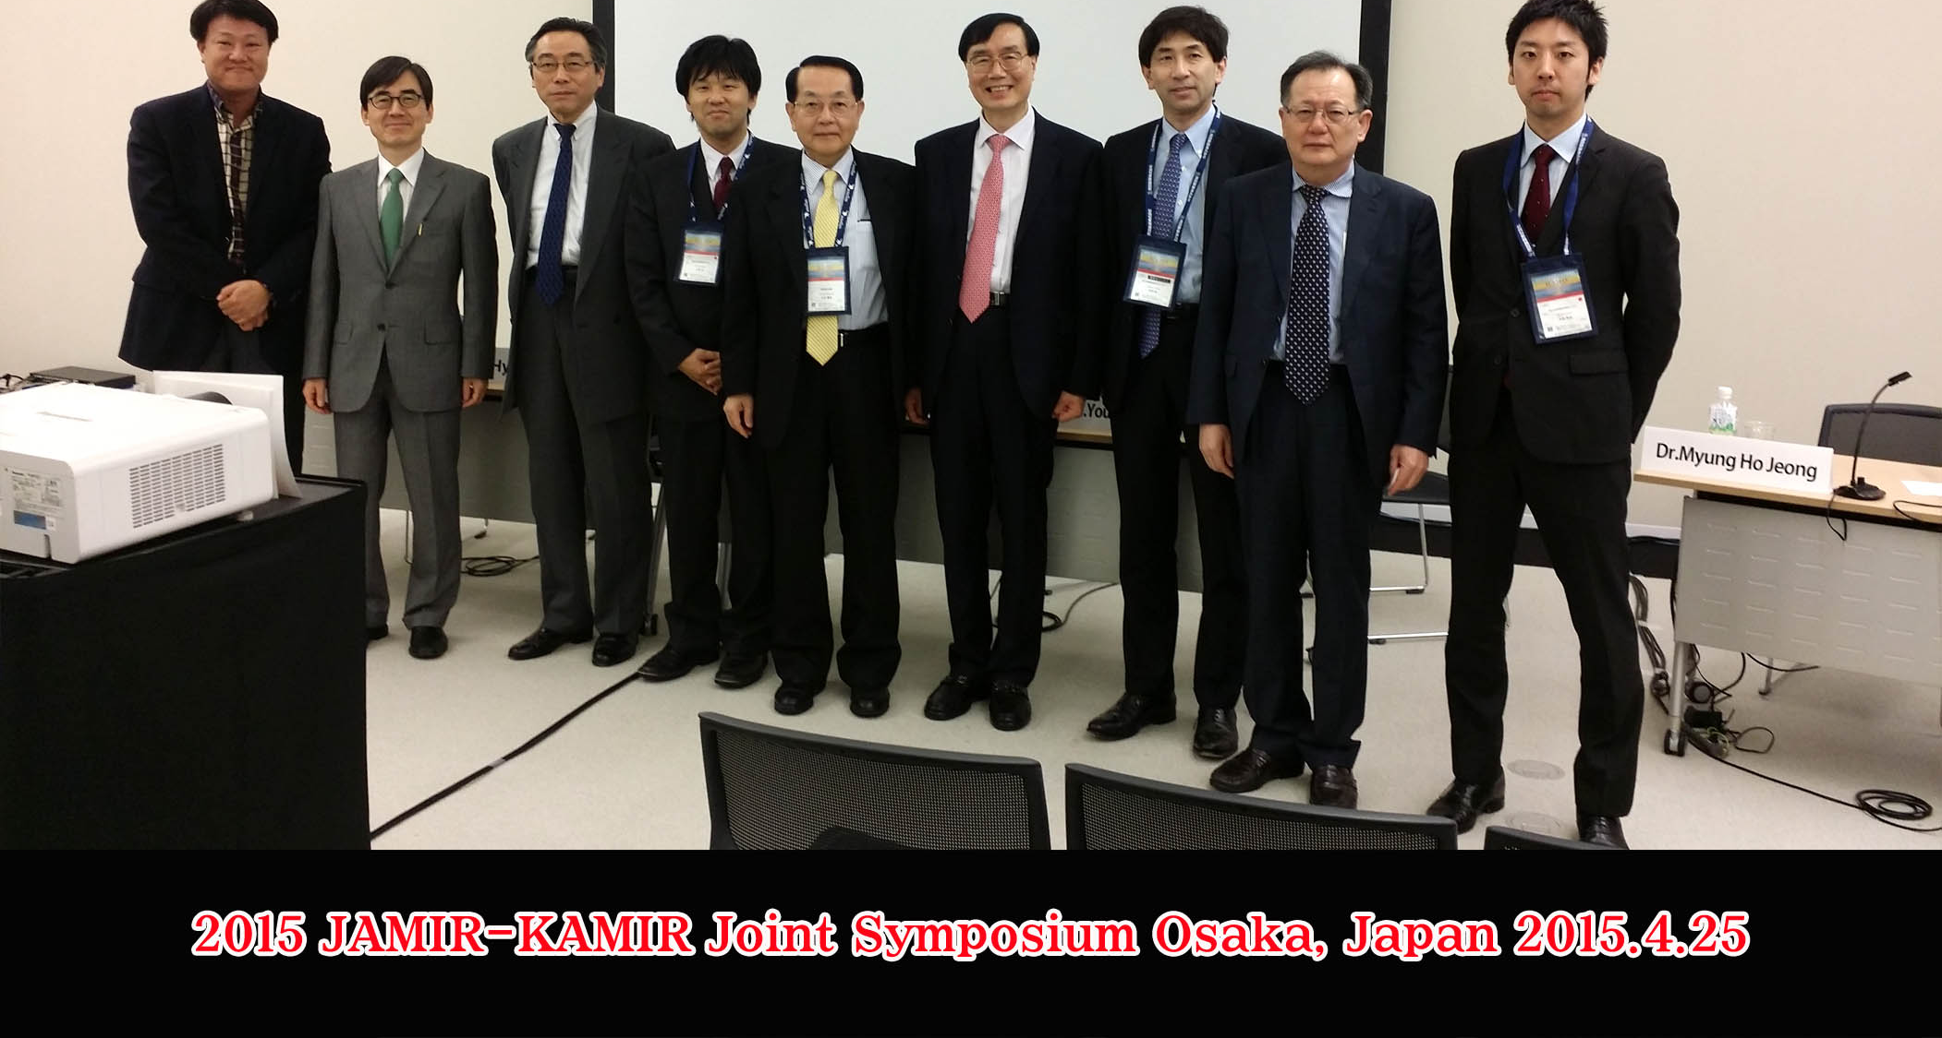

Slide 11
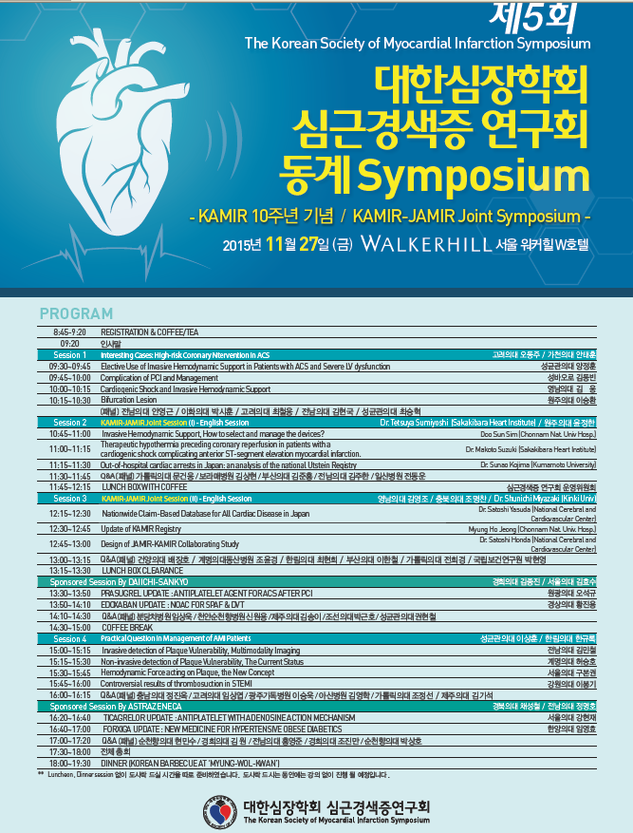
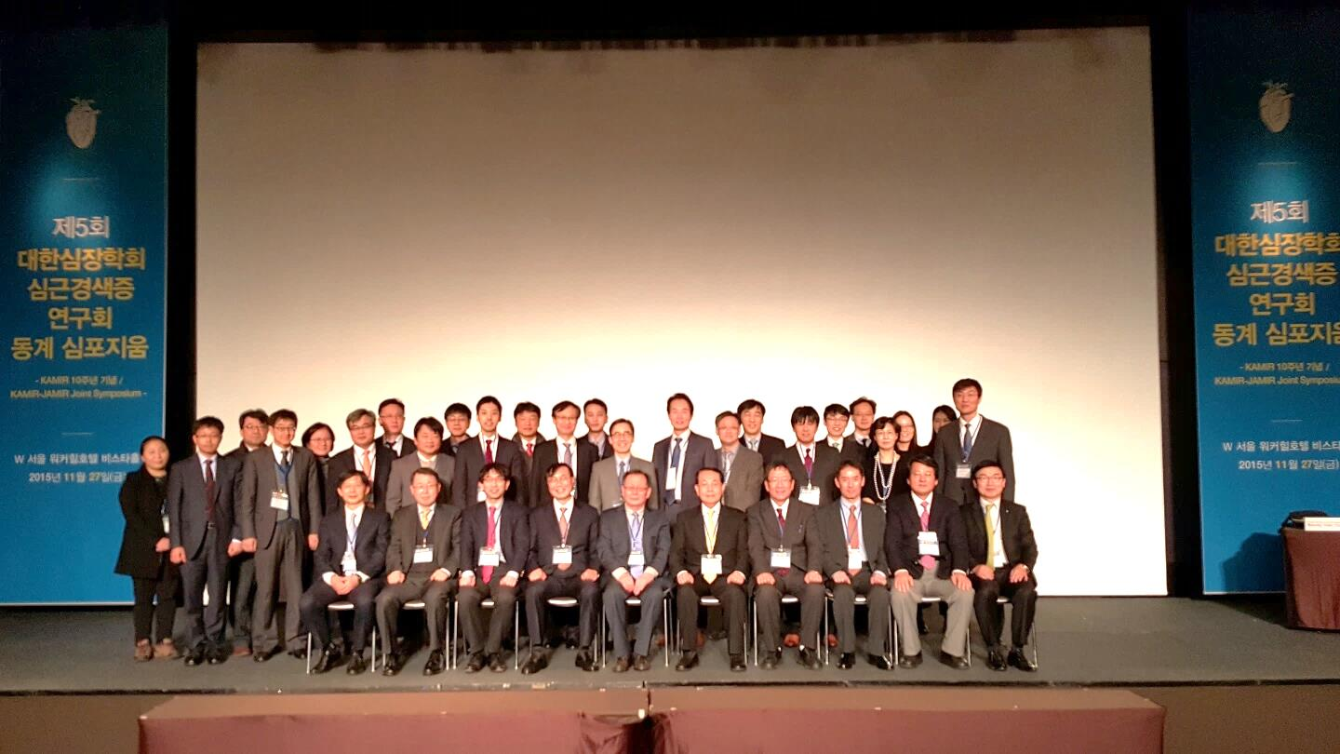

Slide 12
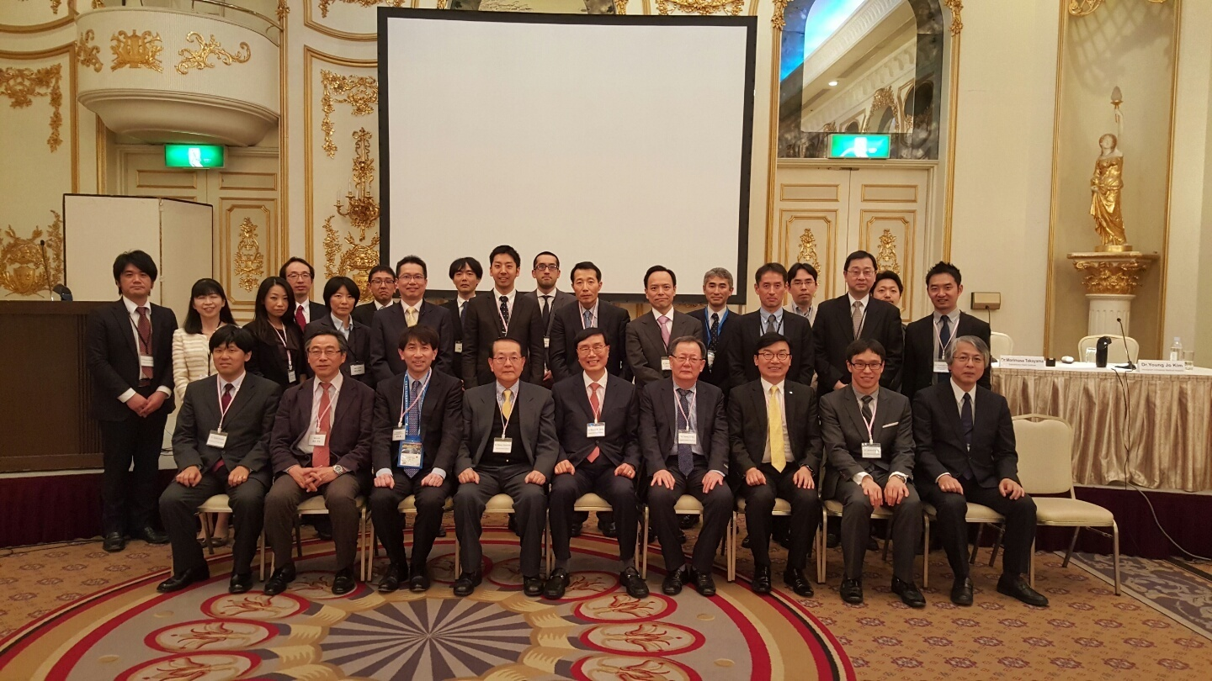
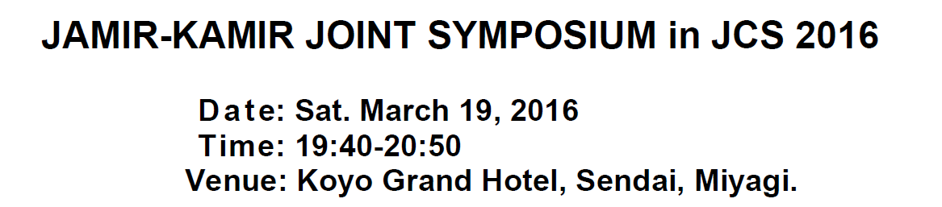

Slide 13
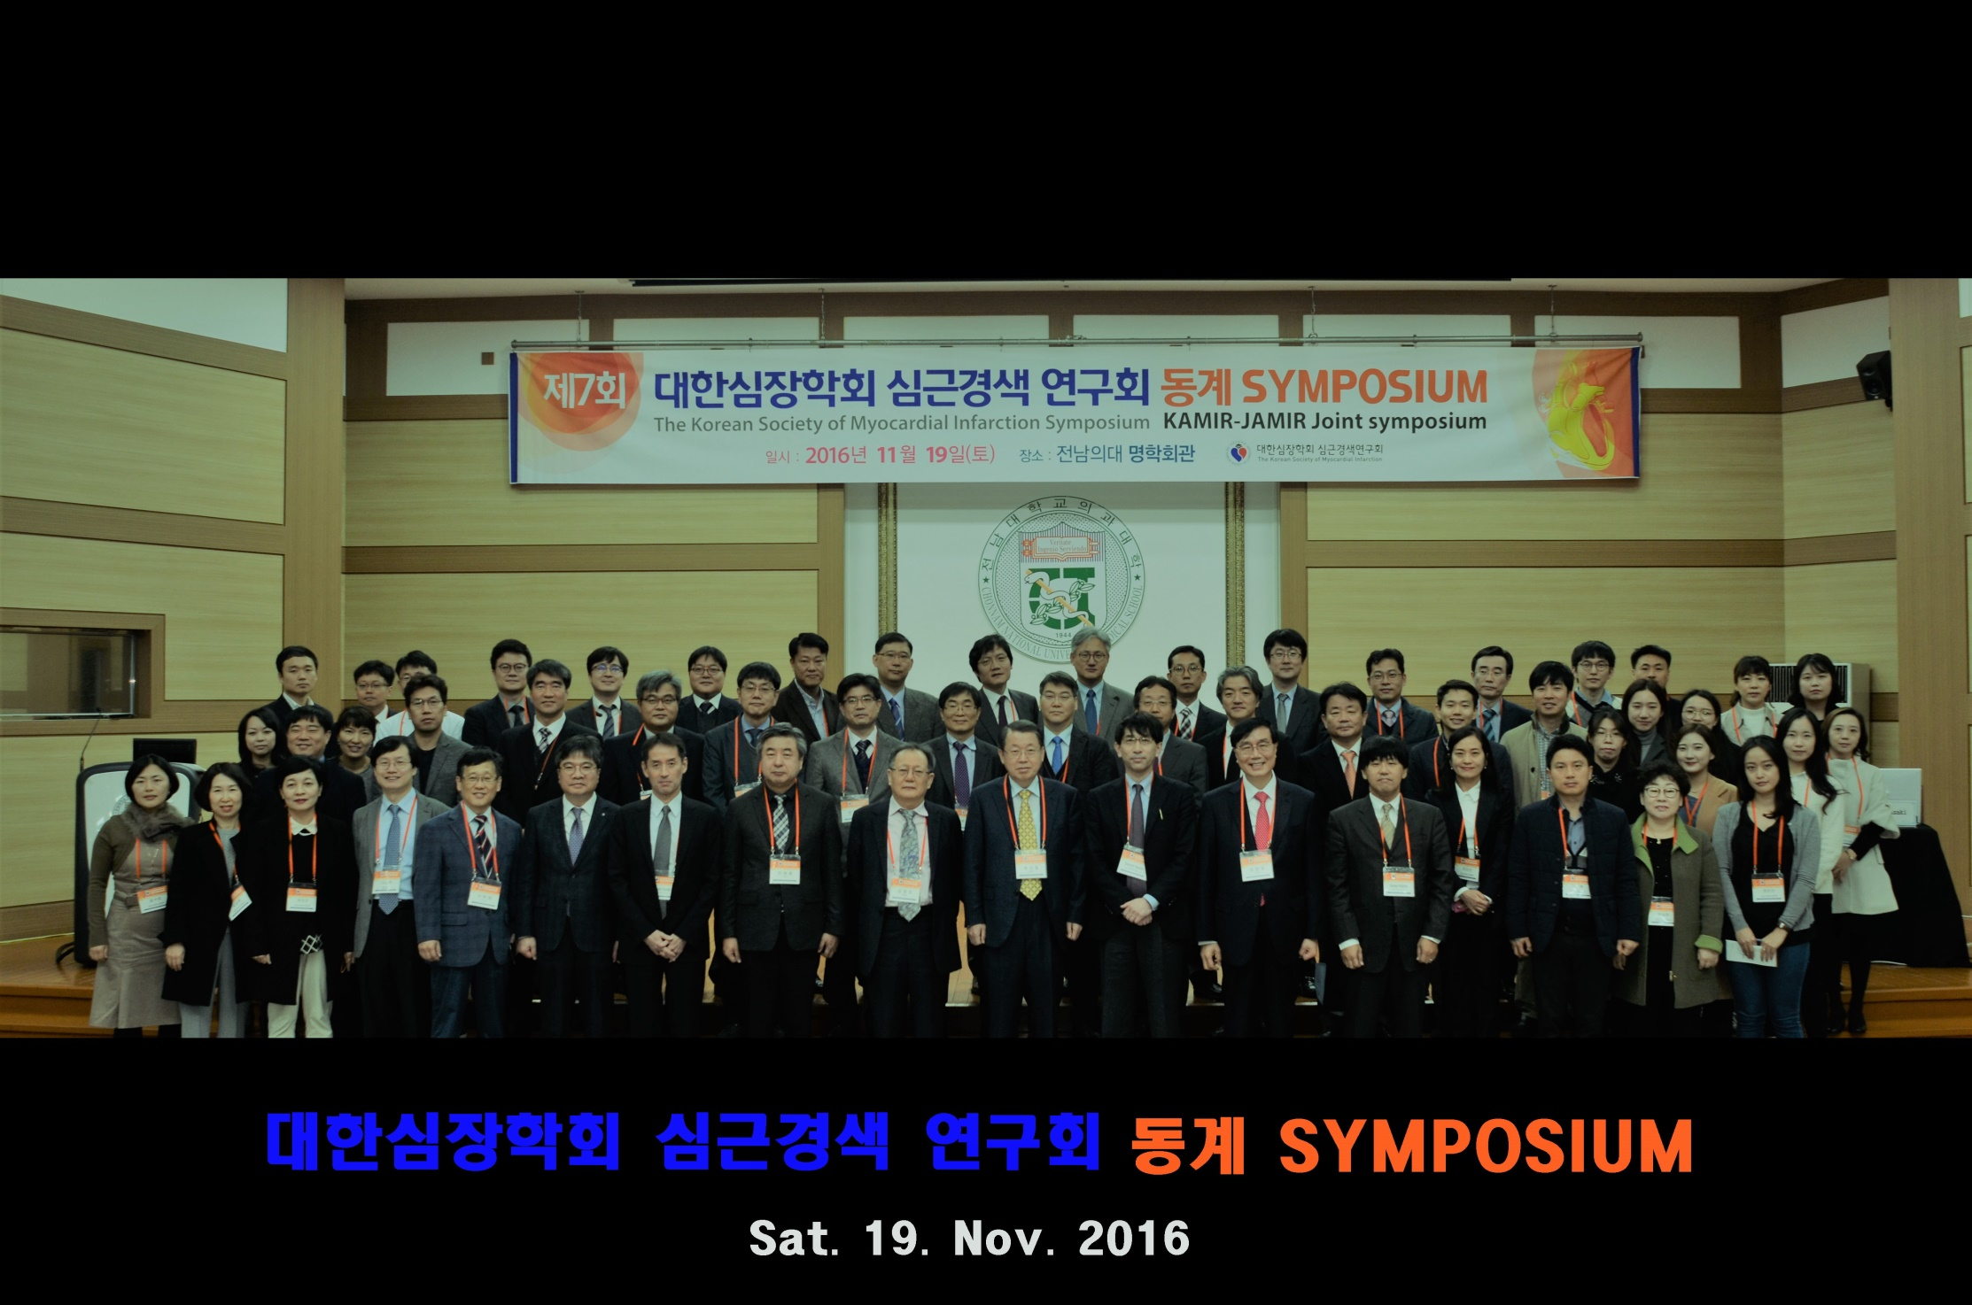
KAMIR-JAMIR Joint Symposium

Slide 14
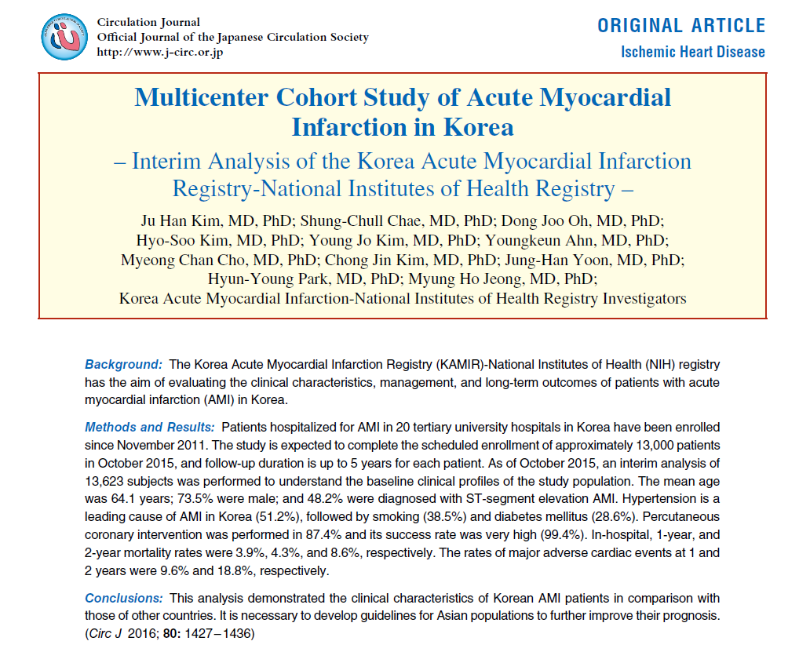

Slide 15
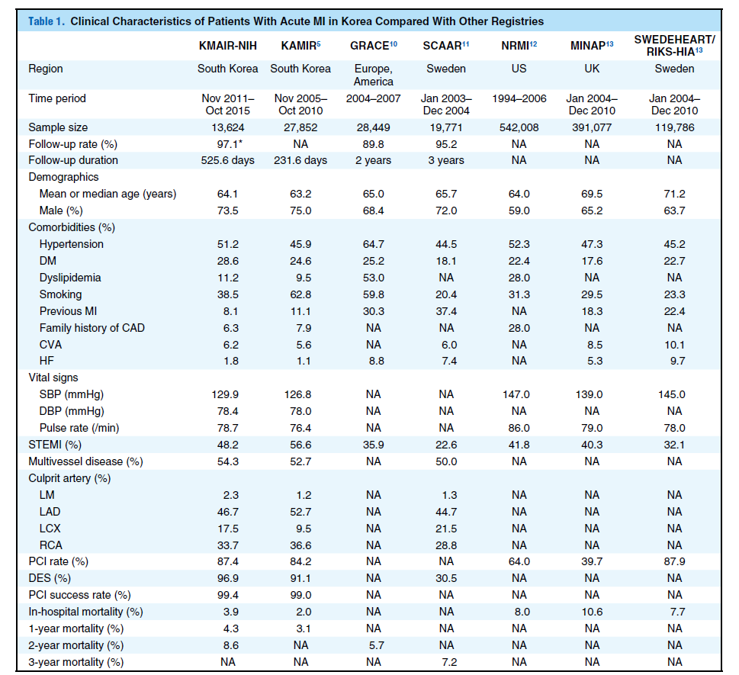

Slide 16
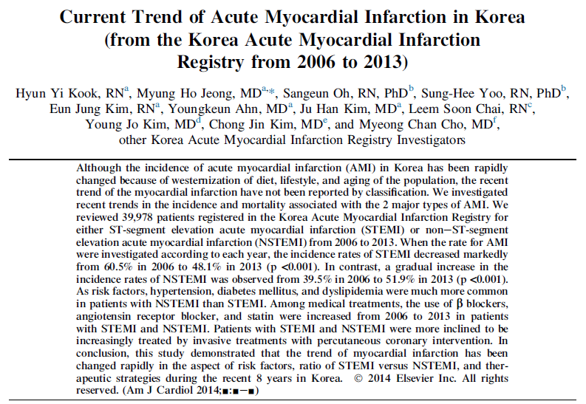
Current Trend of KAMIR
Current Trend of KAMIR - Dec 2014 Am J Cardiol

Slide 17
Current Trend of KAMIR
Variables | STEMI (n=22,514) NSTEMI (n=17,464) |  | p value
 | n(%) or mean±SD
Age (years) | 64.1±13.2 | 66.5±12.5 | <0.001
Male | 16,823 (74.8) | 11,715 (67.2) | <0.001
Body mass index (kg/m²) | 24.0±3.4 | 23.9±3.4 | 0.831
Overweight (BMI≥23) | 7,541 (37.5) | 5,773 (36.4) | 0.029
Risk factors
Hypertension | 10,390 (48.9) | 9,596 (58.4) | <0.001
Diabetes mellitus | 5,548 (26.2) | 5,546 (33.8) | <0.001
Dyslipidemia | 2,221 (10.5) | 2,227 (13.6) | <0.001
Smoking history | 11,324 (51.2) | 6,828 (39.8) | <0.001
Previous angina | 7,278 (32.9) | 7,512 (43.8) | <0.001

Slide 18
Current Trend of KAMIR
Variables | STEMI (n=22,514) NSTEMI (n=17,464) |  | p value
 | n(%) or mean±SD
Clinical characteristics
Chest pain | 19,287 (86.9) | 13,041 (75.9) | <0.001
Dyspnea | 5,021 (22.9) | 4,649 (27.2) | <0.001
PCI | 20,882 (93.1) | 13,670 (78.5) | <0.001
Killip class (≥III) | 3,188 (15.0) | 2,178 (13.3) | <0.001
In-hospital mortality | 1,310 (5.9) | 637 (3.7) | <0.001

Slide 19
Current Trend of KAMIR
 |  | 2006 | 2007 | 2008 | 2009 | 2010 | 2011 | 2012 | 2013 | p for trend
Aspirin | STEMI | 3,508 (90.2) | 2,838 (88.2) | 3,047 (97.7) | 2,792 (98.6) | 2,211 (99.2) | 2,084 (99.1) | 1,837 (97.2) | 1,570 (96.2) | <0.001
 | NSTEMI | 2,314 (91.0) | 1,822 (87.9) | 2,199 (96.5) | 2,181 (97.4) | 1,724 (97.8) | 1,831 (97.1) | 1,856 (96.6) | 1,684 (95.6) | <0.001
Clopidogrel
 | STEMI | 2,380 (62.0) | 1,922 (60.4) | 1,653 (47.5) | 1,475 (47.4) | 1,166 (46.6) | 1,129 (46.9) | 871 (44.6) | 728 (44.6) | <0.001
 | NSTEMI | 1,285 (51.1) | 1,084 (51.3) | 963 (39.4) | 889 (36.7) | 674 (34.8) | 671 (32.9) | 690 (34.9) | 608 (34.5) | <0.001
Cilostazol
 | STEMI | 1,374 (35.3) | 865 (26.9) | 803 (27.4) | 874 (32.9) | 525 (24.4) | 454 (22.2) | 365 (19.4) | 122 (7.5) | <0.001
 | NSTEMI | 771 (30.3) | 469 (22.6) | 556 (26.2) | 561 (26.6) | 365 (21.4) | 414 (22.4) | 374 (19.5) | 168 (9.5) | <0.001

Slide 20
Current Trend of KAMIR
 |  | 2006 | 2007 | 2008 | 2009 | 2010 | 2011 | 2012 | 2013 | p for trend
Beta blocker | STEMI | 2,500 (64.3) | 2,120 (65.9) | 2,386 (67.0) | 2,375 (74.3) | 1,938 (74.9) | 1,797 (72.9) | 1,614 (82.2) | 1,352 (82.8) | <0.001
 | NSTEMI | 1,684 (66.2) | 1,329 (64.1) | 1,703 (67.8) | 1,803 (72.1) | 1,448 (72.5) | 1,511 (72.4) | 1,559 (78.4) | 1,440 (81.7) | <0.001
ACEi | STEMI | 2,411 (62.0) | 1,938 (60.2) | 2,066 (58.0) | 1,721 (53.8) | 1,364 (52.7) | 1,053 (42.7) | 941 (47.9) | 961 (58.9) | <0.001
 | NSTEMI | 1,505 (59.2) | 1,205 (58.2) | 1,337 (53.2) | 1,247 (49.8) | 963 (48.2) | 874 (41.9) | 757 (38.1) | 834 (47.3) | <0.001
ARB | STEMI | 607 (15.6) | 376 (11.7) | 523 (14.7) | 685 (21.4) | 502 (19.4) | 631 (25.6) | 596 (30.4) | 345 (21.1) | <0.001
 | NSTEMI | 1,060 (16.5) | 662 (12.5) | 998 (16.4) | 1,306 (22.9) | 962 (21.0) | 1,257 (27.6) | 1,336 (33.8) | 903 (26.6) | <0.001
Statin | STEMI | 2,718 (69.9) | 2,128 (66.1) | 2,380 (66.8) | 2,188 (68.4) | 1,731 (66.9) | 1,799 (73.0) | 1,635 (83.3) | 1,460 (89.5) | <0.001
 | NSTEMI | 1,693 (66.6) | 1,362 (65.7) | 1,609 (64.0) | 1,622 (64.8) | 1,315 (65.9) | 1,601 (76.7) | 1,634 (82.2) | 1,558 (88.4) | <0.001

Slide 21
Current Trend of KAMIR
 |  | 2006 | 2007 | 2008 | 2009 | 2010 | 2011 | 2012 | 2013 | p for trend
Risk factors
HT | STEMI | 1,753 (45.3) | 1,453 (45.4) | 1,670 (47.6) | 1,456 (46.5) | 1,206 (47.5) | 1,172 (49.1) | 920 (62.8) | 760 (66.7) | <0.001
 | NSTEMI | 1,365 (53.9) | 1,118 (54.3) | 1,392 (56.3) | 1,382 (56.0) | 1,094 (56.1) | 1,169 (57.6) | 1,097 (69.4) | 979 (73.4) | <0.001
DM | STEMI | 951 (24.6) | 794 (24.8) | 878 (25.0) | 771 (24.6) | 616 (24.3) | 622 (26.1) | 505 (34.5) | 411 (36.1) | <0.001
 | NSTEMI | 821 (32.5) | 664 (32.2) | 788 (31.8) | 772 (31.3) | 644 (33.0) | 637 (31.4) | 667 (42.2) | 553 (41.5) | <0.001
DL | STEMI | 238 (6.2) | 310 (9.7) | 370 (10.6) | 298 (9.5) | 338 (13.4) | 288 (12.1) | 200 (13.7) | 179 (15.7) | <0.001
 | NSTEMI | 265 (10.5) | 281 (13.7) | 366 (14.8) | 298 (12.1) | 287 (14.8) | 279 (13.8) | 227 (14.4) | 224 (16.8) | <0.001

Slide 22
Current Trend of KAMIR
 |  | 2006 | 2007 | 2008 | 2009 | 2010 | 2011 | 2012 | 2013 | p for trend
Overweight | STEMI | 1,483 (41.2) | 1,205 (41.4) | 1,156 (36.8) | 915 (35.1) | 790 (35.5) | 890 (36.4) | 643 (34.6) | 540 (35.0) | <0.001
 | NSTEMI | 975 (41.1) | 755 (39.9) | 777 (34.5) | 755 (35.8) | 609 (34.9) | 661 (34.7) | 648 (34.2) | 593 (35.1) | <0.001
Chest pain | STEMI | 3,392 (89.2) | 2,810 (89.1) | 3,050 (86.5) | 2,687 (85.5) | 2,159 (84.7) | 1,986 (81.4) | 1,713 (87.7) | 1,490 (91.3) | <0.001
 | NSTEMI | 975 (41.1) | 755 (39.9) | 777 (34.5) | 755 (35.8) | 609 (34.9) | 661 (34.7) | 648 (34.2) | 593 (35.1) | 0.023
Dyspnea | STEMI | 957 (26.0) | 770 (24.8) | 837 (23.8) | 633 (20.3) | 603 (23.9) | 446 (18.4) | 420 (21.5) | 355 (21.8) | <0.001
 | NSTEMI | 801 (33.3) | 546 (26.9) | 675 (27.3) | 636 (26.1) | 510 (26.1) | 461 (22.5) | 558 (28.1) | 462 (26.2) | <0.001

Slide 23
Current Trend of KAMIR
 |  | 2006 | 2007 | 2008 | 2009 | 2010 | 2011 | 2012 | 2013 | p for trend
Smoking history | STEMI | 2,380 (62.0) | 1,922 (60.4) | 1,653 (47.5) | 1,475 (47.4) | 1,166 (46.6) | 1,129 (46.9) | 871 (44.6) | 728 (44.6) | <0.001
 | NSTEMI | 1,285 (51.1) | 1,0848 (51.3) | 963 (39.4) | 889 (36.7) | 674 (34.8) | 671 (32.9) | 690 (34.9) | 608 (34.5) | <0.001
Previous angina | STEMI | 1,467 (38.3) | 1,170 (37.0) | 1,233 (35.2) | 953 (30.8) | 826 (32.6) | 804 (33.3) | 461 (23.7) | 364 (22.3) | <0.001
 | NSTEMI | 1,199 (47.7) | 1081 (52.9) | 1,134 (46.0) | 1,015 (42.1) | 888 (45.7) | 964 (47.2) | 671 (33.9) | 560 (31.8) | <0.001

Slide 24
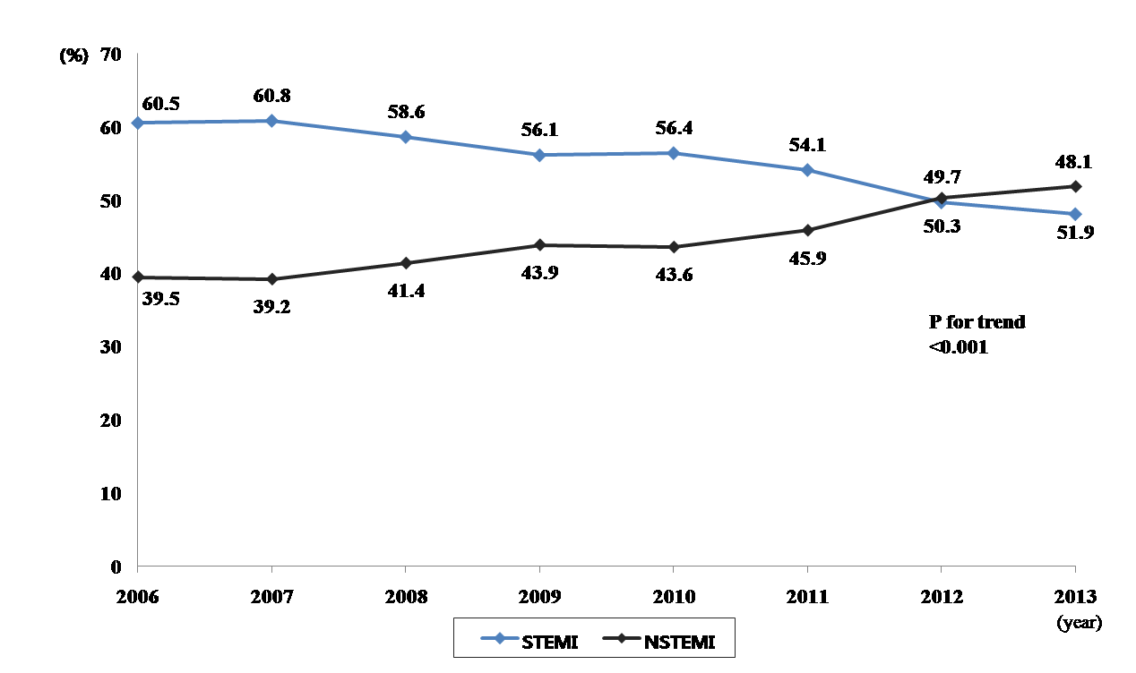
Incidence Rate for STEMI and NSTEMI
STEMI
NSTEMI

Slide 25
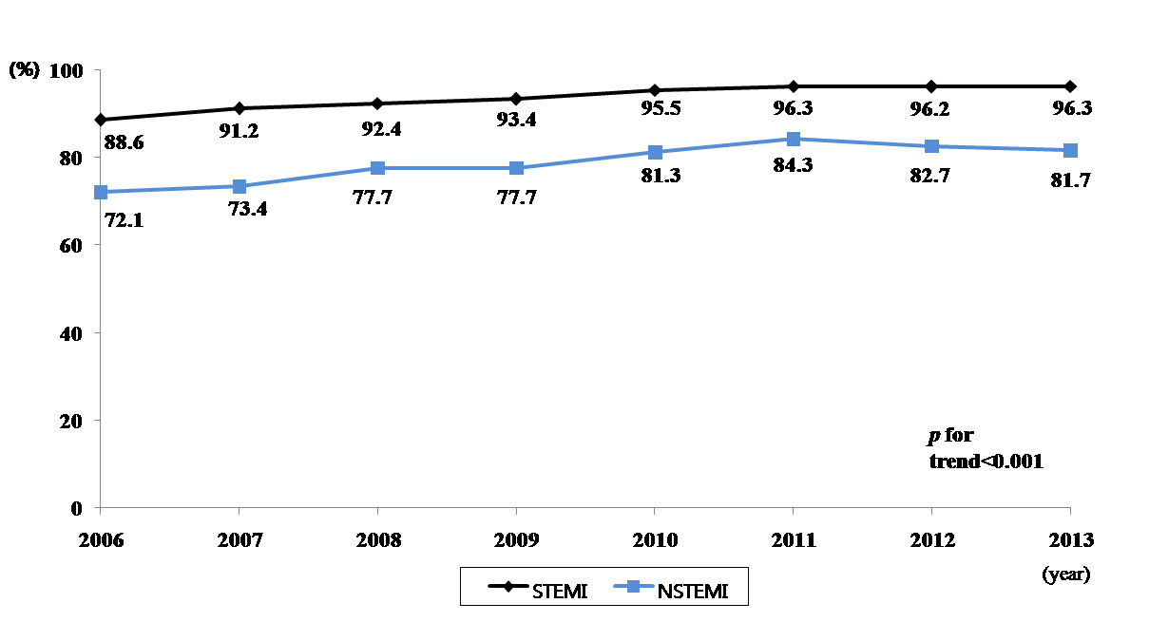
PCI Rate for STEMI and NSTEMI
Success rate = 99.4%
Success rate = 99.5%

Slide 26
Contents
Risk Factor
Risk Stratification
Medical Treatment
Interventional Treatment

Slide 27
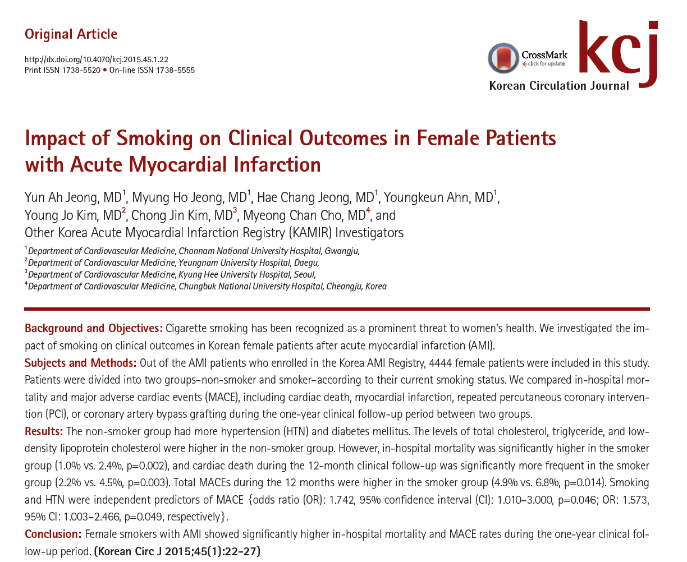
KAMIR Investigators. Korean Circ J 2015;45:22-7

Slide 28
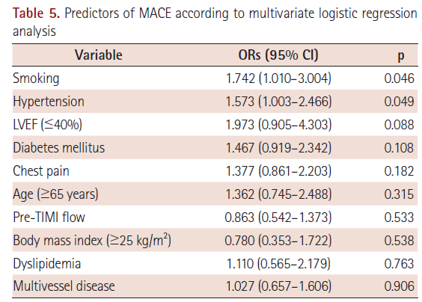
KAMIR Investigators. Korean Circ J 2015;45:22-7

Slide 29
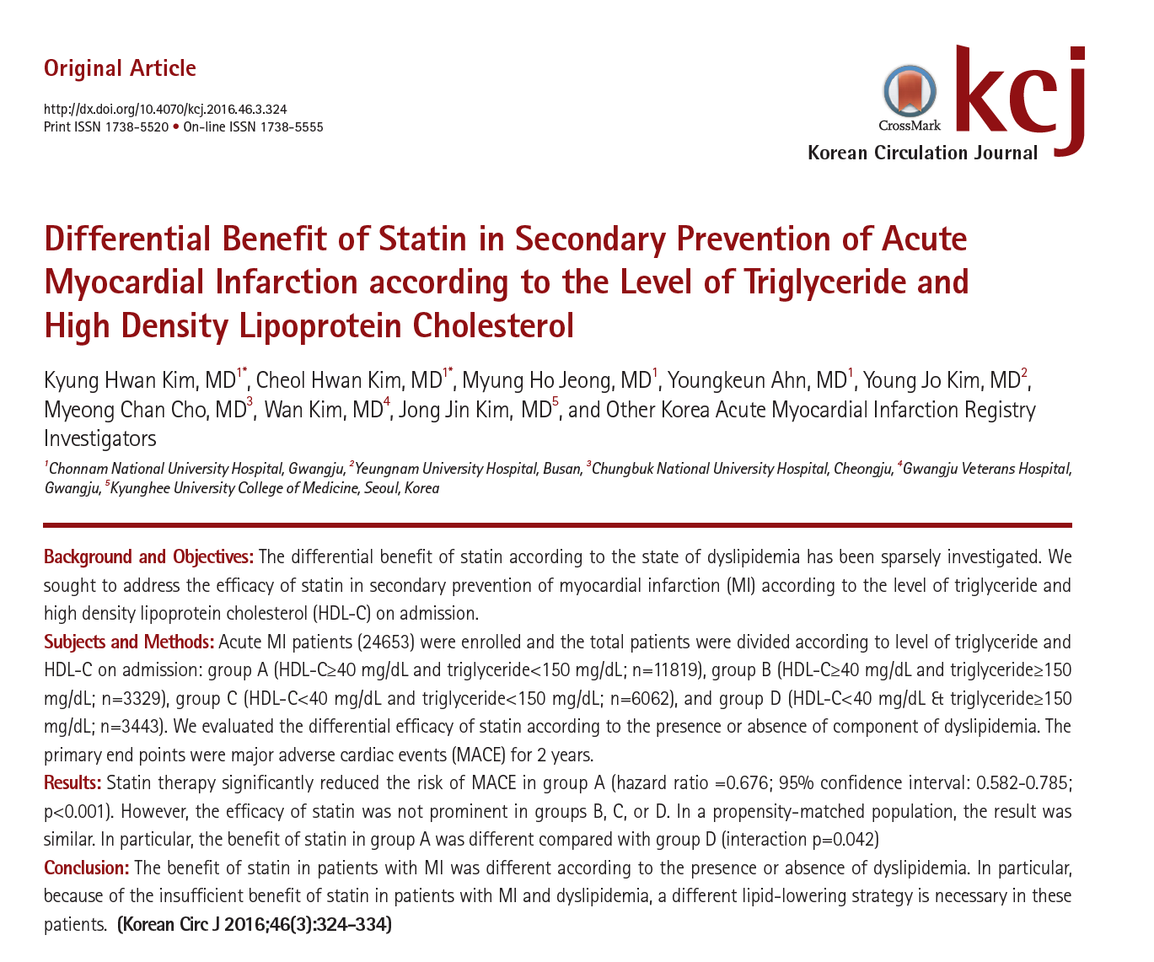

Slide 30
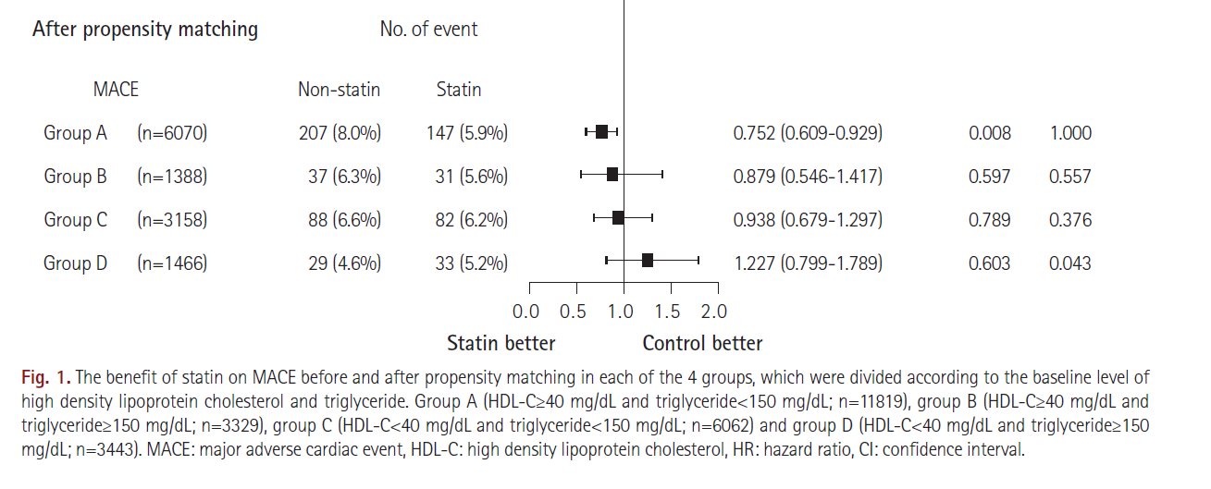
KAMIR Investigators. Kor Circulation J 2016;46: 324-34

Slide 31
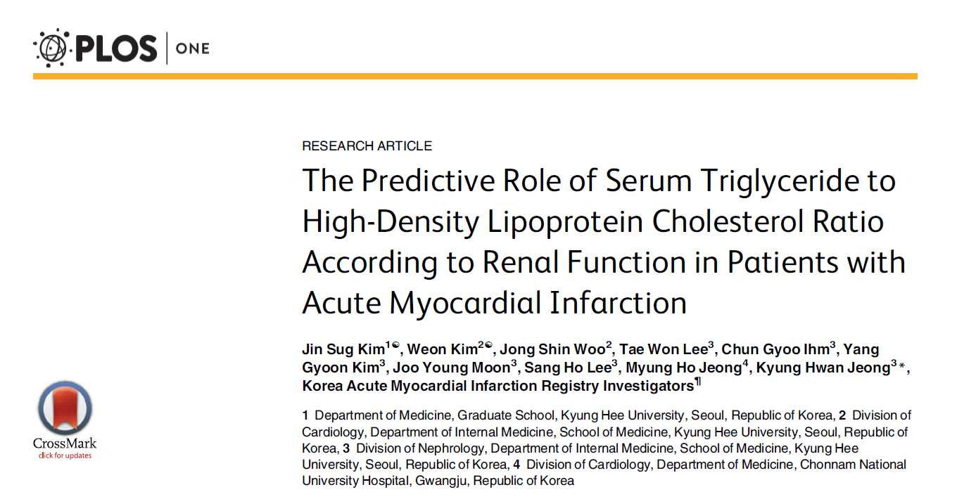
KAMIR Investigators. PLoS One 2016 Oct 27; 11: e0165484

Slide 32
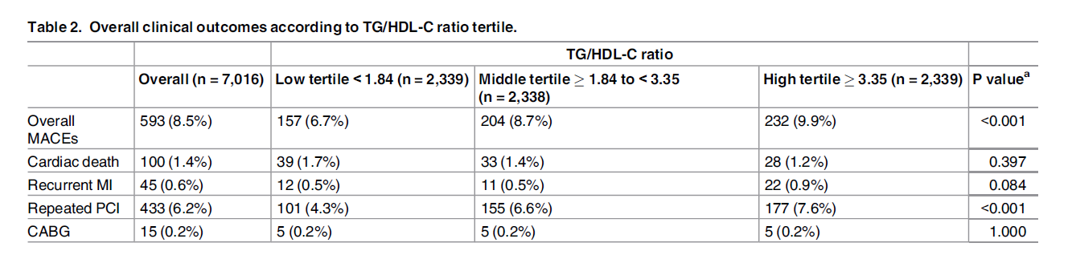
KAMIR Investigators. PLoS One 2016 Oct 27; 11: e0165484

Slide 33
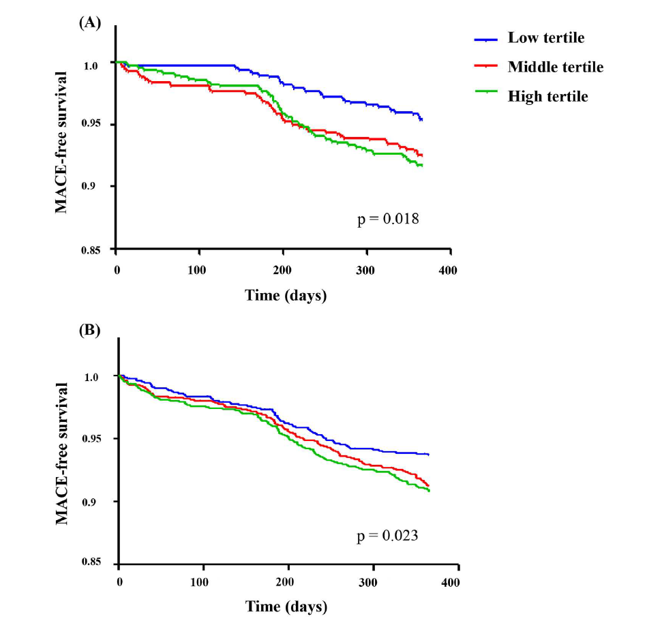
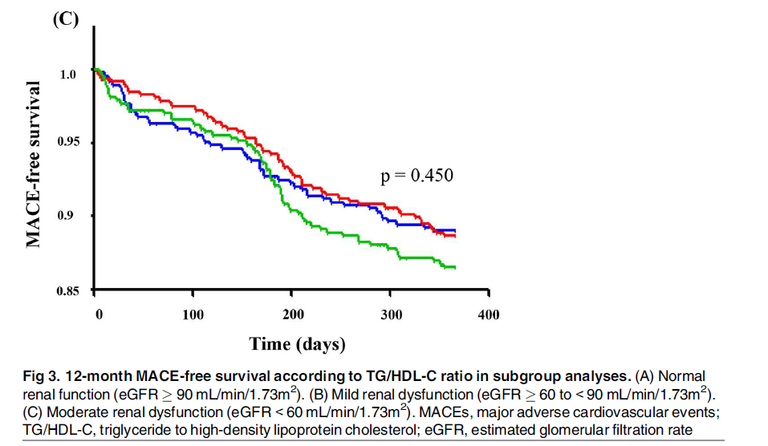
KAMIR Investigators. PLoS One 2016 Oct 27; 11: e0165484

Slide 34
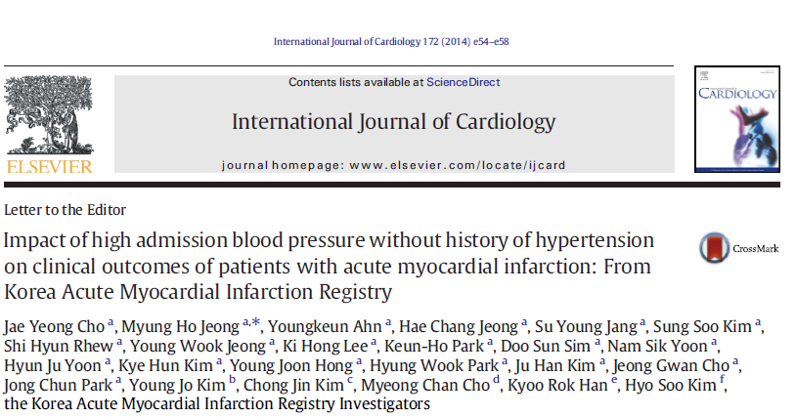
KAMIR Investigators. Int J Cardiol 2014;172:e54-8

Slide 35
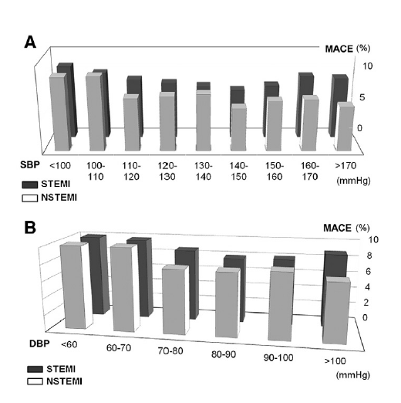
KAMIR Investigators. Int J Cardiol 2014;172:e54-8

Slide 36
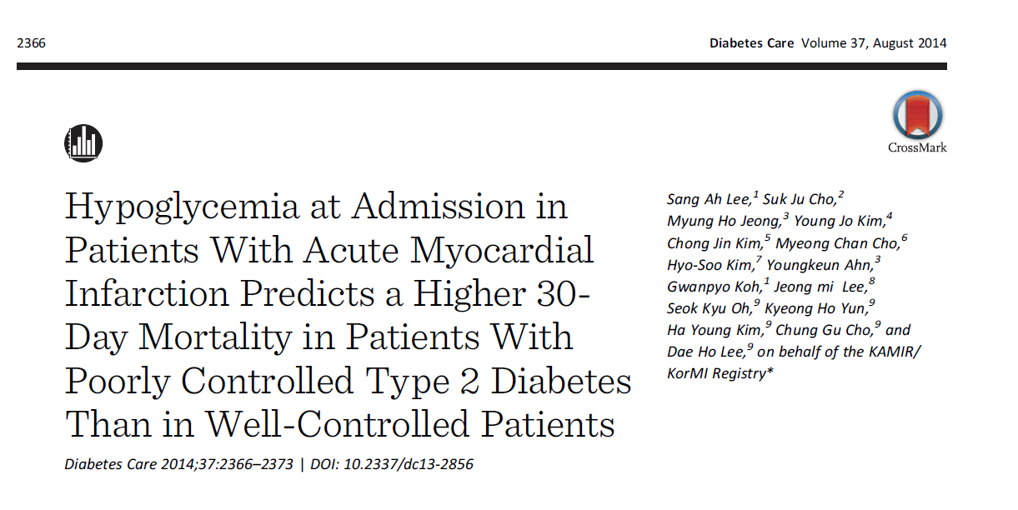
KAMIR Investigators. Diabetic Care 2014;37:2366-73

Slide 37
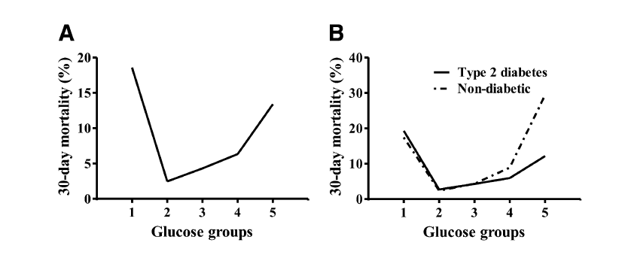
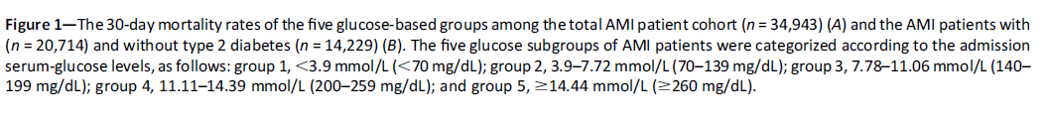
KAMIR Investigators. Diabetic Care 2014;37:2366-73

Slide 38
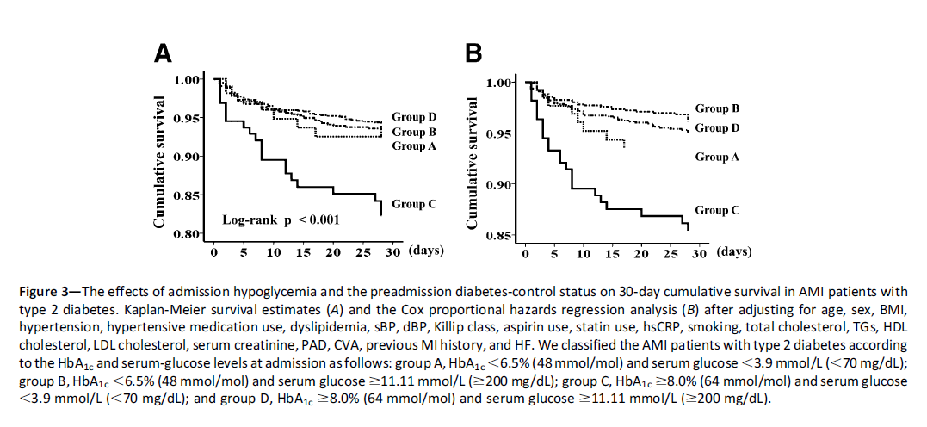
KAMIR Investigators. Diabetic Care 2014;37:2366-73

Slide 39
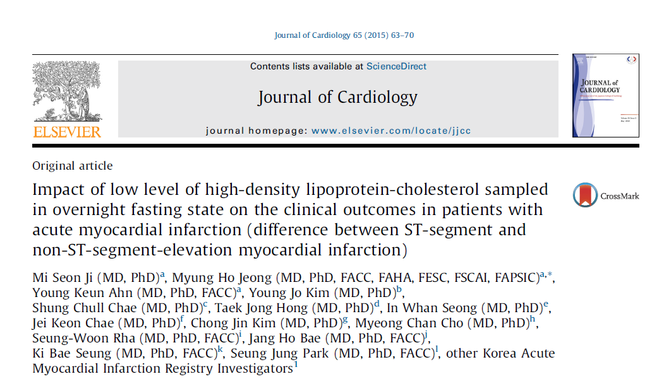
KAMIR Investigators. J Cardiol 2015;65:63-70

Slide 40
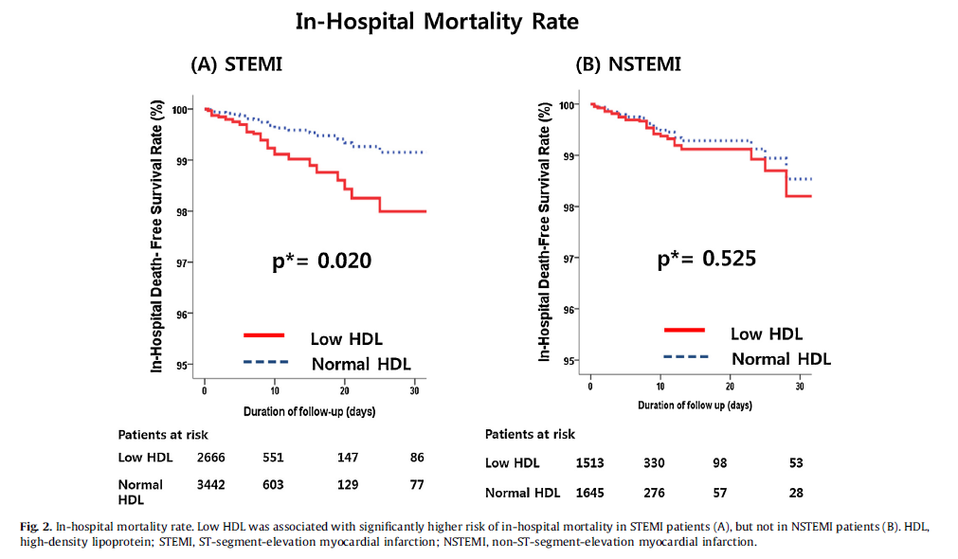
KAMIR Investigators. J Cardiol 2015;65:63-70

Slide 41
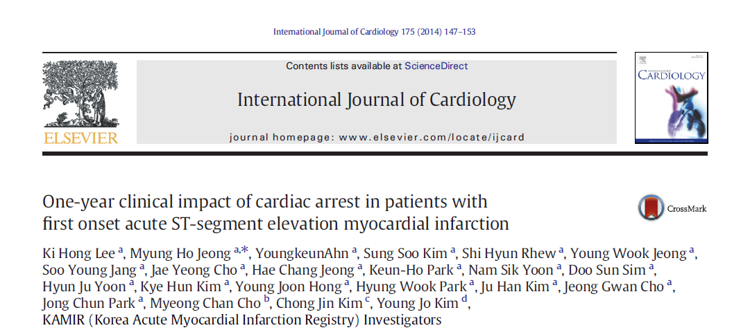
KAMIR Investigators. Int J Cardiol 2014;175:147-53

Slide 42
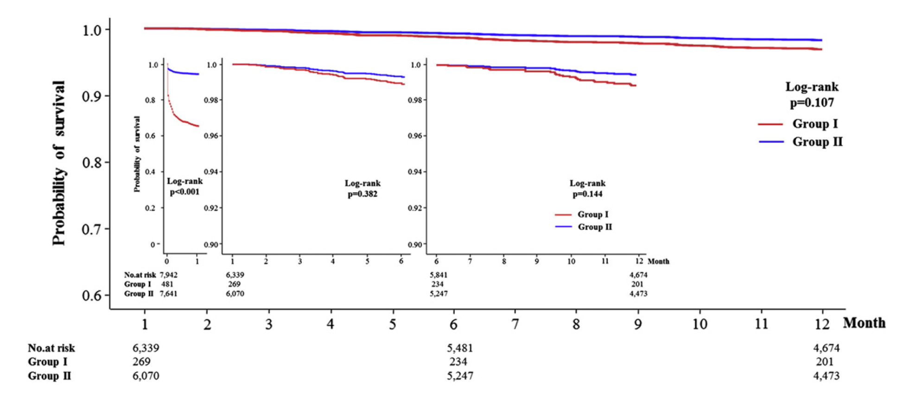
KAMIR Investigators. Int J Cardiol 2014;175:147-53

Slide 43
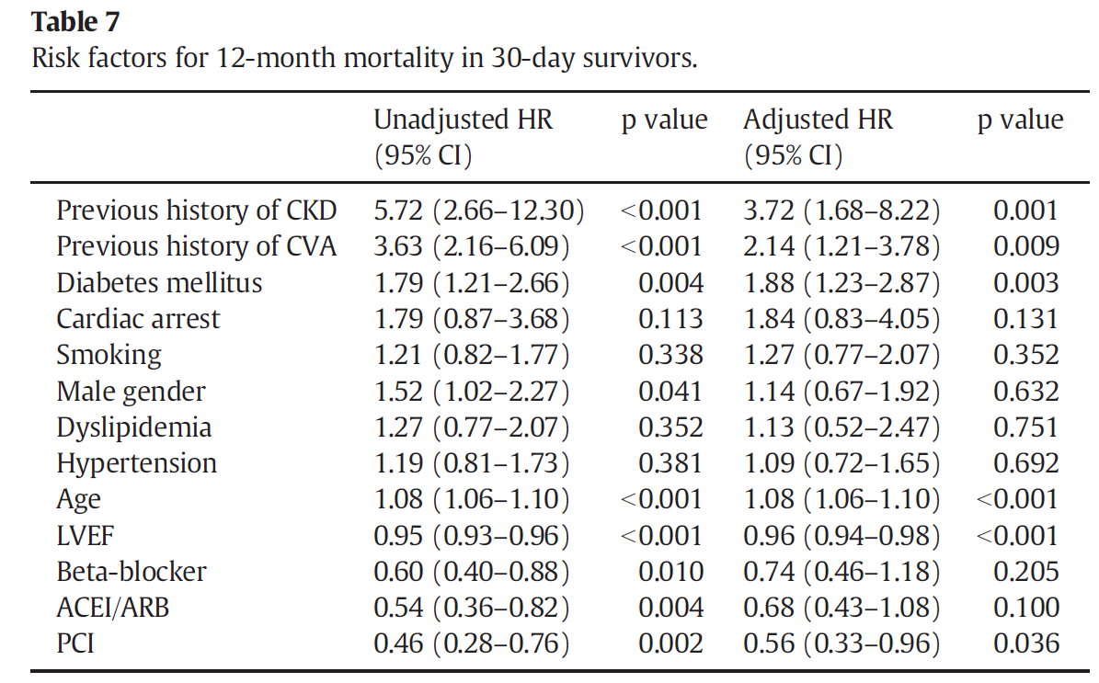
KAMIR Investigators. Int J Cardiol 2014;175:147-53

Slide 44
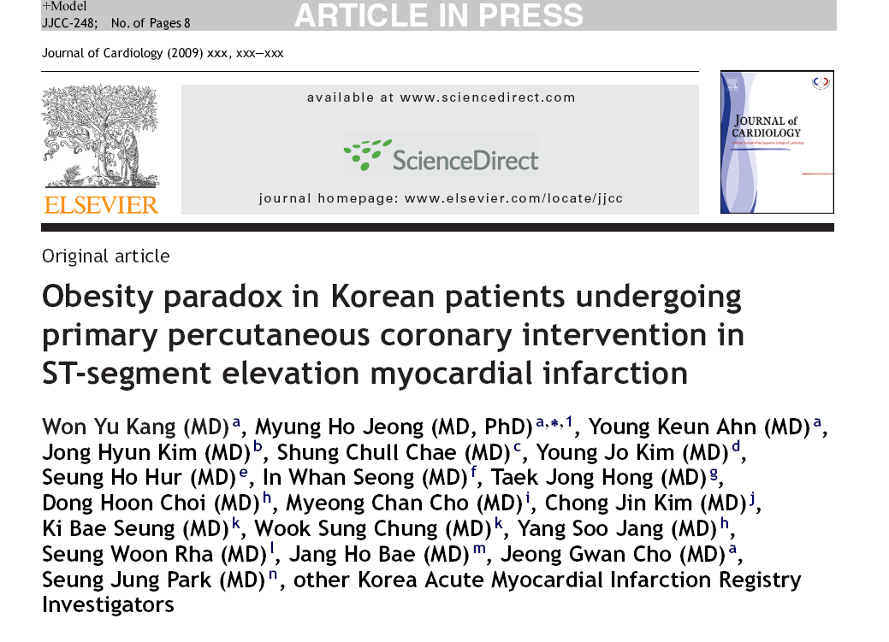
Obesity Paradox
KAMIR Investigators. J Cardiol 2010; 55:84-91

Slide 45
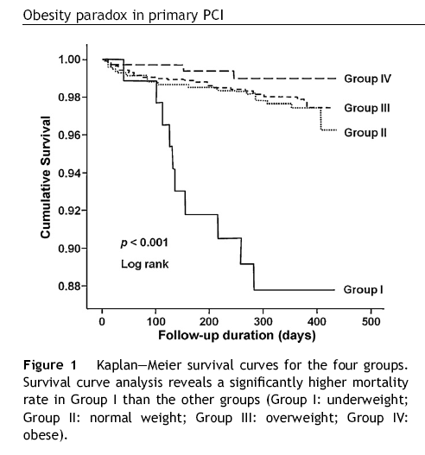
KAMIR Investigators. J Cardiol 2010; 55:84-91

Slide 46
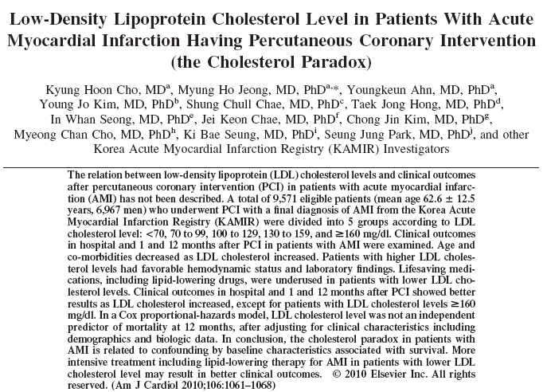
KAMIR Investigators. Am J Cardiol 2010; 106:1061-8

Slide 47
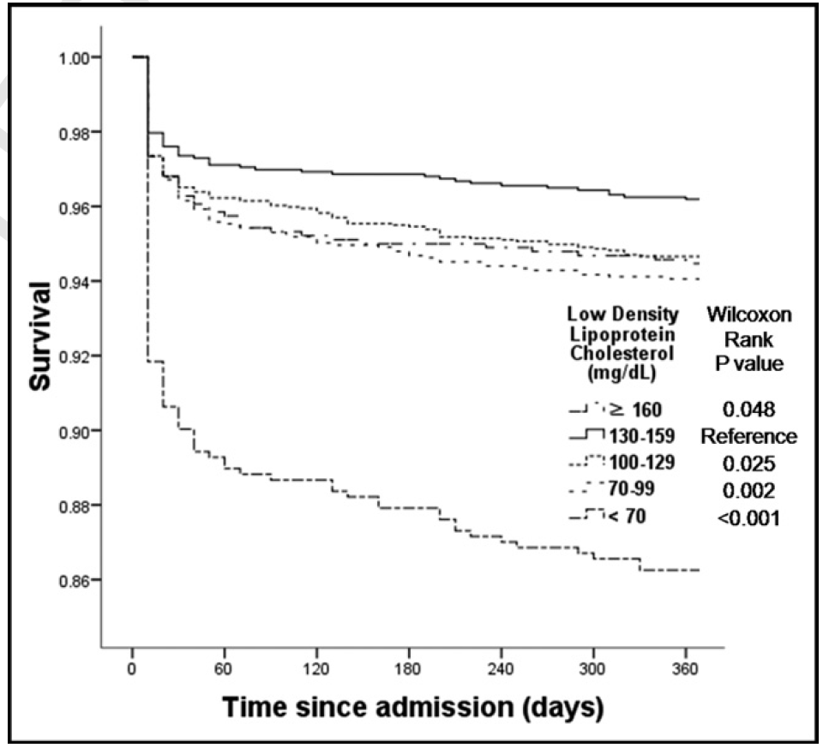
KAMIR Investigators. Am J Cardiol 2010; 106:1061-8

Slide 48
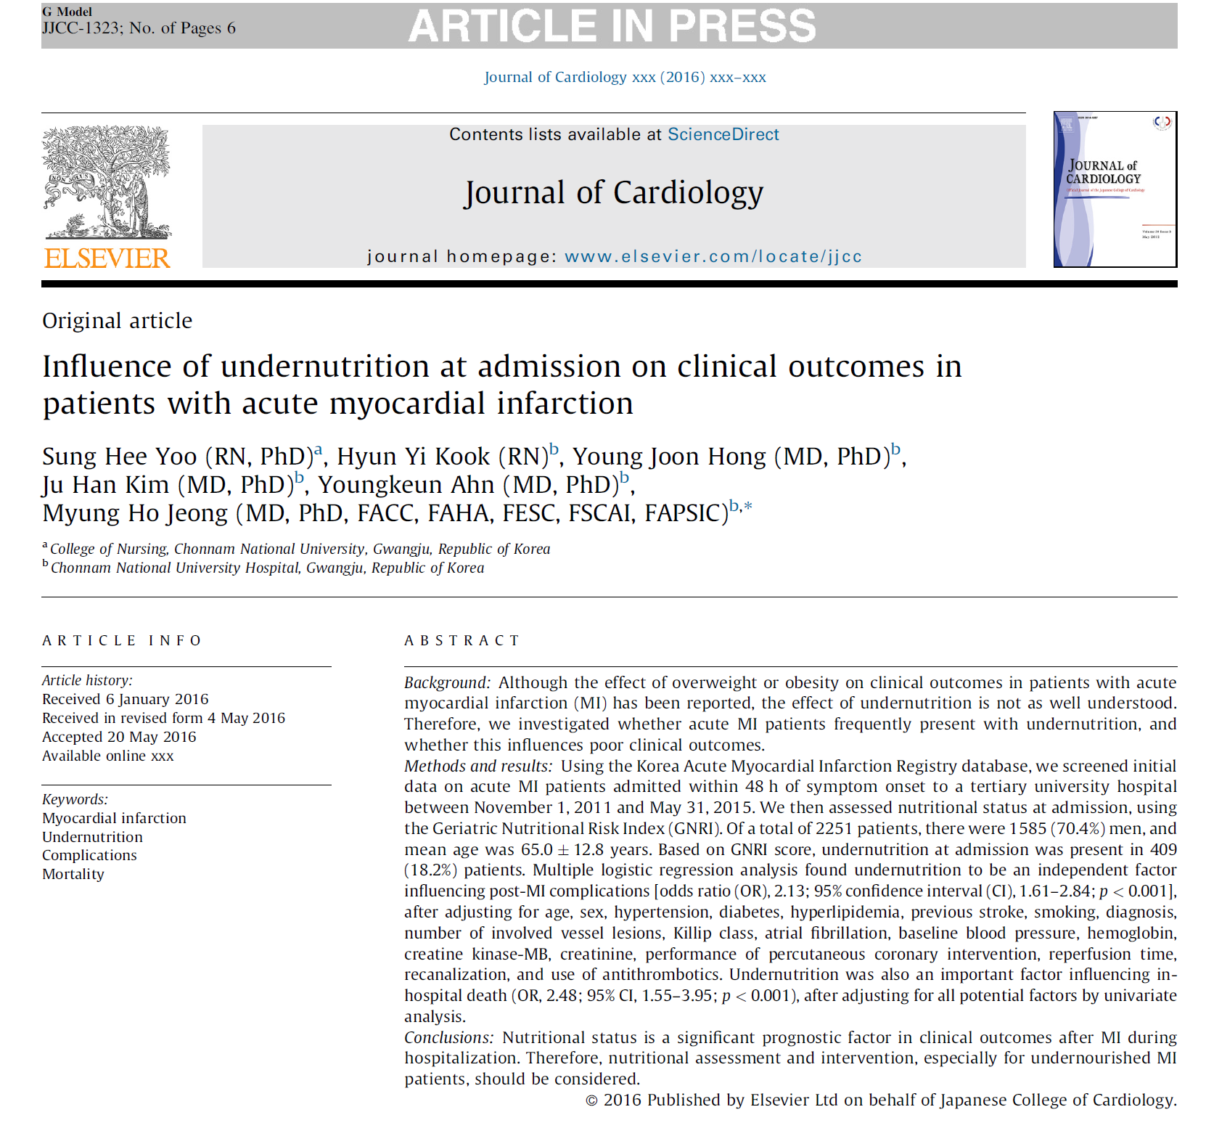
KAMIR Investigators. J Cardiol 2016 Aug 23 [Epub ahead of Print]

Slide 49
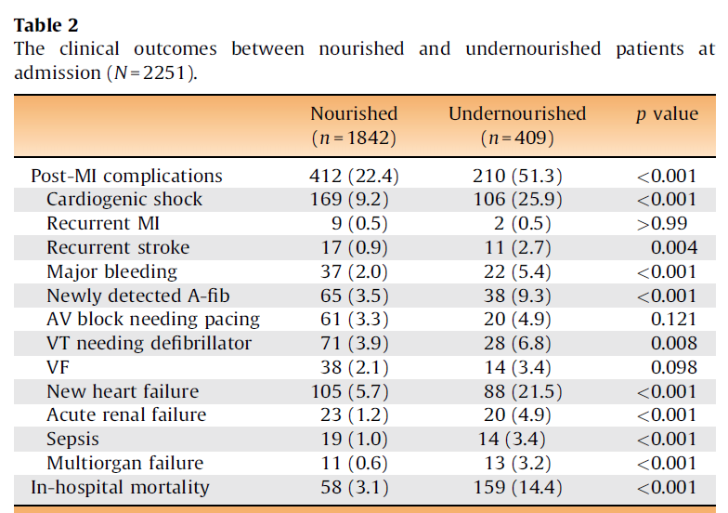
KAMIR Investigators. J Cardiol 2016 Aug 23 [Epub ahead of Print]

Slide 50
Contents
Risk Factor
Risk Stratification
Medical Treatment
Interventional Treatment

Slide 51
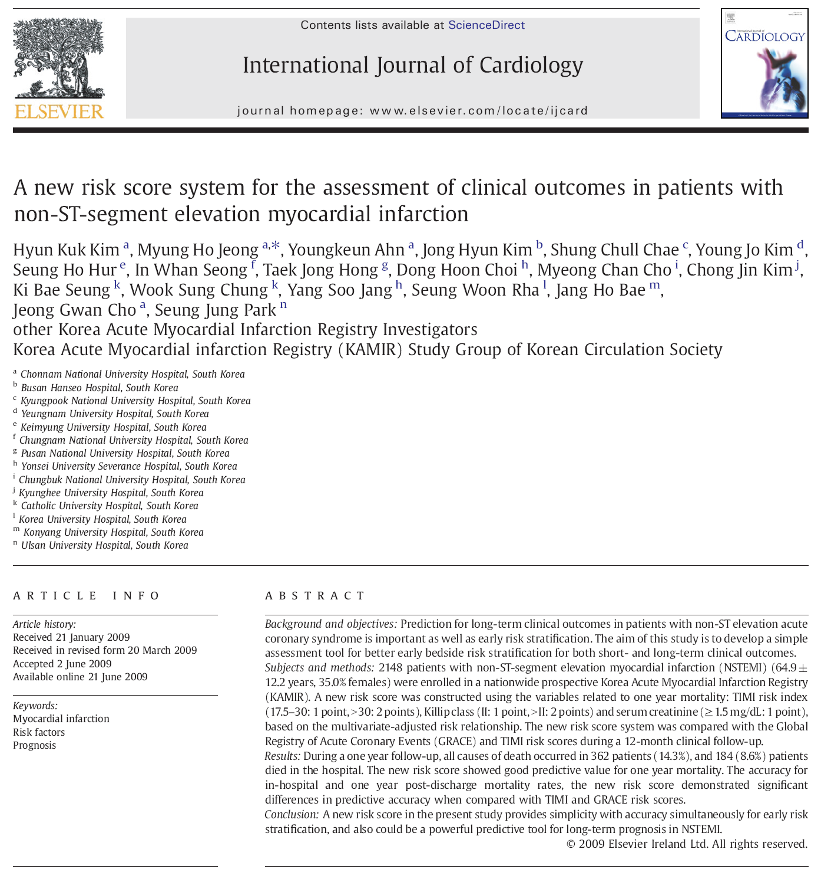
KAMIR Investigators. Int J Cardiol 2010;145:450-4

Slide 52

KAMIR Investigators. Int J Cardiol 2010;145:450-4

Slide 53

KAMIR Investigators. Int J Cardiol 2010;145:450-4

Slide 54

KAMIR Investigators. Int J Cardiol 2010;145:450-4

Slide 55

KAMIR Investigators. Am J Cardiol 2011;107:965-71
Notes:
We proposed hospital discharge score system for the assessment of clinical outcomes in AMI.
KAMIR score was constructed with 6 clinical variables.

Slide 56

KAMIR Investigators. Am J Cardiol 2011;107:965-71

Slide 57

KAMIR Investigators. Am J Cardiol 2011;107:965-71

Slide 58

KAMIR Score
GRACE Score
KAMIR Investigators. Am J Cardiol 2011;107:965-71
Notes:
KAMIR score is better than GRACE score in the prediction of one-year mortality.

Slide 59



CNUH data. Korean Med J 2015;88:168-76

Slide 60


KAMIR Investigators. Int J Cardiol 2014;174:777-80

Slide 61


KAMIR Investigators. Int J Cardiol 2014;174:777-80

Slide 62

KAMIR Investigators. Int J Cardiol 2015;193:20-2

Slide 63

KAMIR Investigators. Int J Cardiol 2015;193:20-2

Slide 64

KAMIR Investigators. Am J Cardiol 2015;115:1167-73

Slide 65

KAMIR Investigators. Am J Cardiol 2015;115:1167-73

Slide 66

KAMIR Investigators. Am J Cardiol 2015;115:1167-73

Slide 67
Contents
Risk Factor
Risk Stratification
Medical Treatment
Interventional Treatment

Slide 68

KAMIR Investigators. Circulation 2009;119:3207-14

Slide 69

Triple vs. Dual antiplatelet therapy in AMI Pts
KAMIR Investigators. Circulation 2009;119:3207-14

Slide 70


CNUH Data. J Cardiol 2014;63:99-106

Slide 71

KAMIR Investigators, Int J Cardiol 2016;215:193-200

Slide 72

KAMIR Investigators, Int J Cardiol 2016;215:193-200

Slide 73
KAMIR Investigators, Int J Cardiol 2016;215:193-200

Slide 74

Efficacy and Safety of Prasugrel in Patients with Acute Myocardial infarction Undergoing Successful Revascularization
Keun-Ho Park¹, Myung Ho Jeong², Tae Hoon Ahn, MD³, Ki Bae Seung⁴, Dong Joo Oh⁵, Dong-Joo Choi⁶, Hyo-Soo Kim⁷, Hyeon Cheol Gwon⁸, In Whan Seong⁹, Kyung Kuk Hwang¹⁰, Shung Chull Chae¹¹, Kwon-Bae Kim¹², Young Jo Kim¹³, Kwang Soo Cha¹⁴, Seok Kyu Oh¹⁵, Jei Keon Chae¹⁶
¹Chosun University Hospital, Gwangju; ²Chonnam National University Hospital, Gwangju; ³Gachon University Gil Medical Center, Incheon; ⁴The Catholic University of Korea Seoul St. Mary’s Hospital, Seoul; ⁵Korea University Guro Hospital, Seoul; ⁶Seoul National University Bundang Hospital, Seoul; ⁷Seoul National University Hospital, Seoul; ⁸Sungkyunkwan Universtiy Samsung Medical Center, Seoul; ⁹Chungnam National Universtiy Hospital, Daejeon; ¹⁰Chungbuk National University Hospital, Cheongju; ¹¹Kyungpook National University Hospital, Daegu; ¹²Keimyung University Dongsan Medical Center, Daegu;¹³Yeungnam University Hospital, Daegu; ¹⁴Pusan National University Hospital, Busan; ¹⁵Wonkwang University Hospital, Iksan;
¹⁶Chonbuk National University Hospital, Jeonju, Republic of Korea

Slide 75
Temporal Trend of Use of Anti-platelet Agents
Notes:
좀더 세부적으로 살펴보면,
거의 30%정도에서 ticagrelor를 사용하고 있었고,
아마도 contraindication이 많아서 그런지 prasugrel은 6%정도였습니다.
하지만 병원내에서 10%정도에서는 clopidogrel에서 Tica나 prasugrel로 바꾸었고,
6-7%정도에서는 tica나 prasugrel에서 clopidogrel로 바꾼 경우였습니다.
Registry라는 제한점으로 약을 switching한 이유에 대해서는 정확히 파악할 수는 없었으나,
저희들의 실제 임상 경험상 예측을 해본다면,
주로 각 병원에서 시행되고 있는 study의 protocol에 따라 약을 바꾸거나
환자의 상태에 따라서 임상교수님들의 주관적인 판단에 따라 바꾸게 되는데,
Ischemic events 발생하였거나 위험도가 높을 것으로 예상되는 환자에서는 clopidogrel보다 더 센 약으로 바꾸게 되고,
Bleeding events가 발생하였거나 risk가 높은 환자에서는 tica나 prasugrel에서 clopidogrel로 바꾸게 될것으로 예상해 볼수 있는데요,

Slide 76
Study Flow Chart
10,171 AMI patients underwent successful PCI from KAMIR-NIH
between Nov. 2011 and Dec. 2015
Exclusion criteria
: Pts older than 75 yrs, BW<60 kg, or with Hx of CVA or TIA
: Pts received ticagrelor
: Pts with in-hospital switching between Prasugrel and Clopidogrel
: Pts had invalid baseline clinical data
4,421 AMI patients underwent successful PCI from KAMIR-NIH
Prasugrel
(n=637)
Clopidogrel
(n=3,784)
Propensity score matching
Prasugrel
(n=637)
Clopidogrel
(n=637)

Slide 77
Baseline Clinical Characteristics (PSM)
 | Prasugrel (n=637) | Clopidogrel (n=637) | p-value
Age, years | 55.15±8.87 | 55.13±9.87 | 0.967
Male gender (%) | 599 (94.0) | 597 (93.7) | 0.815
Hypertension (%) | 248 (38.9) | 255 (40.0) | 0.688
Diabetes (%) | 148 (23.2) | 149 (23.4) | 0.947
Dyslipidemia (%) | 77 (12.1) | 92 (14.4) | 0.215
Current smoker (%) | 370 (58.1) | 384 (60.3) | 0.425
Family Hx of CAD (%) | 54 (8.5) | 60 (9.4) | 0.556
Previous MI (%) | 25 (3.9) | 24 (3.8) | 0.884
Previous HF (%) | 5 (0.8) | 5 (0.8) | 1.000
Clinical presentation |  |  | 0.641
ST elevation MI (%) | 409 (64.2) | 401 (63.0)
Non-ST elevation MI (%) | 228 (35.8) | 236 (37.0)
Killip class (%) |  |  | 0.361
I | 565 (88.7) | 575 (90.3)
II - IV | 72 (11.3) | 62 (9.7)
LV ejection fraction, % | 52.97±9.51 | 53.18±10.06 | 0.707
LV ejection fraction <50% | 215 (33.8) | 204 (32.0) | 0.512
Ccr, ml/min/1.73m² | 101.19±33.25 | 98.42±31.43 | 0.127
Ccr <60 ml/min/1.73m² | 44 (6.9) | 39 (6.1) | 0.570
Notes:
There were no differences in baseline clincal characteristics between two group.
Around 20% of patients has Diabetes, 64% of patients STEMI.

Slide 78
Baseline Procedural Characteristics (PSM)
 | Prasugrel (n=637) | Clopidogrel (n=637) | p-value
Vascular access |  |  | 0.954
Transradial intervention | 256 (40.2) | 255 (40.0)
Transfemoral intervention | 381 (59.8) | 382 (60.0)
Infarct-related artery (%) |  |  | 0.994
LAD | 302 (47.4) | 307 (48.2)
LCX | 110 (17.3) | 108 (17.0)
RCA | 216 (33.9) | 213 (33.4)
LM | 9 (1.4) | 9 (1.4)
Involved vessel number (%) |  |  | 0.531
Single vessel | 380 (59.7) | 369 (57.9)
Multi-vessel disease or LM | 257 (40.3) | 268 (42.1)
Treatment at target lesion |  |  | 0.636
Only ballooning or thrombosuction | 28 (4.4) | 26 (4.1)
Bare metal stent | 12 (1.9) | 8 (1.3)
Drug-eluting stent | 597 (93.7) | 603( 94.7)
ACC/AHA Type B2/C (%) | 584 (91.7) | 588 (92.3) | 0.680
Glycoprotein IIb/IIIa inhibitor (%) | 128 (20.1) | 114 (17.9) | 0.317
Notes:
The high proportion of patients were performed via transradial approach
Glycoprotein Iib/IIIa inhibitor was used in 22% of patients.

Slide 79
In-hospital Medication (PSM)
Variable, n (%) | Prasugrel (n=637) | Clopidogrel (n=637) | p-value
Aspirin | 637 (100.0) | 637 (100.0) | 1.000
Clopidogrel | 0 (0.0) | 637 (100.0) | <0.001
Prasugrel 10mg MD/5mg MD | 612 (96.1)/25 (3.9) | 0 (0.0) | <0.001
Cilostazol | 2 (0.3) | 105 (16.5) | <0.001
Beta-blocker | 579 (90.9) | 594 (93.2) | 0.120
Calcium channel blockers | 22 (3.5) | 26 (4.1) | 0.556
ACEi or ARB | 530 (83.2) | 528 (82.9) | 0.881
Statin | 614 (96.4) | 618 (97.0) | 0.530
Notes:
Maintenance dose of prasugrel was mainly 10mg. More than 96% of patients

Slide 80
PRU between Prasugrel vs. Clopidogrel
Only 31.8% of all patients was available
86.78±78.86 | 217.85±81.64
p<0.001
PRU
Prasugrel (n=205) | Clopidogrel (n=200)
Notes:
In the results, PRU was significantly lower in prasugrel, 87 than clopidogrel 214.

Slide 81
In-hospital Clinical Outcomes
p=0.506 | p=0.478 | p=1.000 | p=1.000 | p=0.762

Slide 82
Six-month Clinical Outcomes
96.3% of total patients follow up.
p=0.499 | p=0.499 | p=0.506 | p=0.686 | p=0.177 | p=0.107 | p=1.000 | p=0.802 | p=0.815

Slide 83
In-hospital Bleeding Complications
p=0.624 | p=0.071 | p=1.000 | p=0.058 | p=0.007 | p=0.015

Slide 84
Independent Predictors of TIMI Major or Minor Bleeding Complications
 | Univariate analysis |  |  | Multivariate analysis
Variables | Odd ratio | 95% CI | p-value | Odd ratio | 95% CI | p-value
TFI vs. TRI | 8.320 | 2.979-23.239 | <0.001 | 6.918 | 2.453-19.510 | <0.001
Gp IIb/IIIa inhibitor | 2.909 | 1.628-5.199 | <0.001 | 2.577 | 1.406-4.724 | 0.002
CCB | 2.983 | 1.129-7.883 | 0.021 | 4.016 | 1.382-11.668 | 0.011
Prasugrel vs. Clopidogrel | 2.056 | 1.137-3.720 | 0.015 | 2.022 | 1.101-3.714 | 0.023
Statin | 0.287 | 0.108-0.764 | 0.008 | 0.432 | 0.149-1.252 | 0.122
ACEi or ARB | 0.523 | 0.278-0.985 | 0.041 | 0.576 | 0.286-1.159 | 0.122
ACC/AHA lesion type B2 or C | 4.501 | 0.615-32.923 | 0.118 | 3.820 | 0.510-28.642 | 0.192
LVEF <50% | 1.451 | 0.820-2.567 | 0.199 | 1.290 | 0.707-2.353 | 0.407
Beta-blocker | 0.523 | 0.229-1.194 | 0.118 | 0.952 | 0.375-2.418 | 0.918
Notes:
<0.200

Slide 85

KAMIR Investigators. J Am Coll Cardiol 2011;58:1664-71

Slide 86

Statin therapy in AMI patients with LDL-C levels < 70 mg/dL
0.25
0.20
0.15
Cumulative incidence of MACEs
0.10
Non-statin therapy group
0.05
Statin therapy group
p=0.024
0.00
0
1
2
3
4
5
6
7
8
9
10
11
12
Months after PCI
No.at risk 1,054 894 780 680
Statin therapy group 607 529 457 400
Non-statin therapy group 447 365 323 280
KAMIR Investigators. J Am Coll Cardiol 2011;58:1664-71

Slide 87

KAMIR Investigators, Int J Cardiol 2015;187:478-485

Slide 88



KAMIR Investigators, Int J Cardiol 2015;187:478-485

Slide 89

KAMIR Investigators, J Cardiol 2016;68:7-12

Slide 90

KAMIR Investigators, J Cardiol 2016;68:7-12

Slide 91

KAMIR Investigators, J Cardiol 2016;68:7-12

Slide 92


Slide 93

KAMIR Investigators, int J Cardiol 2016;225:50-59

Slide 94

KAMIR Investigators, int J Cardiol 2016;225:50-59

Slide 95


KAMIR Investigators, int J Cardiol 2016;225:50-59

Slide 96


KAMIR Investigators. Int J Cardiol 2014;170:291-7

Slide 97

Losartan, Eprosartan
Valsartan, Candersatan.
Irbesartan, Telmisartan,
Olmesartan
KAMIR Investigators. Int J Cardiol 2014;170:291-7

Slide 98

KAMIR Investigators. BMJ 2014;7:g6650

Slide 99

ARB in STEMI with Preserved LV Function
KAMIR Investigators. BMJ 2014;7:g6650

Slide 100

KAMIR Investigators, J Cardiol 2016 Apr 30 [Epub ahead of print]

Slide 101


KAMIR Investigators, J Cardiol 2016 Apr 30 [Epub ahead of print]

Slide 102

KAMIR Investigators, J Am Coll Cardiol Intv 2014;7:592-601

Slide 103

Beta-blocker in Primary PCI
KAMIR Investigators, J Am Coll Cardiol Intv 2014;7:592-601

Slide 104
Contents
Risk Factor
Risk Stratification
Medical Treatment
Interventional Treatment

Slide 105

KAMIR Investigators, J Cardiol 2016 Oct 6 [Epub ahead of Print]

Slide 106

KAMIR Investigators, J Cardiol 2016 Oct 6 [Epub ahead of Print]

Slide 107

KAMIR Investigators, J Cardiol 2016 Oct 6 [Epub ahead of Print]

Slide 108

KAMIR Investigators, J Cardiol 2016 Oct 6 [Epub ahead of Print]

Slide 109

KAMIR Investigators, Circ Cardiovasc Interv 2016 Sep 9 [Epub ahead of Print]

Slide 110
KAMIR Investigators, Circ Cardiovasc Interv 2016 Sep 9 [Epub ahead of Print]

Slide 111
KAMIR Investigators, Circ Cardiovasc Interv 2016 Sep 9 [Epub ahead of Print]

Slide 112

Revascularization in Multi-vessel Disease
KAMIR Investigators, Int J Cardiol 2011;153:148-53

Slide 113

Revascularization in Multi-vessel Disease
KAMIR Investigators, Int J Cardiol 2011;153:148-53

Slide 114


CNUH data, Int J Cardiol 2014;176:505-7

Slide 115

Three-year Clinical Outcomes of Staged,
ad hoc and Culprit-only PCI in STEMI (2006-2009)
*
(n=252)
(n=67)
(n=155)
*
*
*
*
*
CNUH data, Int J Cardiol 2014;176:505-7

Slide 116

KAMIR and Duke Data, JAMA 2014;312:2018-27

Slide 117

KAMIR and Duke Data, JAMA 2014;312:2018-27

Slide 118


KAMIR Investigators. Heart 2015 ;101:1225-32

Slide 119

KAMIR Investigators. Heart 2015 ;101:1225-32

Slide 120

DES in Korean AMI Pts
KAMIR Investigators. Int J Cardiol 2013;163:1-4

Slide 121

DES in Korean AMI Pts
KAMIR Investigators. Int J Cardiol 2013;163:1-4

Slide 122

DES in Korean AMI Pts
KAMIR Investigators. Int J Cardiol 2013;163:1-4

Slide 123

KAMIR Investigators. J Cardiol 2014;64:273-88

Slide 124

KAMIR Investigators. J Cardiol 2014;64:273-88

Slide 125

KAMIR Investigators. J Cardiol 2013;62:210-6

Slide 126


KAMIR Investigators. J Cardiol 2013;62:210-6

Slide 127

KAMIR Investigators, Am J Cardiol 2011;108:206-13

Slide 128


KAMIR Investigators, Am J Cardiol 2011;108:206-13

Slide 129

KAMIR Investigators. Int J Cardiol 2014;172:462-4

Slide 130

KAMIR Investigators. Int J Cardiol 2014;172:462-4

Slide 131


KAMIR Investigators. Int J Cardiol 2016;221:937-43

Slide 132

KAMIR Investigators. Int J Cardiol 2016;221:937-43

Slide 133

KAMIR Investigators. Int J Cardiol 2016;221:937-43

Slide 134

KAMIR Investigators. Int J Cardiol 2016;221:937-43

Slide 135

KAMIR Investigators. Int J Cardiol 2016;221:937-43

Slide 136

KAMIR Investigators. Int J Cardiol 2014;177:1081-4

Slide 137

KAMIR Investigators. Int J Cardiol 2014;177:1081-4

Slide 138


KAMIR Investigators. Int J Cardiol 2015;199:53-62

Slide 139

KAMIR Investigators. Int J Cardiol 2015;199:53-62

Slide 140

KAMIR Investigators. Int J Cardiol 2015;199:53-62

Slide 141

KAMIR Investigators. J Cardiol 2016;67:57-63

Slide 142

KAMIR Investigators. J Cardiol 2016;67:57-63

Slide 143

KAMIR Investigators. J Cardiol 2016;67:57-63

Slide 144

KAMIR Investigators, Am J Cardiol 2011;108:8-14

Slide 145

KAMIR Investigators, Am J Cardiol 2011;108:8-14

Slide 146

KAMIR Investigators. J Cardiol 2012; 59: 249-57

Slide 147

KAMIR Investigators. J Cardiol 2012; 59: 249-57

Slide 148

KAMIR Investigators. J Cardiol 2012; 59: 249-57

Slide 149



Jeong MH. Anatol J Cardiol 2015;15:371-2

Slide 150
Summary of Recent Update of KAMIR Study
NSTEMI is more common than STEMI
PCI rates for STEMI and NSTEMI are 96.3 % (SR=99.4%) and 81.7% (SR=99.5 %)
Risk factors of HT, DM and DL have been increased, but smoking decreased
Moderate levels of BP and BG are associated with good clinical outcomes
KAMIR scores are better than TIMI/GRACE
High intensity statin is effective in selected AMI patients

Slide 151
Summary of Recent Update of KAMIR Study
7. Low dose prasugrel or ticagrelor and
insurmountable ARB will be beneficial
Staged PCI in STEMI and multi-vessel PCI in NSTEMI can be recommended
9. DES is safer and more effective than BMS
10. Octogenarian can be treated by elective PCI using 2nd generation DES
11. Thrombus aspiration/IVUS-guided PCI can be recommended in selective AMI patients
12. ECMO instead of IABP will be effective in CS

Slide 152

Thank You For Your Attention!
Notes:
.

Slide 153

KAMIR Will Be The Best AMI Registry in the World !
Thank You for Your Great Support !
KAMIR-JAMIR Joint Symposium

