Slide 1
Anticoagulation in patients with acute myocardial infarction who were presenting with atrial fibrillation improved clinical outcomes
Seung-Jae Joo, Jae-Geun Lee, Hyung-Yoon Kim, and other KAMIR-NIH investigators
Cardiology Division, Jeju National University Hospital, Jeju, KOREA

Slide 2
Case; 86 year-old Male
Brief History
2004. 5. 6 STEMI, inferior wall
CAG; prox RCA 100% with thrombus
Primary PCI with VISION 3.5 x 23 mm
Dual anti-platelet therapy for 1 year, then aspirin 100 mg qd
2015. 12. 23 Acute stroke, Lt MCA territory
ECG; atrial fibrillation
anticoagulation with rivaroxaban 20 mg qd without aspirin
2016. 11. 27 chest pain, 1 hour PTA

Slide 3
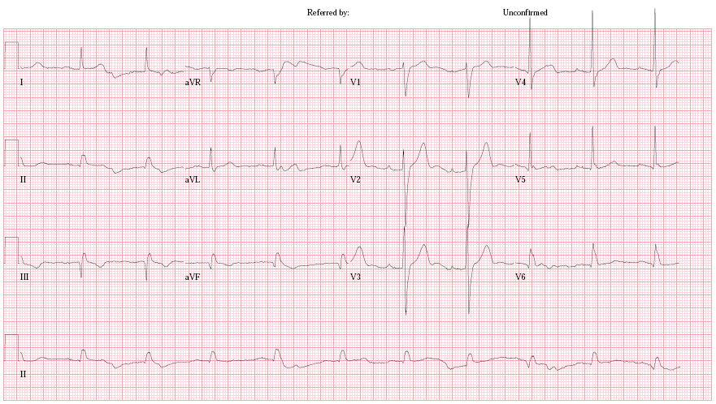
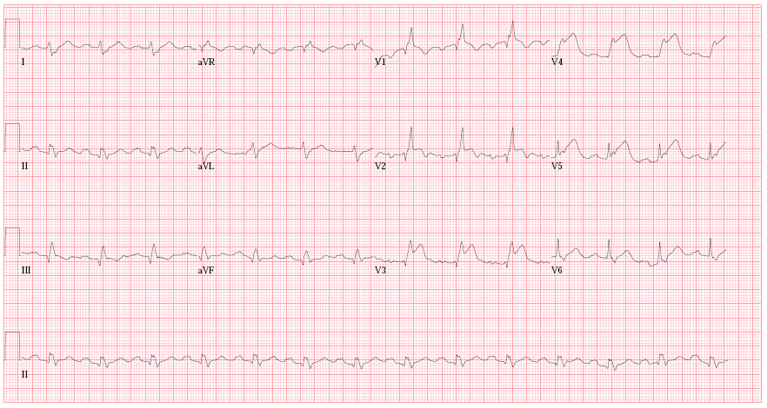
Case; 86 year-old Male
2016-02-16
2016-11-27

Slide 4
Case; 86 year-old Male

Slide 5
Case; 86 year-old Male
Prox-to-mid LAD; Endeavor Onyx 3.0 x 34 mm
Mid-to-dist LAD; Endeavor Onyx 2.75 x 22 mm

Slide 6
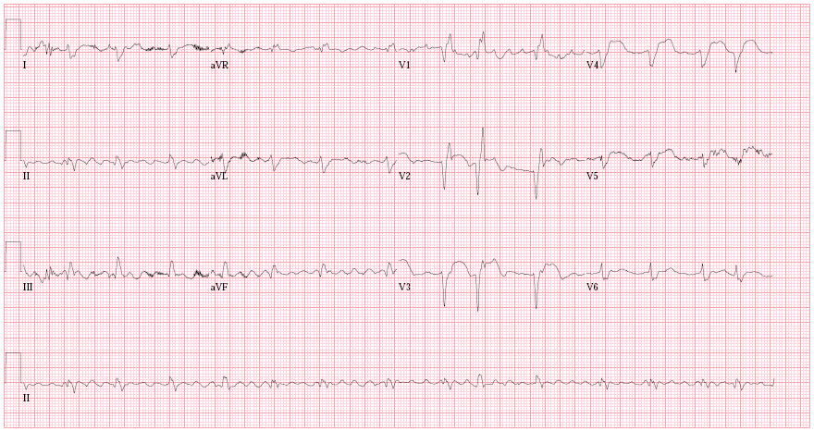
Case; 86 year-old Male
ECG at Discharge
2016-12-01
Anti-thrombotic medication at discharge
Aspirin 100 mg qd, clopidogrel 75 mg qd, rivaroxaban 15 mg qd

Slide 7
2015 ESC Guidelines for the management of ACS in patients presenting without persistent ST-segment elevation
Recommendations | Class | Level
In patients with a firm indication for OAC (e.g. atrial fibrillation with a CHA2DS2-VASc score ≥2, recent venous thromboembolism, LV thrombus or mechanical valve prosthesis), OAC is recommended in addition to antiplatelet therapy. | I | C
If at low bleeding risk (HAS-BLED ≤2), triple therapy with OAC, aspirin and clopidogrel should be considered for 6 months, followed by OAC and aspirin or clopidogrel continued up to 12 months. | IIa | C
If at high bleeding risk (HAS-BLED ≥3), triple therapy with OAC, aspirin and clopidogrel should be considered for a duration of 1 month, followed by OAC and aspirin or clopidogrel continued up to 12 months irrespective of the stent type (BMS or new-generation DES). | IIa | C
Roffi M et al. Eur Heart J. 2016;37:267-315

Slide 8
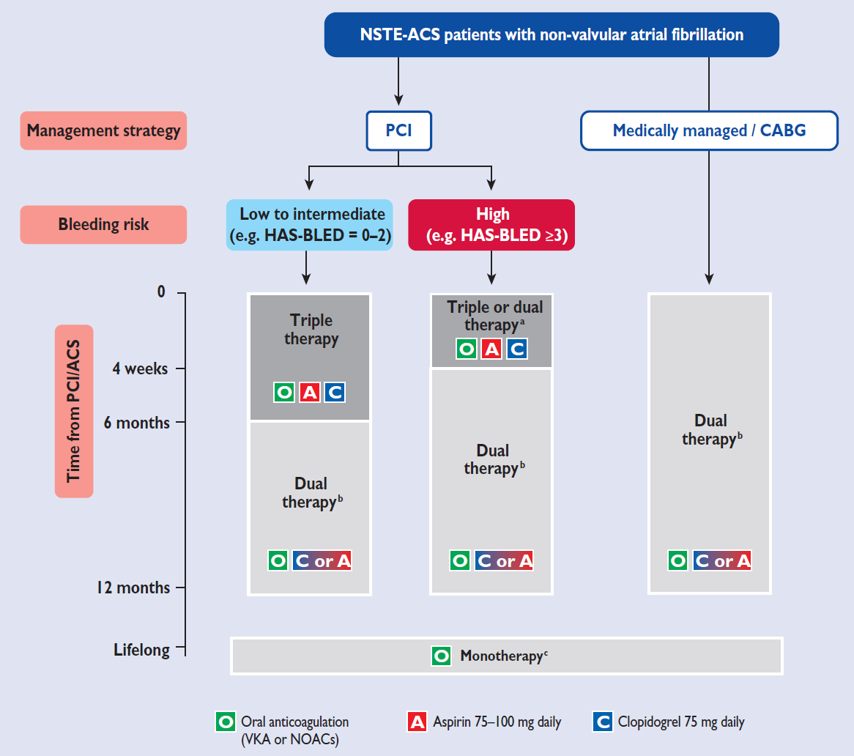
2015 ESC Guidelines for the management of ACS in patients presenting without persistent ST-segment elevation

Slide 9
Recommendations on the Management of Patients Treated With Triple Therapy
2016 ACC/AHA Guideline on Duration of Dual Antiplatelet Therapy in Patients With CAD
Assess ischemic and bleeding risks using validated risk predictors (eg, CHA₂DS₂-VASc, HAS-BLED)
Keep triple therapy duration as short as possible; dual therapy only (oral anticoagulant and clopidogrel) may be considered in select patients
Consider a target INR of 2.0–2.5 when warfarin is used
Clopidogrel is the P2Y12 inhibitor of choice
Use low-dose (≤100 mg daily) aspirin
PPIs should be used in patients with a history of GI bleeding and are reasonable to use in patients with increased risk of GI bleeding
Levine GN et al. Circulation. 2016;134:e123-55

Slide 10
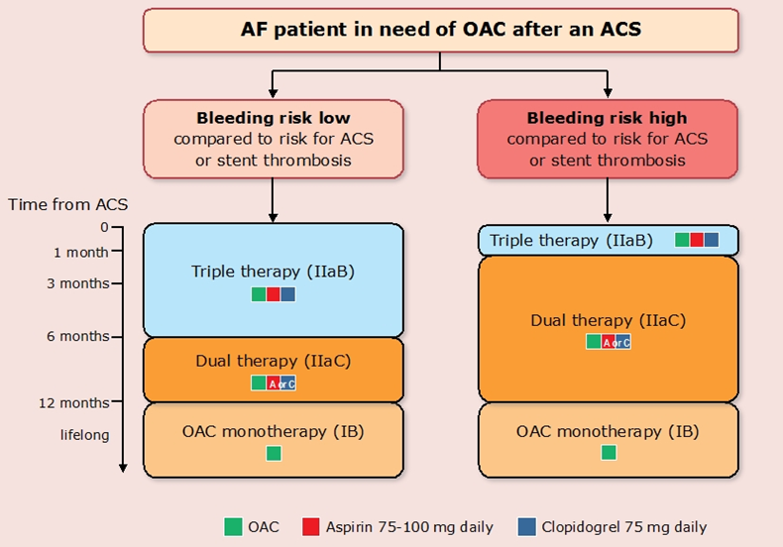
Antithrombotic Therapy after ACS in AF Patients Requiring Anticoagulation.
2016 ESC Guidelines for the Management of AF
Kirchhof P et al. Eur Heart J. 2016 Aug 27. pii: ehw210

Slide 11
Triple Therapy in Patients with AMI during Initial Hospitalization
Bleeding Complications?

Slide 12
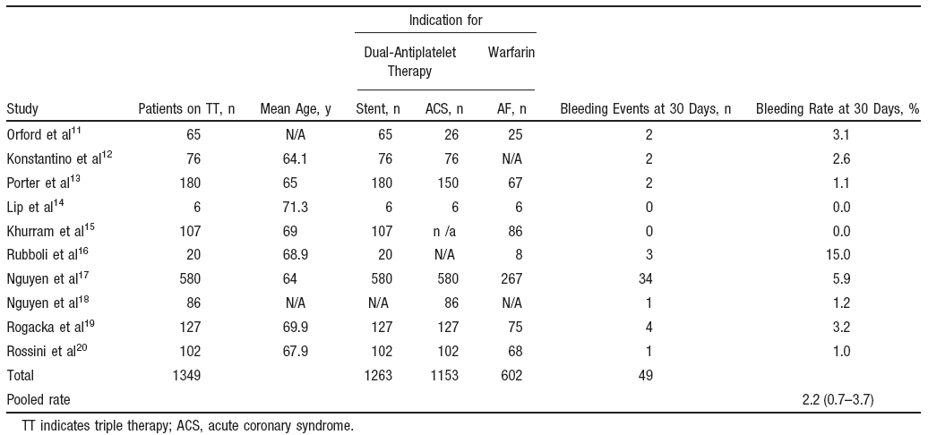
Results of a Meta-Analysis of Observational Studies Reporting 30-Day Bleeding Rates in Patients Receiving “Triple Therapy”
2.2 (0.7-3.7%)
Paikin JS et al. Circulation. 2010;121:2067-2070

Slide 13
KAMIR-NIH Registry
13031 patients with AMI enrolled in the KAMIR-NIH Registry
From Nov 2011 to Oct 2015
446 patients with AMI who demonstrated A.Fib
during the admission on the spot ECG
In-hospital anticoagulation treatment
Group A
Dual antiplatelet treatment
(n=388)
Group B
Triple antithrombotic treatment
(n=58)

Slide 14
Baseline Characteristics
 | Group A (n=388) | Group B (n=58) | P - value
 | n (%) or mean ± SD
Age, mean (SD), yrs | 70.1 ± 12.0 | 72.1 ± 9.54 | 0.146
Sex, male | 258 (65.6) | 33 (55.9) | 0.097
Hypertension | 240 (61.1) | 35 (59.3) | 0.452
DM | 127 (32.3) | 23 (39.0) | 0.192
Dyslipidemia | 29 (7.4) | 5 (8.5) | 0.464
Smoking | 191 (48.6) | 27 (45.7) | 0.556
Previous MI | 49 (12.5) | 6 (10.2) | 0.401
Family history of CAD | 20 (5.1) | 3 (5.1) | 0.648
Heart failure | 14 (3.6) | 3 (5.1) | 0.387
CVA | 36 (9.2) | 6 (10.2) | 0.477
CHA₂DS₂-VASc Score |  |  | 0.010*
≤1 | 103 (26.5) | 7 (12.1)
≥2 | 285 (73.5) | 51 (87.9)

Slide 15
Clinical and Lesion Characteristics
 | Group A (n=388) | Group B (n=58) | P - value
 | n (%) or mean ± SD
SBP, mmHg | 115.2 ± 37.6 | 117.1 ± 37.7 | 0.072
DBP, mmHg | 69.5 ± 23.3 | 69.8 ± 22.5 | 0.937
Killip class
I | 219 (55.7) | 32 (54.2) | 0.469
II-IV | 174 (44.3) | 27 (45.8) | 0.469
STEMI, % | 200 (51.0) | 30 (50.8) | 0.545
Multi - vessel disease, % | 90 (26.9) | 9 (20.0) | 0.370
PCI rate, % | 329 (83.7) | 43 (72.9) | 0.065
Culprit artery, %
LM | 13 (3.3) | 1 (1.7) | 0.434
LAD | 146 (37.2) | 25 (42.4) | 0.441
LCX | 52 (13.2) | 6 (10.2) | 0.512
RCA | 122 (31.0) | 13 (22.0) | 0.159

Slide 16
Use of Dual Antiplatelet Agents
 | Group A (n=388) | Group B (n=58) | P - value
 | n (%) or mean ± SD
Clopidogrel | 292 (75.3) | 50 (86.2) | 0.042*
Cilosazol | 45 (11.6) | 9 (15.5) | 0.254
Prasugrel | 52 (13.4) | 0 (0.0) | <0.001*
Ticagrelor | 93 (24.0) | 13 (22.4) | 0.471

Slide 17
In-hospital Bleeding Complications
%

Slide 18
In-hospital Clinical Outcomes
P=0.120
P<0.001
P=0.001
P=0.404
P=0.619
P=0.497

Slide 19
Conclusion
Triple antithrombotic treatment during hospitalization for patients with AMI and AF with higher CHA₂DS₂-VASc score was not increasing bleeding complications, rather it would be beneficial.

Slide 20
Triple Therapy in Patients with AMI after Initial Hospitalization
Long-term Clincal Outcomes?

Slide 21
Methods
KAMIR-NIH Registry; 13,031 patients with AMI in Korea
434 patients with AF on the initial ECG and who survived the initial attack
89 patients with OAC (Group 1)
345 patients without OAC (Group 2)

Slide 22
Baseline Characteristics of Patients (I)
 | Group 1 (N = 89) | Group 2 (N = 345) | p value
Age (years) | 71.2 ± 9.9 | 67.9 ± 12.4 | 0.010
Male | 46 (51.7%) | 248 (71.9%) | 0.001
Smoker | 12 (13.5%) | 122 (35.4%) | <0.001
Hypertension | 60 (67.4%) | 206 (59.7%) | 0.183
Diabetes mellitus | 36 (40.4%) | 96 (27.8%) | 0.021
Dyslipidemia | 12 (13.5%) | 28 (8.1%) | 0.119
Myocardial infarction | 10 (11.2%) | 32 (9.3%) | 0.577
Angina | 16 (18.0%) | 46 (13.3%) | 0.264
Congestive heart failure | 10 (11.2%) | 17 (4.9%) | 0.028
Hemorrhagic stroke | 0 (0%) | 4 (1.2%) | 0.307
Ischemic stroke | 19 (21.3%) | 20 (5.8%) | <0.001
Transient ischemic attack | 1 (1.1%) | 3 (0.9%) | 0.823
Total ischemic stroke | 20 (22.5%) | 23 (6.7%) | <0.001

Slide 23
Baseline Characteristics of Patients (II)
 | Group 1 (N = 89) | Group 2 (N = 345) | p value
CHA₂DS₂-VASc score | 4.7 ± 1.7 | 3.7 ± 1.8 | <0.001
CHA₂DS₂-VASc score ≥ 2 | 85 (95.5%) | 301 (87.2%) | 0.027
HAS-BLED score | 2.7 ± 0.9 | 2.4 ± 0.9 | 0.001
HAS-BLED score ≥ 3 | 55 (61.8%) | 166 (48.1%) | 0.024
Family history of CAD | 4 (4.5%) | 19 (5.5%) | 0.703
Killip class ≥ II | 36 (40.4%) | 105 (30.4%) | 0.072
ST elevation MI | 35 (39.3%) | 169 (49.0%) | 0.122
PCI | 63 (70.8%) | 292 (84.6%) | 0.005
IV Thrombolysis | 1 (1.1%) | 3 (0.9%) | 1.0
CAD; coronary artery disease, MI; myocardial infarction, PCI; percutaneous coronary intervention, IV; intravenous

Slide 24
In-hospital Complications
 | Group 1 (N = 89) | Group 2 (N = 345) | p value
Cardiogenic shock | 12 (13.5%) | 39 (11.3%) | 0.581
New-onset HF | 9 (10.1%) | 19 (5.5%) | 0.143
Recur ischemia | 2 (2.2%) | 5 (1.4%) | 0.636
Re-myocardial infarction | 0 (0%) | 4 (1.2%) | 0.586
Stent thrombosis | 0 (0%) | 4 (1.2%) | 0.586
Ischemic stroke | 2 (2.2%) | 3 (0.9%) | 0.273
Hemorrhagic stroke | 0 | 0
Decrease of Hb > 5 g/dL | 1 (1.1%) | 2 (0.6%) | 0.499
Decrease of Hct > 15% | 2 (2.2%) | 5 (1.4%) | 0.636
Minor bleeding | 2 (2.2%) | 16 (4.6%) | 0.549
Hb; hemoglobin, Hct; hematocrit, HF; heart failure

Slide 25
Discharge Medications
 | Group 1 (N = 89) | Group 2 (N = 345) | p value
Aspirin | 86 (96.6%) | 344 (99.7%) | 0.029
Clopidogrel | 76 (85.4%) | 298 (86.4%) | 0.863
Prasugrel | 4 (4.5%) | 36 (10.4%) | 0.100
Ticagrelor | 8 (9.0%) | 38 (11.0%) | 0.580
P2Y12 inhibitor | 84 (94.4%) | 338 (98.0%) | 0.077
ASA + P2Y12 inhibitor | 84 (94.4%) | 338 (98.0%) | 0.077
Cilostazol | 9 (10.1%) | 50 (14.5%) | 0.385
Abciximab | 13 (14.6%) | 62 (18.0%) | 0.531
Calcium channel blockers | 12 (13.5%) | 34 (9.9%) | 0.335
Beta-blockers | 65 (73.0%) | 274 (79.4%) | 0.198
ACE inhibitors | 25 (28.1%) | 148 (42.9%) | 0.011
ARB | 43 (48.3%) | 124 (35.9%) | 0.038
ACE inhibitors or ARB | 67 (75.3%) | 271 (78.6%) | 0.567
Statins | 71 (79.8%) | 305 (88.4%) | 0.037
ACE; angiotensin-converting enzyme, ARB; angiotension receptor blockers

Slide 26
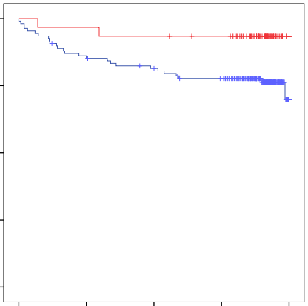
Kaplan-Meier Survival Curve of Clinical Events
Composite of Cardiac Death, MI, TVR, Admission due to Heart Failure, or Stent Thrombosis
%
100
with OAC
90
without OAC
80
70
p = 0.052
60
0
100
200
300
400
Days

Slide 27
Cox Proportional Hazard Analysis for Clinical Events* at 1-year
 | Univariate analysis |  |  | Multivariate analysis
 | HR | 95% CI | p value | HR | 95% CI | p value
OAC | 0.27 | 0.06 - 1.12 | 0.071 | 0.20 | 0.05 - 0.84 | 0.029
CHA₂DS₂-VASc ≥ 2 | 1.37 | 1.12 - 1.67 | 0.002 | 1.39 | 1.00 - 1.94 | 0.052
HAS-BLED ≥ 3 | 2.66 | 1.17 - 6.02 | 0.020 | 1.25 | 0.41 - 3.83 | 0.694
Age ≥ 75 years | 1.75 | 1.07 - 2.86 | 0.025 | 1.01 | 0.50 - 2.02 | 0.981
Sex (male) | 0.45 | 0.17 - 1.15 | 0.194 | 0.90 | 0.37 - 2.17 | 0.814
*Clinical events; cardiac death, myocardial infarction, target vessel revascularization, admission due to heart failure, or stent thrombosis
CI; confidence interval, HR; hazard ratio, OAC; oral anticoagulant

Slide 28
Conclusion
Anticoagulation in selected patients with AMI who were presenting with atrial fibrillation improved 1-year clinical outcomes without increased major bleeding complications.

Slide 29
Thank You for Your Attention!

