Slide 1
Role of Circulating Microparticles in Atherothrombotic Disease
Pil-Ki Min, MD, PhD
Cardiology Division,
Gangnam Severance Hospital,
Yonsei University College of Medicine

Slide 2
Extracellular Vesicles
Santilli F, et al. Thromb Haemost 2016;116:220
Notes:
The extracellular vesicles contain a mixed population of circulating elements characterized by different sizes and including microparticles (or microvesicles), exosomes, and apoptotic bodies.

Slide 3
Release of MVs and Exosomes
Raposo G & Stoorvogel W. J Cell Biol 2013;200:373
Notes:
Microparticles or microvesicles bud directly from the plasma membrane, whereas exosomes are represented by small vesicles of different sizes that are formed as the intraluminal vesicles by budding into early endosomes and multivesicular endosomes and are released by fusion of MVEs with the plasma membrane.
In particular, MPs represent a heterogeneous population of small vesicles deriving from virtually all cell types developing by plasma membrane budding, and released by shedding, during cell growth, proliferation, activation.

Slide 4
Surface Antigens on MV surface
Tomaniak M, et al. IJC 2017;226:93
Notes:
MPs are characterized by an integral plasma membrane, expressing membrane proteins of their parent cells.
MP subsets expose PS, which can be detected by binding of Annexin V.

Slide 5
Potential Use of MPs in Dx of CVD
Tomaniak M, et al. IJC 2017;226:93
Notes:
A key feature of MPs is their procoagulant potential enabling them to play a relevant role both in hemostasis and thrombosis.
Indeed, MPs can be accumulated in complicated atherosclerotic plaques and can also be exposed to circulation by plaque erosion or rupture, thus contributing to the pathogenesis of atherothrombotic diseases
by acting as a messenger linking thrombosis and inflammation.
Until now, numerous preclinical and clinical studies have suggested the potential role of circulating MPs in Dx of CVD and in CV risk stratification.
Recent studies suggested that MV levels not only are indicative of the severity of the disease, but also may contribute to the progression of both chronic and acute cardiovascular conditions.

Slide 6
Circulating MPs in Diagnosis of Atherosclerotic Diseases
Notes:
A correlation between MP levels and the severity of CAD was observed in many studies so far.

Slide 7
MV in Dx of CAD
84 pts with CAD, 42 controls
EMP by flow cytometry (CD31+ or CD51+)
PMP by flow cytometry (CD42+)
Assessing endothelial injury in CAD
Bernal-Mizrachi Let al. AHJ 2003;145:962
Notes:
The relation was first observed more than 10 years ago in a prospective, case-controlled study comparing patients with CAD and healthy volunteers.
EMV expressing CD31 were able to discriminate patients with CAD from control subjects, with 2.5-fold higher levels observed in the course of SCAD than in healthy volunteers and a further 12-fold increase in ACS.
In this subpopulation, EMV positive for CD31 were able to discriminate between MI and UA.
Both EMV enumerating CD51 and PMV positive for CD42 were significantly higher in CAD population than in control subjects, however they failed to differentiate subgroups of CAD
(ACS, MI, UA, SCAD).

Slide 8
MV in Dx of CAD
EMPs by CD31+ and CD51+ represent different species
CD31+ EMP in acute ischemia
CD51+ EMP in all CAD
Bernal-Mizrachi Let al. AHJ 2003;145:962
Notes:
Both EMV enumerating CD51 and PMV positive for CD42 were significantly higher in CAD population than in control subjects, however they failed to differentiate subgroups of CAD
(ACS, MI, UA, SCAD).

Slide 9
Annexin⁺MPs in ACS vs SA
33 patients with SA vs 43 patients with ACS
Biasucci LM, et al. Circ J 2012;76:2174
Notes:
In more recent study performed in CAD patients undergoing PCI with stenting, higher MP levels were observed in MI patients compared with SA patients.
Moreover, MP release time course was different between the two groups.
Figure 2. (A) Comparison of AMP levels in patients with STEMI, NSTEMI, SA + PAD, and SA alone.
AMP, Annexin V positive microparticles; MP, microparticles; NSTEMI, non ST elevation myocardial infarction; PAD, peripheral artery disease; SA, stable angina; STEMI, ST elevation myocardial infarction; *P<0.05.
(B) AMP release time course in ACS and SA patients.

Slide 10
PMP in ACS vs SA
33 patients with SA vs 43 patients with ACS
Biasucci LM, et al. Circ J 2012;76:2174
Notes:
Comparison of PMP levels in patients with STEMI, NSTEMI, SA + PAD, and SA alone.
PMP, platelet derived microparticles; NSTEMI, non ST elevation myocardial infarction; PAD, peripheral artery disease; SA, stable angina; STEMI, ST elevation myocardial infarction; *P<0.05.
(B) PMP release time course in ACS and SA patients.

Slide 11
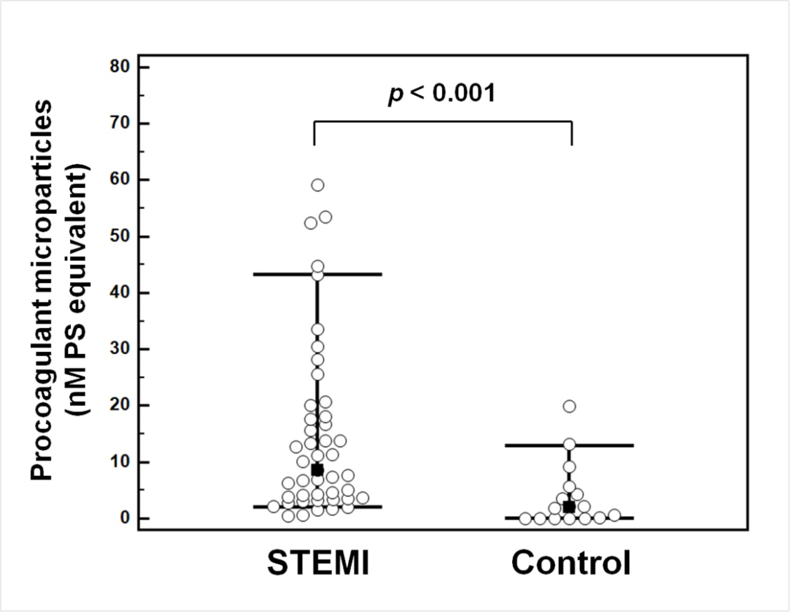
Circulating procoagulant MPs
AMI (n=45) vs Control (n=16)
Baseline individual values of circulating procoagulant MPs captured onto annexin A5
MPs in AMI was higher than control (14.6±15.4 vs. 3.9±5.7 nM PS eq, p<0.001) * Especially in CD42b⁺ MPs or CD146⁺ MPs
Min PK, et al. Atherosclerosis 2013;227:323
Notes:
Methods: The study population consisted of 45 patients with STEMI who underwent primary percutaneous
coronary intervention (PCI), and 16 control patients. Before and after PCI, blood samples were
collected from the femoral artery and from the culprit coronary arteries. In controls, only peripheral
blood was obtained. MPs were measured by a solid-phase capture assay using a commercial kit. The cell
origins of MPs were determined by antigenic capture with specific antibodies.
Results: Baseline levels of MPs in patients with STEMI were higher than in controls. Before PCI, the levels
of MPs were significantly higher in culprit coronary arteries than in peripheral arteries in STEMI patients
(20.7 15.5 vs. 14.6 15.4 nM phosphatidylserine (PS) equivalent, p ¼ 0.027). MPs from the culprit
coronary artery were significantly reduced after PCI (20.7 15.5 vs. 14.3 14.9 nM PS equivalent,
p ¼ 0.010). Similarly, the locally increased levels of endothelial- and platelet-derived MPs within the
culprit coronary arteries were significantly decreased after PCI.
Conclusion: Locally increased levels of MPs in culprit coronary arteries and their significant reduction
after successful PCI suggest a potential role in coronary atherothrombosis in the early period of STEMI.

Slide 12
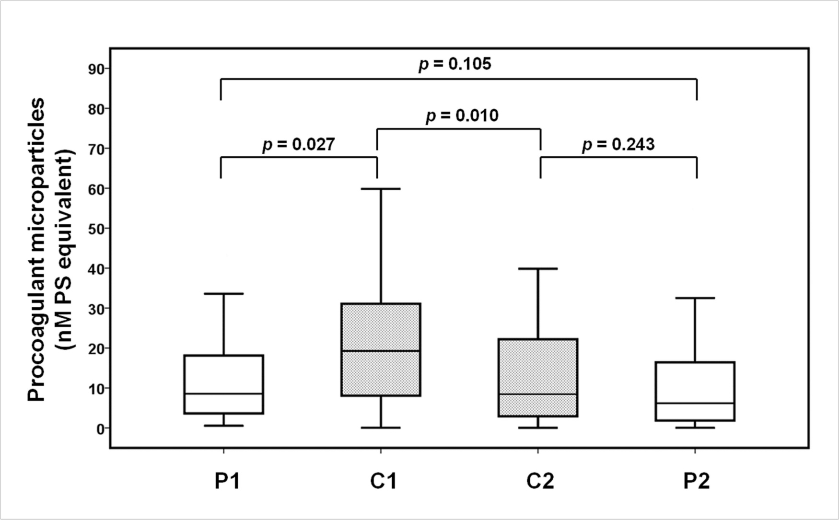
Procoagulant MPs
Pre PCI vs Post PCI, Coronary vs Peripheral
Circulating procoagulant MPs captured onto annexin A5
Min PK, et al. Atherosclerosis 2013;227:323
Notes:
Before PCI, the levels of MPs were significantly higher in culprit coronary arteries than in peripheral arteries in STEMI patients (20.7 15.5 vs. 14.6 15.4 nM phosphatidylserine (PS) equivalent, p ¼ 0.027).
MPs from the culprit coronary artery were significantly reduced after PCI (20.7 15.5 vs. 14.3 14.9 nM PS equivalent, p ¼ 0.010).
Similarly, the locally increased levels of endothelial- and platelet-derived MPs within the culprit coronary arteries were significantly decreased after PCI.
Conclusion: Locally increased levels of MPs in culprit coronary arteries and their significant reduction
after successful PCI suggest a potential role in coronary atherothrombosis in the early period of STEMI.

Slide 13
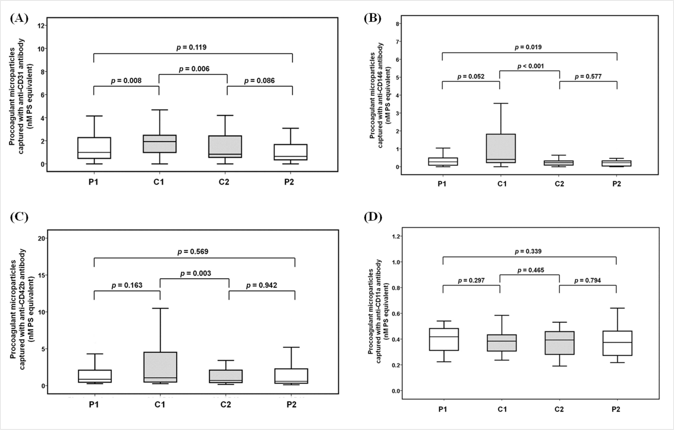
Impact of PCI on MPs according to cellular origin
Min PK, et al. Atherosclerosis 2013;227:323
Notes:
Similarly, the locally increased levels of endothelial- and platelet-derived MPs within the culprit coronary arteries were significantly decreased after PCI.
Conclusion: Locally increased levels of MPs in culprit coronary arteries and their significant reduction
after successful PCI suggest a potential role in coronary atherothrombosis in the early period of STEMI.

Slide 14
MPs in Dx of Atherosclerotic Diseases
Tomaniak M, et al. IJC 2017;226:93
Notes:
This observation suggests potential role of circulating MPs as biomarkers in Dx of atherosclerotic diseases.

Slide 15
Circulating MPs in CV risk Assessment
Notes:
Quantification of MV of different cellular origin was acclaimed as a promising tool to improve risk stratification for future CV events.

Slide 16
MACE vs CD31⁺/Annexin V⁺ MPs
200 patients with stable CAD
MACCE: MI, PCI or CABG, Stroke, CV death
Sinning JM, et al. Eur Heart J 2011;32:2034
Notes:
For example, in a group of 200 subjects with SCAD, an increased concentration of EMV positive for annexin and CD31 was an independent predictor of cardiovascular events, comprising cardiovascular death, the need for revascularization and the occurrence of a first major adverse
cardiovascular or cerebrovascular event (MACCE) during the observational period of 6 years [30].

Slide 17
Coronary Plaque Component by VH-IVUS in target lesion in stable angina (n=35)
Min PK, et al. PLoS ONE 2016;11:e0148128
Notes:
In our study using VH-IVUS to evaluate the association between circulating MV and the composition of coronary plaque in SCAD patients increased levels of circulating PMV positive for CD31, CD42b and CD146 were associated with the amount of necrotic core in the target lesion.
However, it should be noted that in this study the concentrations of MV were measured using a solid phase capture assay combined with the prothrombinase assay to provide a functional assessment of the procoagulant potential of isolated circulating MV [34].
Fig 1. Comparison of the relative plaque composition between the two groups. The site of the minimum
luminal area (A), site of the largest necrotic core area (B), and target lesion volume of a 10-mm segment
centered on the minimal luminal area (C). Plaque compositions assessed by VH-IVUS were classified into 4
major components: FT, FF, NC, and DC. Data are shown as mean ± 95% confidence interval.

Slide 18
Circulating MPs vs Relative Plaque Component
Min PK, et al. PLoS ONE 2016;11:e0148128
Notes:
Circulating MPs were positively correlated with the percentage of the NC area at the minimal luminal site (r = 0.491, p = 0.003) and the percentage of the NC volume (r = 0.496, p =0.002).
Elevated levels of circulating MPs were associated with the amount of NC in the target lesion in those with stable angina, suggesting a potential role of circulating MPs as a biomarker for detecting unstable plaque in patients with stable angina.
Fig 3. Correlation between the levels of circulating MPs and relative plaque components assessed by VH-IVUS analysis. The target lesion volume of a 10-mm segment centered on the following minimal luminal areas is shown: (A) FT, (B) FF, (C) NC, and (D) DC.

Slide 19
MP in CV Risk Stratification
Tomaniak M, et al. IJC 2017;226:93
Notes:
Other studies also suggested the potential role of circulating MPs in CV risk stratification.

Slide 20
Influence of Antiplatelet Tx on MPs formation

Slide 21
Impact of Abciximab on MPs in STEMI
PCI without (n=56) vs. with (n=30) abciximab
Min PK, et al. Korean Circ J 2013;43:600
Notes:
In our study performed in 86 STEMI patients, procoagulant circulating MPs levels were compared before and after PCI according to the use of abciximab during PCI.
In patients who had undergone PCI without abciximab, no significant change in the level of MPs was observed after PCI.
However, in the abciximab group, the level of circulating MPs was significantly decreased after PCI (12.0±10.7 nM vs. 7.8±11.7 nM PS eq, p=0.018).
Fig. 1. Comparison of levels of microparticles captured on immobilized annexin V before and after coronary intervention in patients with ST-segment elevation myocardial infarction who had undergone coronary intervention without abciximab (n=56) or with abciximab (n=30). The line within the box denotes the median. The box spans the Interquartile Range (IQR). The whiskers extend to the minimum or maximum values within 1.5 IQR. PS: phosphatidylserine, PCI: percutaneous coronary intervention.

Slide 22
Impact of Abciximab on MPs in STEMI
PCI without (n=56) vs. with (n=30) abciximab
Min PK, et al. Korean Circ J 2013;43:600
Notes:
Levels of CD31+, CD146+, or CD42b+ MPs also showed a significant reduction after PCI in the abciximab group.
Conclusion: Primary PCI with additional abciximab significantly reduced the level of procoagulant MPs in patients with STEMI.
Fig. 1. Comparison of levels of microparticles captured on immobilized annexin V before and after coronary intervention in patients with ST-segment elevation myocardial infarction who had undergone coronary intervention without abciximab (n=56) or with abciximab (n=30). The line within the box denotes the median. The box spans the Interquartile Range (IQR). The whiskers extend to the minimum or maximum values within 1.5 IQR. PS: phosphatidylserine, PCI: percutaneous coronary intervention.

Slide 23
Effect of Clopidogrel on PMPs in ACS
Kafian S, et al. Platelets 2015;26:467
Notes:
Kafian et al. investigated the association between patients' response to clopidogrel, assessed by whole blood impedance aggregometry, and
circulating PMV in 200 patients with ACS who had undergone PCI and received a loading dose of aspirin and clopidogrel before the procedure. This study revealed for the first time that levels of both CD42a- and CD62P positive PMV were almost two-fold higher in patients with high on
treatment platelet reactivity (HPR) compared with patients without HPR, which might have indicated ongoing platelet activation despite clopidogrel treatment.

Slide 24
Effect of Clopidogrel on PMPs in ACS
Kafian S, et al. Platelets 2015;26:467
Notes:
Interestingly, patients with a documented lower platelet reactivity had significantly fewer PMV exposing CD62P than patients with HPR or those with adequate platelet reactivity to clopidogrel [43].
Taken together, these data suggest that PMVs are potential biomarkers of antiplatelet responses to clopidogrel.

Slide 25
Effect of Antiplatelet Tx on MP formation
Tomaniak M, et al. IJC 2017;226:93
Notes:
Effect of antiplatelet Tx on MP formation was tested in various in vitro and in vivo studies.

Slide 26
Effect of Antiplatelet Agents on PMV
Tomaniak M, et al. IJC 2017;226:93
Notes:
Although the effect of aspirin was controversial, both P2Y12 antagonists and GPIIb-IIIa antagonists were shown to reduce the rate of MV generation.
Assessment of MPs could possibly constitute another modality of assessment of individual response to antiplatelet therapy in the future.

Slide 27
Challenges in Clinical Application
Notes:
The clinical applications of EV have not been realized, because EV detection and isolation are challenging.

Slide 28
EV subtypes
Tomaniak M, et al. IJC 2017;226:93
Notes:
There is currently no consensus on the nomenclature and properties of different EV subtypes, because
The sizes of exosomes, MPs, and apoptotic bodies partially overlap
They are released simultaneously from same cell types
They have similar morphology when assessed with transmittance electron microscope
Fig. 2. A summary of extracellular vesicles' subtypes and the thresholds of currently available diagnostic modalities.
NTA — nanoparticle tracking analysis,
RPS — tunable resistive pulse sensing,
PS — phosphatidylserine;
CD — clusters of differentiation;
TF — tissue factor;
DNA — deoxyribonucleic acid;
mRNA — messenger ribonucleic acid

Slide 29
Concentration vs Diameter of EVs
Van Der Pol E, et al. J Thromb Haemost 2016;14:48
Notes:
Moreover, other plasma particles, such as lipoprotein particles, overlap in size with EVs.
The concentration of EV decreases because of centrifugation losses and aggregation of EV subpopulations.
Because EV may also bind to cells or be phagocytosed, the removal of cells during preparation may also results in the removal of EV subpopulations.
Therefore, perfect separation of EV from cells in body fluids, particularly blood, will never become feasible.

Slide 30
Nomenclature of EVs
Van Der Pol E, et al. J Thromb Haemost 2016;14:48
Notes:
The most well-known types of EV are probably microparticles and exosomes, but many more types of EV have been classified on the basis of various criteria. Figure 1 shows a list of common EV terms.
As this plethora of terms is based on different criteria, in vitro studies, and outdated isolation and detection techniques, the single term ‘EV’ was introduced to avoid confusion and to improve the exchange of information between investigators and societies.

Slide 31
Conclusion

Slide 32
Role of MPs in Atherothrombosis
Rautou PE, et al. Circ Res. 2011;109:593-606
Notes:
A large body of evidence supports the role of MPs at different steps of atherosclerosis
development, progression, and complications.
Figure. Implication of MPs in the development, progression, and complications of atherosclerotic plaques.
A, Lesion initiation. Circulating endothelial and leukocyte microparticles (MPs) are increased in patients with high atherothrombotic risk.
These MPs induce endothelial dysfunction by decreasing nitric oxide (NO) synthesis as the result of an inhibition of the endothelial nitric oxide synthase (eNOS) function and/or an increase in caveolin-1, increasing oxidative stress and production of endothelial superoxide anion (O2 -). The highly unstable O2-anion can uncouple the eNOS, thus decreasing NO production. Some MP subpopulations also can enhance thromboxane A2 (TXA2) production and thus vascular contraction. Opposite effects also have been reported with MPs derived from lymphocytes as they increase the inducible NO synthase (iNOS) and cyclooxygenase-2 (COX-2) enzymes expression in the smooth muscle cells, thus increasing vasodilatory mediators concentration within the media and decreasing contractile force.
B, Lesion progression. Human atherosclerotic plaques contain high levels of MPs. These MPs are in the vicinity of the immature and leaky neovessels contained in plaques. MPs harbor intercellular adhesion molecule (ICAM)-1 and transfer this adhesion molecule to endothelial
cell membrane, thus enhancing the recruitment of monocytes into plaques. Once transmigrated, monocytes differentiate into macrophages
and foam cells, leading to phagocytosis of modified low density lipoprotein (LDL, yellow triangles). MPs could contribute to macrophages and foam cells apoptosis, leading to the release of MPs and creating a vicious circle.

Slide 33
Role of MPs in Atherothrombosis
Rautou PE, et al. Circ Res. 2011;109:593-606
Notes:
A large body of evidence supports the role of MPs at different steps of atherosclerosis
development, progression, and complications.
Figure. Implication of MPs in the development, progression, and complications of atherosclerotic plaques.
C, Advanced lesions. Vulnerable atherosclerotic plaques prone to rupture are characterized by an increased number of vasa vasorum and frequent intraplaque hemorrhage. Plaque MPs express CD40 ligand (CD40L), stimulate endothelial cell proliferation after CD40 ligation, and promote angiogenesis. Therefore, plaque MPs likely contribute to the transition from stable to unstable plaques.
D, Plaque rupture. Plaque MPs expose at their surface phosphatidylserine (PS) and, frequently, tissue factor (TF), conferring MPs a high procoagulant activity. At the time of plaque rupture, locally released plaque MPs stimulate thrombus formation. Platelet MPs are shed from
activated platelets and participate in thrombus. The interactions between P-selectin glycoprotein ligand-1 (PSGL-1) carried by leukocyte
MPs and platelet P-selectin are necessary to concentrate TF activity at the thrombus edge. Endothelial, leukocyte, smooth muscle
cell, erythrocyte, and platelet MPs are represented by pink, green, brown, red, and blue circles, respectively.

Slide 34
Obstacles to overcome before wider clinical application
Consensus in nomenclature
Standardized pre-analytical and analytical protocol
Development of more accurate methods of isolation and purification of different subpopulations of EVs to which an origin and function can be attributed
Notes:
Circulating EVs have become a subject of increasing interest in recent years as useful biomarkers or effectors in CVD

Slide 35

Thank You For Your Attention

Slide 37
MPs assay

Slide 38
Exosome-mediated transfer of mRNAs and miRNAs
Valadi H, et al. Nat Cell Biol 2007;9:654
Notes:
A breakthrough in the field was made in 2007 when it was discovered that exosomes carry nucleic acids, namely mRNA and miRNA.
Valadi H, Ekstrom K, Bossios A, Sjostrand M, Lee JJ and Lotvall JO. Exosome-mediated transfer of mRNAs and microRNAs is a novel mechanism of genetic exchange between cells.
Nat Cell Biol 2007;9:654-9.

Slide 39
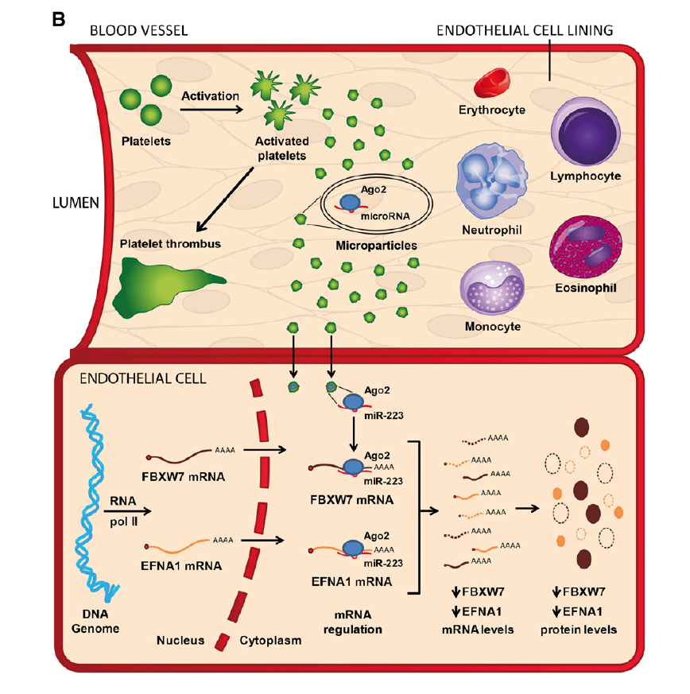
Platelet deliver Ago2/miR to EC via PMP
Laffont B, et al. Blood 2013;122:253
Notes:
Therefore, activated platelets may deliver, through the release of microparticles, mRNA regulatory Ago2-miR complexes to other cells and regulate expression of endogenous genes in recipient cells, such as endothelial cells.
Figure 6. Platelet MP-derived miR-223 can regulate HUVEC gene expression at the protein level.
(B) Proposed model for the intercellular transfer of functional Ago2•microRNA complexes between activated platelets and endothelial cells through the release of MPs. RNA pol II, RNA polymerase II.
Laffont et al. [45] demonstrated that platelet microparticles specifically containing AGO2/miR-223 complexes could regulate reporter gene expression in recipient endothelial cells.
Laffont B, Corduan A, Ple H, Duchez AC, Cloutier N, Boilard E et al. Activated platelets can deliver mRNA regulatory Ago2*microRNA complexes to endothelial cells via microparticles.
Blood 2013;122:253-61.
Jansen et al. [107] revealed that microvesicles from apoptotic endothelial cells promoted endothelial cell migration and proliferation in recipient endothelial cells. These authors found that miR-126 was predominantly expressed in these microvesicles, was transferred to recipient cells, and downregulated expression of direct target genes.
In correlation, administration of miR-126-enriched microvesicles promoted re-endothelialization after electrical denudation of the common carotid artery in wildtype mice, while treatment with miR-126-depleted microparticles abrogated such re-endothelialization.
Jansen F, Yang X, Hoelscher M, Cattelan A, Schmitz T, Proebsting S et al. Endothelial microparticle-mediated transfer of MicroRNA-126 promotes vascular endothelial cell repair
via SPRED1 and is abrogated in glucose-damaged endothelial microparticles. Circulation 2013;128:2026-38.

Slide 40
Protein and RNA transfer by EVs
Raposo G & Stoorvogel W. J Cell Biol 2013;200:373
Notes:
Vesicles are referred to as important mediators of intercellular communication thanks to their capacity to transfer proteins, lipids, and nucleic acids between cells, and thus, to influence various physiological and pathological processes both in parental and in recipient cells
Membrane-associated (triangles) and transmembrane proteins (rectangles) and RNAs (curved symbols) are selectively incorporated into the ILV of MVEs or into MVs budding from the plasma membrane. MVEs fuse with the plasma membrane to release exosomes into the extracellular milieu. MVs and exosomes may dock at the plasma membrane of a target cell (1). Bound vesicles may either fuse directly with the plasma membrane (2) or be endocytosed (3). Endocytosed vesicles may then fuse with the delimiting membrane of an endocytic compartment (4).
Both pathways result in the delivery of proteins and RNA into the membrane or cytosol of the target cell.
Fusion and endocytosis are only represented for exosomal vesicles, but plasma membrane–derived MVs may have similar fates.

