Slide 1
Meta-analysis: Worse outcomes in women compared to men in AMI
Jae-Sik Jang, MD, PhD
Cardiology Division, Inje University Busan Paik Hospital
Notes:
This subject seems very conclusive, but actually I’m not sure this is really true..
So I’d like to talk whether this subject is true or not.

Slide 2
Disclosures
Nothing to disclose
Notes:
I’ll talk in the order of epidemiology, Review of previous Evidences and Updated meta-analysis

Slide 3
Contents
Epidemiology & Overview
Previous Evidences
Updated Meta-Analysis
Notes:
I’ll talk in the order of epidemiology, Review of previous Evidences and Updated meta-analysis

Slide 4
Contents
Epidemiology & Overview
Previous Evidences
Updated Meta-Analysis

Slide 5
Incidence of MI in Men and Women
Framingham Study: 26-year F/U
Lerner DJ, Kannel WB. Am Heart J 1986; 111:383
Notes:
According to the 26 year F/U results of Framingham study, incidence of MI increases dramatically by age and more steeper increase is noted in women

Slide 6
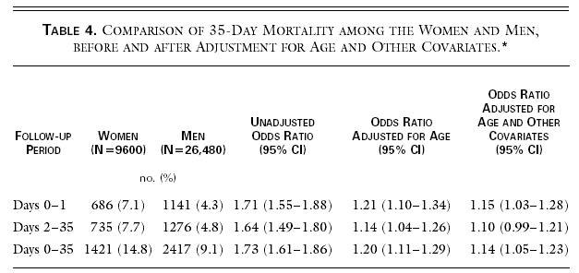
Women fare worse than men after acute MI
Women admitted for acute MI have 40-100% higher mortality at 30 days, as compared with men. This over-mortality is reduced after adjustment for age and co-morbidities.
Malacrida, ISIS-3, N Engl J Med 1998;338:8-14
Notes:
ISIS3 = il y a 20 ans (publié lancet 92)
Women with MI have higher 30 day mortality than men and this over- mortality does not exist after adjustemnt for age and comorbidities

Slide 7
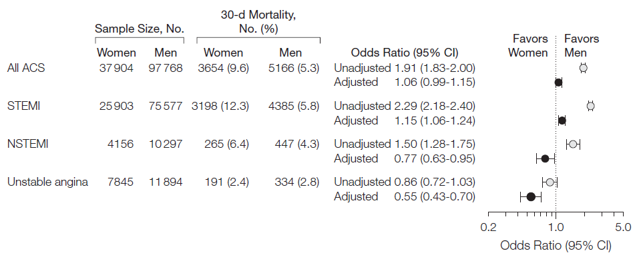
Women fare worse than men after acute MI
Women admitted for acute MI have 40-100% higher mortality at 30 days, as compared with men. This over-mortality is reduced after adjustment for age and co-morbidities.
Sex-age interaction : discrepancy between studies
Sex-type of MI interaction : STEMI ≠ NSTEMI
Berger, JAMA 2009;302:874-82
Notes:
This over mortality in women has sex-age interaction although there is discrepancy between studies
However, A significant sex-type of MI interaction was demonstrated in this study.
In STEMI patients 30 day mortality was higher among women, whereas in NSTEMI and UA, mortality was lower among women.
Results Thirty-daymortalitywas9.6%inwomenand5.3%inmen(oddsratio[OR], 1.91; 95% confidence interval [CI], 1.83-2.00). After multivariable adjustment, mortal- ity was not significantly different between women and men (adjusted OR, 1.06; 95% CI, 0.99-1.15). A significant sex by type of ACS interaction was demonstrated (P .001). In STEMI, 30-day mortality was higher among women (adjusted OR, 1.15; 95% CI, 1.06- 1.24), whereas in NSTEMI (adjusted OR, 0.77; 95% CI, 0.63-0.95) and unstable angina, mortality was lower among women (adjusted OR, 0.55; 95% CI, 0.43-0.70). In a cohort of 35 128 patients with angiographic data, women more often had nonobstructive (15% vs 8%) and less often had 2-vessel (25% vs 28%) and 3-vessel (23% vs 26%) coronary disease, regardless of ACS type. After additional adjustment for angiographic disease se- verity, 30-day mortality among women was not significantly different than men, regard- less of ACS type. The relationship between sex and 30-day mortality was similar across the levels of angiographic disease severity (P for interaction=.70).

Slide 8
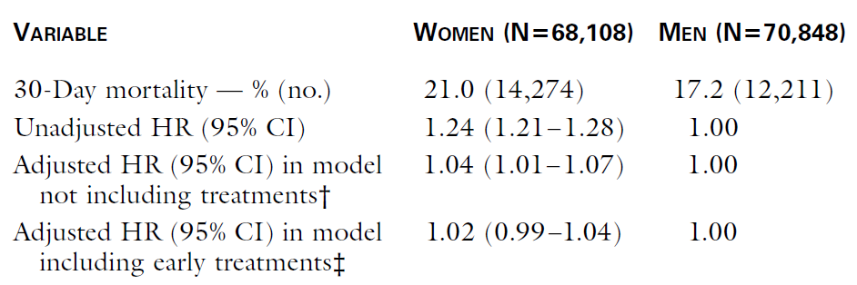
Women fare worse than men after acute MI
Women admitted for acute MI have 40-100% higher mortality at 30 days, as compared with men. This over-mortality is reduced after adjustment for age and co-morbidities.
Sex-age interaction : discrepancy between studies
Sex-Type of MI interaction : STEMI ≠ NSTEMI
Women receive fewer treatments and no difference in mortality is observed after adjustment for co-morbidities and treatments
Gan, N Engl J Med 2000;343:8-15
Notes:
Medicare, 139000 patients, pas de transferts, admis entre 94 et 95

Slide 9
What is Differ in Women with AMI?
Plaque
Risk factors
Symptoms
…….

Slide 10
Plaque of culprit lesions in STEMI
280 Consecutive STEMI / VH-IVUS on culprit before PCI
Ahn SH et al. Heart Vessels. 2016 Nov;31(11):1767-1775.
Notes:
In this study of 280 STEMI patients who underwent VH IVUS on culprit lesion before PCI, there were some differences in plaque
Plaque burden was significantly lwoer in women
The amount of Fibrofatty plaque was smaller and dense calcium was greater in women compared to men.
Abstract There is limited research on plaque charac- teristics of ST elevation myocardial infarction (STEMI) patients according to the gender and age. 280 Consecutive STEMI patients who underwent VH-IVUS imaging on cul- prit before percutaneous coronary intervention (PCI) were enrolled in this study. Women were signi cantly older than men (69.8 ± 10 vs. 55.9 ± 11.3, p < 0.001). After propen- sity matching, men had higher plaque burden (79.7 ± 7.8 vs. 73.7 ± 13.0 %, p = 0.010), more bro-fatty tissue (12.8 ± 9.9 vs. 9.5 ± 6.8 %, p = 0.04) and less dense cal- cium than women (8.4 ± 5.8 vs. 12.3 ± 8.7 %, p = 0.007). Subgroups dividing by 50, 65, 75 years old, plaque burden was higher in elderly men aged 66–75 years compared to the
young men aged less than 50 (75.5 ± 9.2 vs. 68.4 ± 10.1 %, p = 0.012). And middle aged men ranged 51–65 years showed signi cantly more plaque burden at minimal lumen area site than matched aged women (77.5 ± 8.0 vs. 69.0 ± 17.6 %, p = 0.012). Elderly women aged 66–75 years showed signi cantly more necrotic core (28.6 ± 7.3 %) and dense calcium (14.9 ± 7.5 %) compared to all the younger or matched subgroups of men. These differences in plaque composition are blunted in the very elderly of men and women aged over 75 years. The ndings may explain the gender differences in clinical prognosis in STEMI patients.

Slide 11
Plaque of culprit lesions in STEMI
280 Consecutive STEMI / VH-IVUS on culprit before PCI
Elderly women aged 66–75 years showed significantly more necrotic core and dense calcium
These differences in plaque composition are blunted in the very elderly of men and women aged over 75 years
Ahn SH et al. Heart Vessels. 2016 Nov;31(11):1767-1775.
Notes:
There were also changes in plaque composition by age
Elderly women aged 66 to 75 years showed significantly more …..
These differences were blunted after age 75
Abstract There is limited research on plaque charac- teristics of ST elevation myocardial infarction (STEMI) patients according to the gender and age. 280 Consecutive STEMI patients who underwent VH-IVUS imaging on cul- prit before percutaneous coronary intervention (PCI) were enrolled in this study. Women were signi cantly older than men (69.8 ± 10 vs. 55.9 ± 11.3, p < 0.001). After propen- sity matching, men had higher plaque burden (79.7 ± 7.8 vs. 73.7 ± 13.0 %, p = 0.010), more bro-fatty tissue (12.8 ± 9.9 vs. 9.5 ± 6.8 %, p = 0.04) and less dense cal- cium than women (8.4 ± 5.8 vs. 12.3 ± 8.7 %, p = 0.007). Subgroups dividing by 50, 65, 75 years old, plaque burden was higher in elderly men aged 66–75 years compared to the
young men aged less than 50 (75.5 ± 9.2 vs. 68.4 ± 10.1 %, p = 0.012). And middle aged men ranged 51–65 years showed signi cantly more plaque burden at minimal lumen area site than matched aged women (77.5 ± 8.0 vs. 69.0 ± 17.6 %, p = 0.012). Elderly women aged 66–75 years showed signi cantly more necrotic core (28.6 ± 7.3 %) and dense calcium (14.9 ± 7.5 %) compared to all the younger or matched subgroups of men. These differences in plaque composition are blunted in the very elderly of men and women aged over 75 years. The ndings may explain the gender differences in clinical prognosis in STEMI patients.

Slide 12
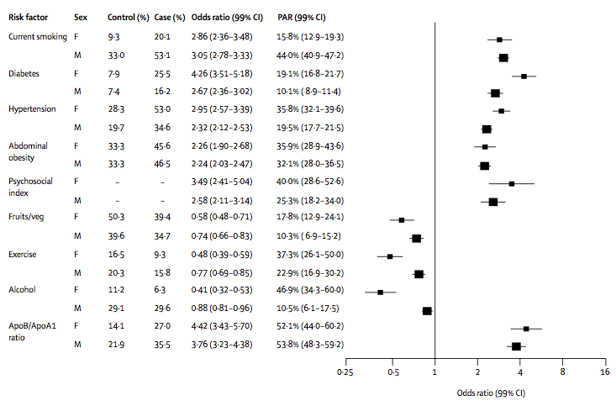
Risk Factors and AMI in Women vs. Men
INTERHEART Study: Case control study in 52 countries
Yusuf S et al. Lancet 2004;364:937-52
* after adjustment for age, sex, and geographic region
Notes:
In the INTERHEART case control study from 52 countries
We can see the similar odd ratios between women and man for the association of AMI with smoking, lipids, abdominal obesity, composite of psychosocial variables and vegetable and fruit consumption.
However, the increased risk associated with HT and DM and protective effect of exercise and alcohol seemed to be greater in women than in men.
Figure 4: Association of risk factors with acute myocardial infarction in men and women after adjustment for age, sex, and geographic region For this and subsequent figures, the odds ratios are plotted on a doubling scale. Prevalence cannot be calculated for psychosocial factors because it is derived from a model.
population attributable risks (PAR)
Figure 4 presents odds ratios and PARs for risk of acute myocardial infarction in men and women. Similar odds ratios were recorded in women and men for the association of acute myocardial infarction with smoking, raised lipids, abdominal obesity, composite of psychosocial variables, and vegetable and fruit consumption. However, the increased risk associated with hypertension and diabetes, and the protective effect of exercise and alcohol, seemed to be greater in women then in men (figure 4).

Slide 13
Typical versus Atypical Symptoms in Women presenting with AMI
Mehta LS et al. Circulation. 2016;133:00-00
Notes:
Women often present with atypical chest pain and angina- equivalent symptoms such as dyspnea, weakness, fatigue, and indigestion

Slide 14
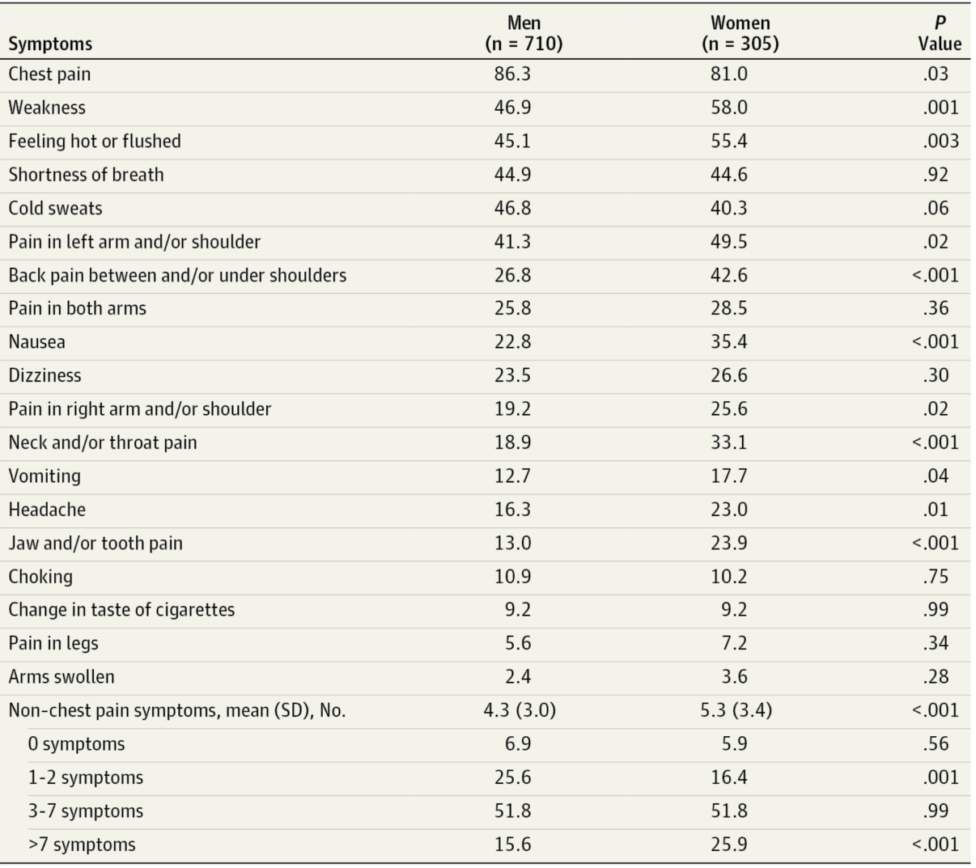
More Symptoms, Less Chest pain in Women
GENESIS PRAXY study
Khan NA et al. JAMA Intern Med 2013;173:1863-71
Notes:
In this GENESIS PRAXY Study, women had more symtoms, such as……
However women complained less chest pain than men..

Slide 15
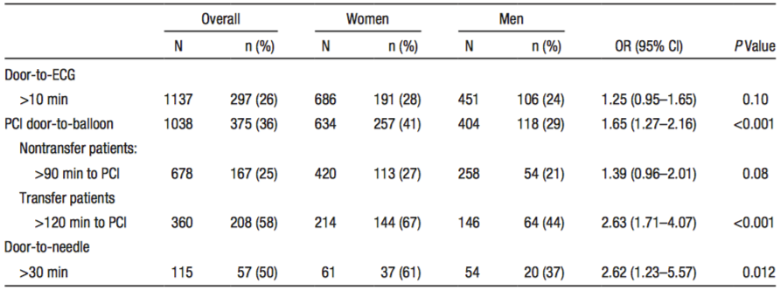
Women Exceed Time Guidelines
VIRGO Study (1465 STEMI pts from 103 US Hospitals)
D’Onofrio G et al. Circulation 2015;131:1324-32
Notes:
Because of predominent atypical symptoms in women patients with MI, they were more likely to exceed in-hospital and transfer time guidelines for PCI than men
More so when transferred from other hospitals
and more likely to exceed door to needle time.
Background—Sex disparities in reperfusion therapy for patients with acute ST-segment–elevation myocardial infarction have been documented. However, little is known about whether these patterns exist in the comparison of young women with men.
Methods and Results—We examined sex differences in rates, types of reperfusion therapy, and proportion of patients exceeding American Heart Association reperfusion time guidelines for ST-segment–elevation myocardial infarction in a prospective observational cohort study (2008–2012) of 1465 patients 18 to 55 years of age, as part of the US Variations in Recovery: Role of Gender on Outcomes of Young AMI Patients (VIRGO) study at 103 hospitals enrolling in a 2:1 ratio of women to men. Of the 1238 patients eligible for reperfusion, women were more likely to be untreated than men (9% versus 4%, P=0.002). There was no difference in reperfusion strategy for the 695 women and 458 men treated. Women were more likely to exceed in-hospital and transfer time guidelines for percutaneous coronary intervention than men (41% versus 29%; odds ratio, 1.65; 95% con dence interval, 1.27–2.16), more so when transferred (67% versus 44%; odds ratio, 2.63; 95% con dence interval, 1.17–4.07); and more likely to exceed door-to-needle times (67% versus 37%; odds ratio, 2.62; 95% con dence interval, 1.23–2.18). After adjustment for sociodemographic, clinical, and organizational factors, sex remained an important factor in exceeding reperfusion guidelines (odds ratio, 1.72; 95% con dence interval, 1.28–2.33).

Slide 16
Contents
Epidemiology & Overview
Previous Evidences
Updated Meta-Analysis

Slide 17
FL vs. PPCI in STEMI: Meta-Analysis of 22 Trials
PCAT-2 Trialists’ Collaborative Group
Boersma E et al. Eur Heart J 2006;27:779-88
Notes:
A meta-analysis of 22 trials found found that women had lower 30 day mortality with primary PCI whether they presented within first 2 hours of symptom onset or after 2 hour.
A pooled analysis of 22 trials that randomized 6763 STEMI patients to primary PCI versus thrombolytics found that women had lower 30-day mortality with primary PCI, regardless of whether they presented within the first 2 hours of symptom onset (7.7% versus 9.6%) or after >2-hour delay (8.5% versus 14.4%). Of note was the extremely high mortality in women with delay in presentation treated with thrombolytic therapy.

Slide 18
GUSTO II-B PTCA Substudy
30-day Clinical Outcomes by Sex
 | Women (n=260) | Men (n=877) | P value
ICH (%) | 1.9 | 0.3 | 0/007
Nonfatal disabling stroke (%) | 1.2 | 0.3 | 0.111
Nonfatal recurrent MI (%) | 6.6 | 5.2 | 0.379
30-Day mortality (%) | 11.2 | 4.9 | 0.001
Death, nonfatal recurrent MI, nonfatal disabling stroke (%) | 17.8 | 9.8 | 0.001
Am Heart J 2004;147:133–9
Notes:
The 30-day clinical end point of death, nonfatal MI, and nonfatal disabling stroke was higher for women than men (17.8% vs 9.8%, P .001) and appeared to be present irrespective of treatment arm (19.8% vs 12.0% for t-PA and 15.9% vs 7.5% for PTCA).

Slide 19
GUSTO II-B PTCA Substudy
30-day Clinical Outcomes by Sex and Tx. Strata
 | Women-PTCA (n=139) | Women-t-PA (n=121) | Men-PTCA (n=426) | Men-t-PA (n=451)
ICU (%) | 0 | 4.1 | 0 | 0.7
Nonfatal disabling stroke (%) | 0 | 2.5 | 0.2 | 0.4
Nonfatal recurrent MI (%) | 6.5 | 6.6 | 3.8 | 6.4
30-Day mortality (%) | 10.9 | 11.6 | 4.0 | 5.8
Death, nonfatal recurrent MI, nonfatalb disabling stroke (%) | 15.9 | 19.8 | 7.5 | 12.0
Primary PCI prevented 56 deaths in women compared with 42 deaths in men per 1000 treated
Am Heart J 2004;147:133–9
Notes:
PTCA-treated women had lower rates of the combined 30-day end point compared with t-PA–treated women (15.9% vs 19.8%). Men assigned to PTCA were less likely to reach a 30-day clinical end point when compared with men treated with t-PA (7.5% vs 12.0%).

Slide 20
GUSTO II-B PTCA Substudy
Adjusting for baseline characteristics
(age, Killip class, pulse, SBP)
Am Heart J 2004;147:133–9
Notes:
After adjusting for basline characteristics, female gender did not predict clinical outcomes compared to men.
After ad-justing for differences in baseline variables shown to predict clinical outcome (age, Killip class, pulse, and systolic blood pressure), the likelihood of reaching a clinical end point was no longer significantly different for women compared with men (adjusted OR for women compared with men, 1.35; 95% CI 0.88–2.08)
The greater mortality benefit of primary PCI compared with thrombolytic therapy was confirmed in the GUSTO II-B angioplasty substudy, with primary PCI pre- venting 56 deaths in women compared with 42 deaths in men per 1000 treated.

Slide 21
Previous Evidence: Meta-Anaysis of 35 studies 68,536 pts s/p primary PCI
Unadjusted and Adjusted In-hospital Mortality
Pancholy et al. JAMA Intern Med. 2014;174(11):1822-1830
Notes:
In ths recent meta-analysis of 35 clnical sutids reported that women have a higher risk of in-hospital mortality (relative risk, 1.48; 95% confidence interval, 1.07–2.05) even after adjustment for baseline differences

Slide 22
Previous Evidence: Meta-Anaysis of 35 studies 68,536 pts s/p primary PCI
Unadjusted and Adjusted 1-Year Mortality
Pancholy et al. JAMA Intern Med. 2014;174(11):1822-1830
Notes:
However there were no significant difference in 1 year adjusted mortality between women and men.

Slide 23
Previous Evidence: Meta-Anaysis of 39 studies
Unadjusted RR
5-10 yr mortality
Unadjusted RR
≥ 10 yr mortality
Bucholz EM et al. Circulation. 2014;130:757-767
Notes:
What about long-term mortality among women and men?
In this meta-analysis of 39 studies examining 5-10 year or above 10 year mortality, most studies reported significantly higher unadjusted mortality for women
Similar results were observed for studies examining survival beyond 10 years. Eleven studies (73%) reported significantly higher mortality for women, and 4 studies (27%) found no difference. No studies reported higher mortality for men in unadjusted analyses.
To determine whether study results varied by start point of follow-up, we constructed forest plots of the unadjusted risk ratios stratified by these variables (Figures 2 and 3). No consistent patterns were observed by start point of follow-up.
Figure 2. Unadjusted risk ratios (RRs) for studies examining 5- to 10-year mortality stratified by start point of follow-up.
Figure 3. Unadjusted risk ratios (RRs) for studies examining mortality at ≥10 years stratified by start point of follow-up.

Slide 24
Previous Evidence: Meta-Anaysis of 39 studies
Age-Adjusted RR
Multivariate Adjusted RR
Bucholz EM et al. Circulation. 2014;130:757-767
Notes:
Age adjustment attenuated the association between female sex and increased long-term mortality
However, after multivariate adjustment, only 2 studies reported higher risk for women, and 9 studies reported lower risk for women.
Figure 4. Age-adjusted risk ratios (RRs) for studies stratified by length of follow-up.
Figure 5. Multivariate-adjusted risk ratios (RRs) for studies stratified by length of follow-up.
Age-Adjusted Mortality
Thirteen of the 39 studies reported analyses adjusted for age only, and age-adjusted Mantel-Haenszel odds ratios could be calculated for an additional 6 studies. Age adjustment was performed in a variety of ways, including logistic or proportional hazards regression, Mantel-Haenszel statistics, and direct standardization.
Age adjustment attenuated the association between female sex and increased long-term mortality (Figure 4). Most studies found nonsignificant differences in age-adjusted mortality between men and women, and 1 study even found a reversal in risk after adjustment for age.36 Only 2 studies continued to report a significantly higher age-adjusted risk of mortality for women, which may be due to inadequate adjustment for the effect of age.6,18 Benderly et al6 categorized age into 5-year increments, and Langørgen et al18 adjusted for age using only 2 age strata (<60 and ≥60 years).
Multivariate-Adjusted Mortality
Twenty-two studies reported multivariate risk estimates (Figure 5), nearly all of which found a reduction in the sex differences after adjustment. Eleven studies reported nonsignificant female-to-male relative risks after adjustment; 2 reported significantly higher risk for women; and the remaining 9 reported lower risk for women. Interestingly, risk ratios for female sex actually switched directions after adjustment in 5 of these studies.31,32,36,37,40 In all 5 studies, female sex was sig- nificantly associated with increased mortality in unadjusted analyses but became protective after multivariate adjustment.

Slide 25
Previous Evidence: Meta-Anaysis of 26 studies 98,778 pts s/p primary PCI
Adjusted Short-Term Mortality
Conrotto et al. J Interven Cardiol 2015;28:132–140
Notes:
In this relatively recent meta-analysis of 26 studies, female sex emerged as independently associated to early mortality (OR 1.1; 95%CI, 1.02–1.18) but not to mid-term mortality (OR, 1.01; 95%CI, 0.99–1.03).
Introduction: The increasing use of primary percutaneous coronary intervention (pPCI) has improved clinical outcome in ST-segment elevation myocardial infarction (STEMI) patients, but the impact of sex on early and mid- term outcomes remains to be defined. Methods: Medline, Cochrane Library, Biomed Central, and Google Scholar were searched for articles describing differences in baseline, periprocedural, and midterm outcomes after pPCI, by sex. The primary end point was all- cause mortality at early and mid-term follow-up. Secondary endpoints included in-hospital bleeding and stroke. Results: Sixteen studies were included. Women were older, had more frequent hypertension, diabetes mellitus, and hypercholesterolemia, as well as longer ischemia time and more shock at presentation. Men were more likely to have had a previous myocardial infarction. Female sex emerged as independently associated to early mortality (OR 1.1; 95%CI, 1.02–1.18) but not to mid-term mortality (OR, 1.01; 95%CI, 0.99–1.03). The pooled analysis showed a significantly higher risk of in hospital stroke (OR, 1.69; 95%CI, 1.11–2.56) and major bleeding (OR, 2.04; 95%CI, 1.51–2.77) in women.
Conclusions: As compared to men, women undergoing pPCI have more bleedings and strokes, and a worse early, but not mid-term mortality. These findings may allow a better risk stratification of pPCI patients. (J Interven Cardiol 2015;28:132–140)

Slide 26
Previous Evidence: Meta-Anaysis of 26 studies 98,778 pts s/p primary PCI
Adjusted Mid-Term Mortality
Conrotto et al. J Interven Cardiol 2015;28:132–140

Slide 27
Contents
Epidemiology & Overview
Previous Evidences
Updated Meta-Analysis
Notes:
So I want to introduce you an undated meta-analysis including recent studies.

Slide 28
Background
Whereas some studies examining gender differences in the outcomes of patients with AMI show higher mortality for women after AMI, others have reported no difference or even a survival advantage for women.
It remains unclear if a gender difference in outcomes exists and if this difference in clinical outcomes between genders is a confounded observation due to baseline differences in comorbidities and procedural characteristics
There is limited available evidence in this topic that pooled analyses combining all existing literature.

Slide 29
Objective
We therefore reviewed the literature and pooled all available reports examining gender specific in-hospital and up to 1-year mortality among patients presenting with ST-Elevation Myocardial Infarction (STEMI) and received primary percutaneous coronary intervention.

Slide 30
Data Sources and Searches
We identified relevant studies through electronic searches of MEDLINE and the Cochrane Central Register of Controlled Trials for studies assessing the impact of genders on mortality among patients who underwent primary PCI for STEMI published up to October 2016.
Possible articles for inclusion were found the terms (“sex” or “gender”) and (“primary PCI” or “primary percutaneous coronary intervention” or “STEMI”).
Reference lists of selected articles were reviewed for other potentially relevant citations.

Slide 31
Study Selection
Inclusion criteria were:
- Observational studies or randomized clinical trials involving patients who presented with STEMI.
- Studies reporting in-hospital and/or 6-month to 1-year mortality as one of their outcomes.
Exclusion criteria were:
- Duplicate publication
- Abstracts, Ongoing/unpublished study
- Non-english language article

Slide 32
End points
Primary end point
- In-hospital all-cause mortality
Secondary end points
- 6-month and 1-year all cause mortality

Slide 33
Data Synthesis and Analysis
Risk ratio (RR) with 95% CI for dichotomous data.
For comparison of registry studies with multivariate adjusted analysis, adjusted risk estimates were pooled after logarithmic transformation according to random-effects models with generic inverse variance method.
Heterogeneity by χ² (Cochrane Q) statistic and I² test.
Publication bias by “funnel plot”.
Trim and fill methods to correct the publication bias.
Sensitivity analysis on the basis of the study design (RCTs vs. observational cohort studies).
RevMan (Version 5.1.2) and MIX 2.0 professional version
Notes:
Adjusted odds ratios were pooled after logarithmic transformation according to fixed-effects or random-effects models with generic inverse variance weighting.
Continuous data were expressed as mean (SD) and weighted mean difference (WMD).
We used odds ratio (OR) with 95% CI to express dichotomous data.
Heterogeneity across the included studies analyzed using heterogeneity χ² (Cochrane Q) statistic and I² test.
Publication bias examined by visual inspection of constructed “funnel plot”. Trim and fill methods were used to correct the publication bias.
Sensitivity analyses to examine the heterogeneity on the basis of coronary anatomy among study populations (bifurcation vs. nonbifurcation and left main vs. non-left main) and the study design (RCTs vs. observational cohort studies).
Review Manager (Version 5.1.2) and MIX program were used for all the analyses.

Slide 34
Results
A total of 2,565 publications were reviewed and 64 studies were selected for inclusion and further evaluated. Subsequently, 43 papers were included into the final analysis.
The 43 included studies involved 814,072 patients with STEMI who underwent primary PCI (191,559 women and 622,513 men).
Notes:
Of the 15,230 patients, 6,206 patients underwent IVUS-guided PCI and 9,024 underwent angiography-guided PCI..

Slide 35
Characteristics of Included Studies
Study | Year | Country | Study design | Total | Women | Men
Vacek et al, | 1993 | United States | Observational | 670 | 206 | 464
Hannan et al, | 2000 | United States | Observational | 2291 | 686 | 1605
Vakili et al, | 2001 | United States | Observational | 1044 | 317 | 727
Mehilli et al, | 2002 | Germany | Observational | 1663 | 426 | 1237
De Luca et al, | 2004 | Italy | Observational | 1548 | 353 | 1195
Srimahachota et al, | 2004 | Thailand | Observational | 184 | 53 | 131
Feliciano et al. | 2005 | Portugal | Observational | 245 | 72 | 173
Hurtado-Martinez et al, | 2006 | Spain | Observational | 838 | 183 | 655
Berger and Brown, | 2006 | United States | Observational | 9015 | 2619 | 6396
Kosuge et al, | 2006 | Japan | Observational | 2981 | 790 | 2191
Suessenbacher | 2008 | Austria | Observational | 1087 | 299 | 788
Zanchi et al, | 2009 | Croatia | Observational | 488 | 124 | 364
Rasoul et al, | 2009 | Netherlands | Observational | 4513 | 1048 | 3465
De Luca et al, | 2010 | Italy | RCT | 1662 | 379 | 1283
Zhang et al, | 2010 | China | Observational | 2042 | 468 | 1574
Sjauw et al. | 2010 | Netherlands | Observational | 3277 | 910 | 2367
Jackson et al, | 2011 | United States | Observational | 8771 | 2542 | 6229
Benamer et al. | 2011 | France | Observational | 16740 | 3664 | 13096
Ferrante et al, | 2011 | Italy | Observational | 481 | 138 | 343
Eitel et al, | 2012 | Germany | Observational | 335 | 96 | 239
Ferrante et al, | 2012 | Italy | RCT | 744 | 179 | 565
Jakobsen et al. | 2012 | Denmark | Observational | 7385 | 1980 | 5405
Kang et al. | 2012 | Korea | Observational | 14123 | 3725 | 10398
Dreyer et al, | 2013 | Australia | Observational | 735 | 173 | 562
Mrdovic et al, | 2013 | Serbia | RCT | 2096 | 563 | 1533
Pain et al, | 2013 | United Kingdom | Observational | 1853 | 391 | 1462
Wijnbergen et al, | 2013 | Netherlands | RCT | 870 | 202 | 668
Meller et al, | 2013 | United States | Observational | 1301 | 366 | 935
Otten et al, | 2013 | Netherlands | Observational | 6746 | 1745 | 4991
Toyota et al, | 2013 | Japan | Observational | 4379 | 1197 | 3182
Kunadian et al, | 2013 | United Kingdom | Observational | 2864 | 844 | 2020
Velders et al, | 2013 | Netherlands | Observational | 3483 | 868 | 2615
Birkemeyer et al, | 2014 | Germany | Observational | 1104 | 281 | 828
Gevaert et al. | 2014 | Belgium | Observational | 8073 | 1920 | 6153
Yu et al. | 2015 | United States | RCT | 3602 | 842 | 2760
Biava et al. | 2015 | Italy | Observational | 325 | 75 | 250
Kyto et al. | 2015 | Finland | Observational | 31689 | 10668 | 21021
Laufer-Peri et al. | 2015 | Israel | Observational | 1346 | 271 | 1075
Kuhn et al. | 2015 | Australia | Observational | 13744 | 3501 | 10243
Zheng et al. | 2015 | China | Observational | 11986 | 3574 | 8412
Khera et al. | 2015 | United States | Observational | 632930 | 142075 | 490855
Kanic et al. | 2016 | Slovenia | Observational | 2069 | 597 | 1472
Ng et al. | 2016 | North America, Europe, Japan | Substudy of RCT | 501 | 108 | 393

Slide 36
Gender and Outcomes in STEMI after primary PCI Unadjusted In-Hospital Mortality
Unpublished Data
Notes:
Let me show you the results.
Unadjusted in-hospital mortality was significantly higher in women with AMI compared to men.

Slide 37
Gender and Outcomes in STEMI after primary PCI Unadjusted In-Hospital Mortality according to Study design
Unpublished Data
Notes:
Stratified analysis according to study design show significantly greater mortality in RCTS as well as observational studies.

Slide 38
Gender and Outcomes in STEMI after primary PCI Adjusted In-Hospital Mortality
Unpublished Data
Notes:
However when we abstracted only multivariate adjusted in hospital mortality,
The significant association between higher mortality and women became attenuated with RR of 1.21

Slide 39
Gender and Outcomes in STEMI after primary PCI Unadjusted 30-Day Mortality
Unpublished Data
Notes:
Unadjusted 30 day mortality seemed still greater for women compared to men.
With RR of 1.30

Slide 40
Gender and Outcomes in STEMI after primary PCI Unadjusted 30-Day Mortality according Study Design
Unpublished Data
Notes:
Only 2 RCTs are reporting 30 mortality outcomes with no difference in mortality between women and men.

Slide 41
Gender and Outcomes in STEMI after primary PCI Adjusted 30-Day Mortality
Unpublished Data
Notes:
In the adjusted 30 day mortality analysis , there was no significant difference in mortality between women and men.

Slide 42
Gender and Outcomes in STEMI after primary PCI Unadjusted 1-Year Mortality
Unpublished Data
Notes:
What about 1 year mortality?
The unadjusted one year mortality was still significantly higher for women than men.

Slide 43
Gender and Outcomes in STEMI after primary PCI Unadjusted 1-Year Mortality according to Study Design
Unpublished Data
Notes:
With no interaction between men and women

Slide 44
Gender and Outcomes in STEMI after primary PCI Adjusted 1-Year Mortality
Unpublished Data
Notes:
However, in the analysis of adjusted 1 year mortality, there was no difference between women and men.

Slide 45
Publication Bias by Funnel Plot
Unadjusted In-Hospital Mortality according to Study design
Unpublished Data
Notes:
This funnel plot of unadjusted in hospital mortality seems symmetric with no publication bias

Slide 46
Publication Bias; Trim and Fill Method
Unadjusted In-Hospital Mortality
Egger’s regression test P<0.10
Unpublished Data
Notes:
8 more studies were needed to achieve a symmetrical plot on trim and fill method.
With Egger’s regression based p value less than 0.10 (positive)

Slide 47
Study Limitations
Most studies were observational studies from different cohorts or consecutive patients
Wide variability in risk profile of patients
Different definition of end points across studies.
Could not have access to patient-level data
Some results have significant heterogeneity

Slide 48
Conclusions
This systematic review and meta-analysis of contemporary literature regarding the impact of gender on in-hospital and up to 1-year mortality in patients undergoing primary PCI for STEMI represents the largest data of adjusted outcomes.
We found that women have significantly greater risk for in-hospital mortality than men in both unadjusted and adjusted analysis.
However, this association was no longer present at 1 year after the index procedure when the analysis was adjusted for patients’ risk factors and baseline characteristics.
Notes:
Our meta-analysis demonstrates that IVUS-guided DES implantation significantly reduces death, MI, and MACE compared to angiography-guided PCI,
However, IVUS-guided DES implantation did not reduce TVR in spite of achievement of greater postprocedure MLD.
This data should provide further support for IVUS use in modern DES era, but adequately powered trials that measure patient-oriented outcomes in participants with different risk profiles and lesion subsets are needed.

Slide 49
Thank you for your attention!

